Slide 1
Optimization Tutorials

Slide 2
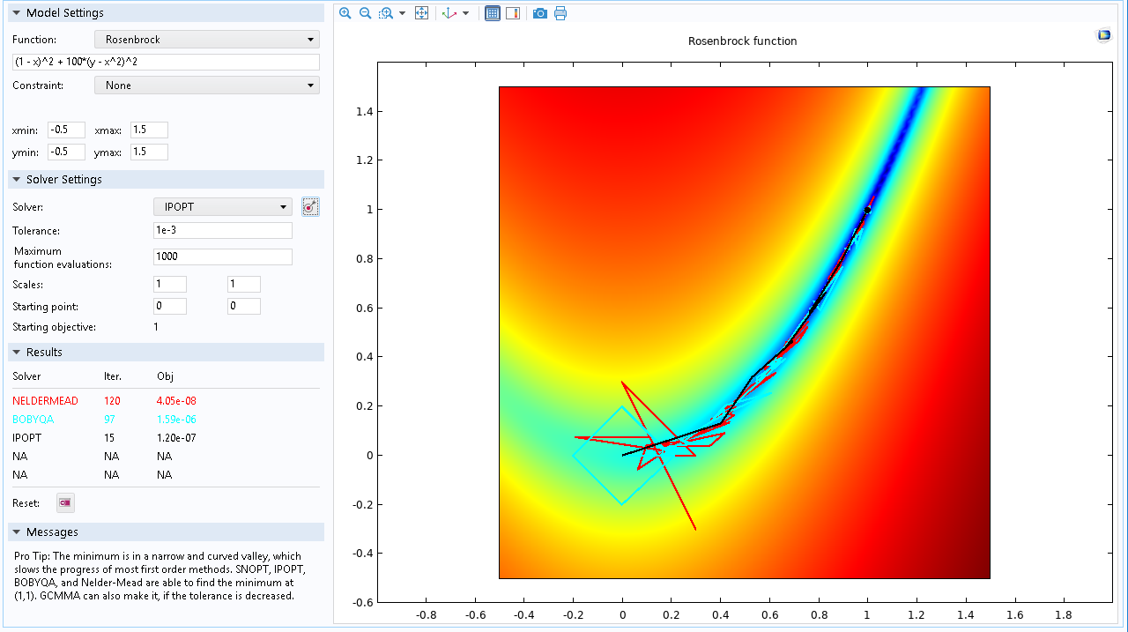
Rosenbrock function
Pro Tip: The minimum is in a narrow and curved valley, which slows the progress of most first order methods. IPOPT, SNOPT, BOBYQA and Nelder-Mead are able to find the minimum at (1,1). GCMMA can also make it, if the tolerance is decreased.
Optimization Tutorials

Slide 3
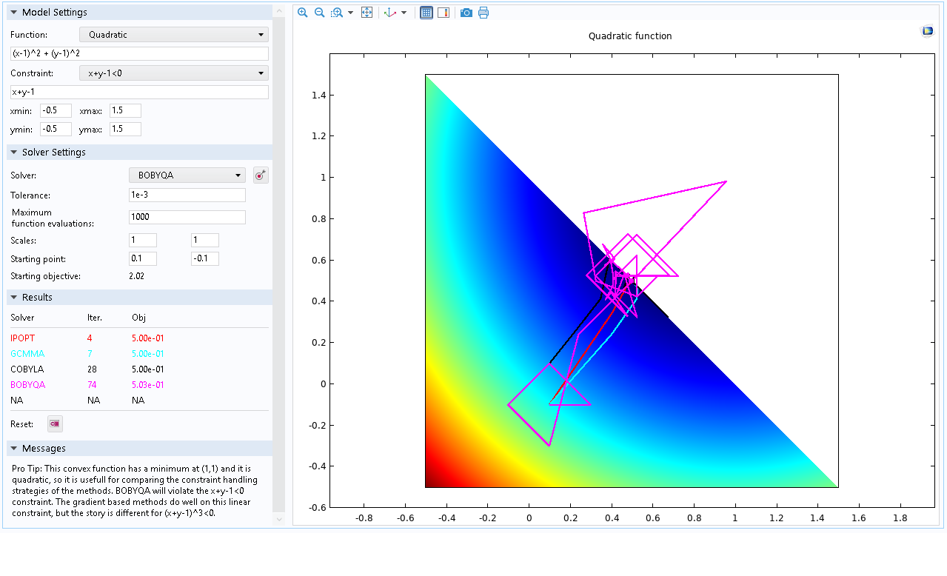
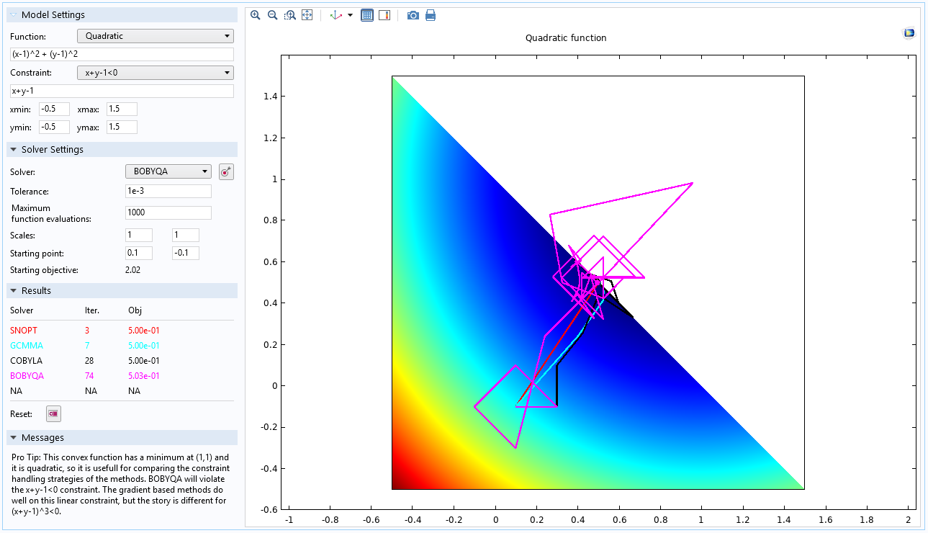
Quadratic
Pro Tip: This convex function has a minimum at (1,1) and it is quadratic, so it is usefull for comparing the constraint handling strategies of the methods. BOBYQA will violate the x+y-1<0 constraint. The gradient based methods do well on this linear constraint, but the story is different for (x+y-1)^3<0.
Optimization Tutorials

Slide 4
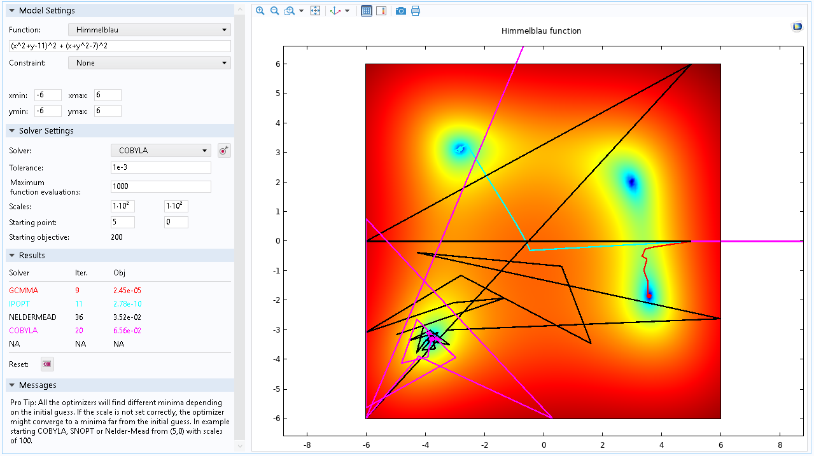
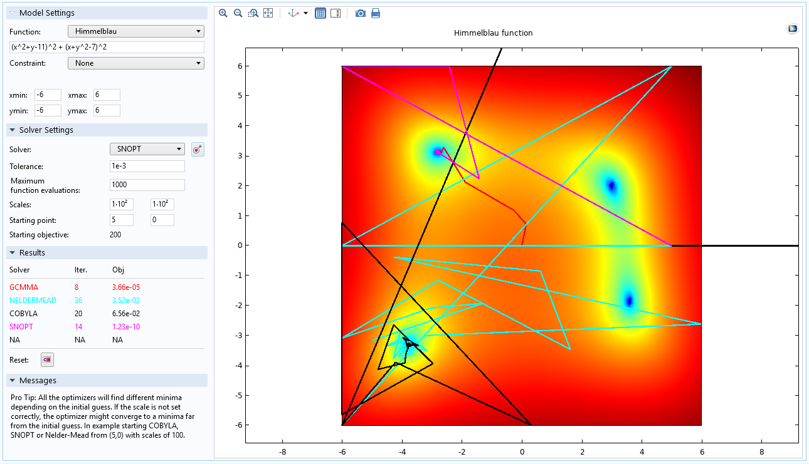
Himmelblau
Pro Tip: All the optimizers will find different minima depending on the initial guess. If the scale is not set correctly, the optimizer might converge to a minima far from the initial guess. In example starting IPOPT, MMA , COBYLA, or Nelder-Mead from (5,0) with scales of 100.
Optimization Tutorials

Slide 5
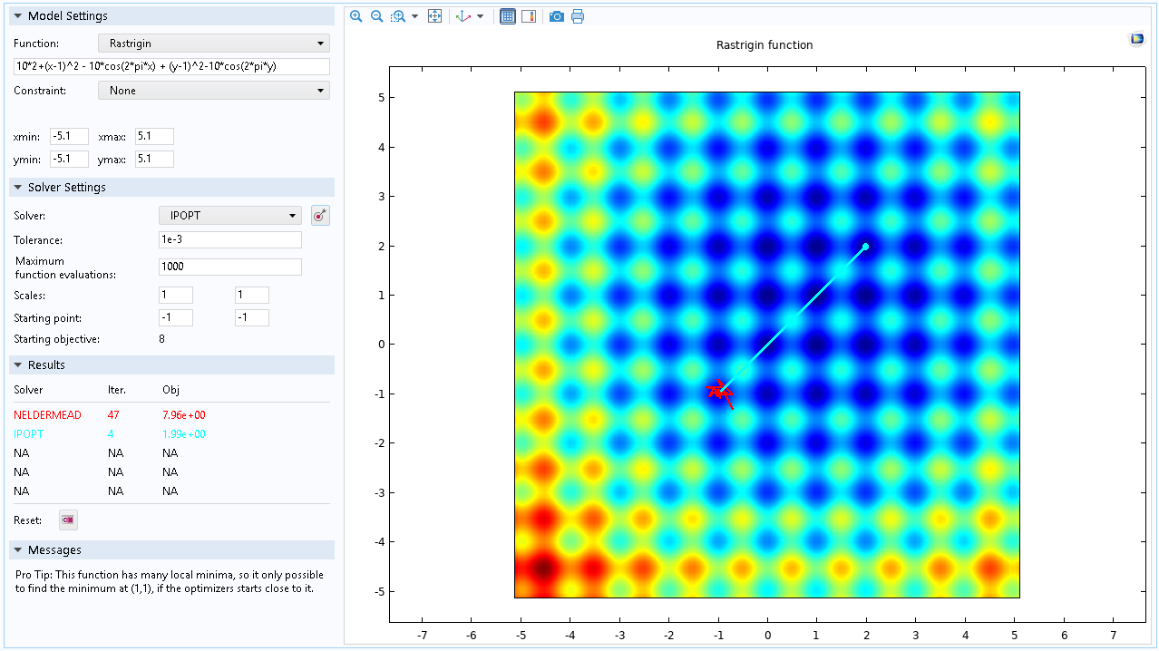
Rastrigin
Pro Tip: This function has many local minima, so it only possible to find the minimum at (1,1), if the optimizers starts close to it.
Optimization Tutorials

Slide 6
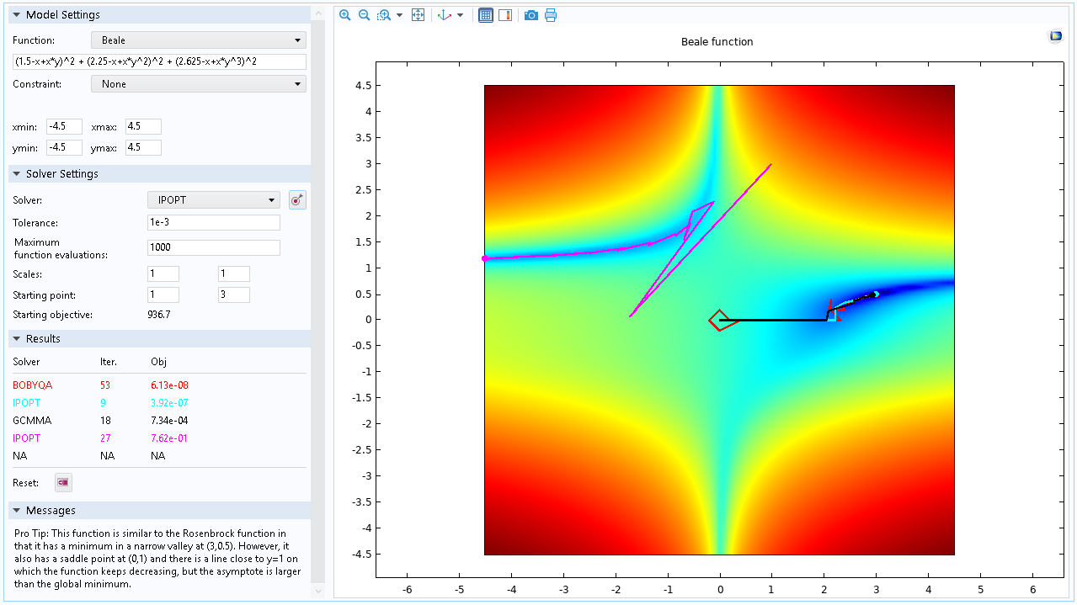
Beale
Pro Tip: This function is similar to the Rosenbrock function in that it has a minimum in a narrow valley at (3,0.5). However, it also has a saddle point at (0,1) and there is a line close to y=1 on which the function keeps decreasing, but the asymptote is larger than the
global minimum.
Optimization Tutorials

Slide 7
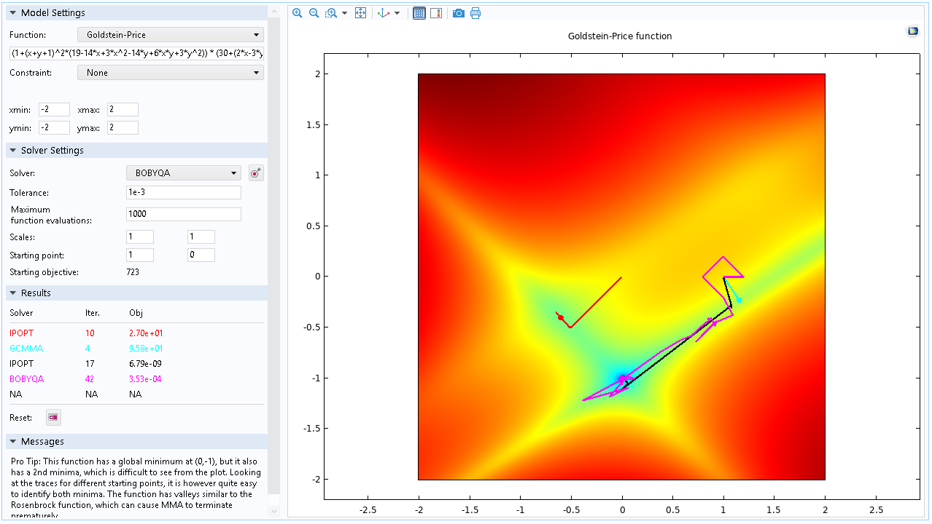
Goldstein-
Price
Pro Tip: This function has a global minimum at (0,-1), but it also has a 2nd minima, which is difficult to see from the plot. Looking at the traces for different starting points, it is however quite easy to identify both minima. The function has valleys similar to the Rosenbrock function, which can cause GCMMA to terminate
prematurely.
Optimization Tutorials

Slide 8
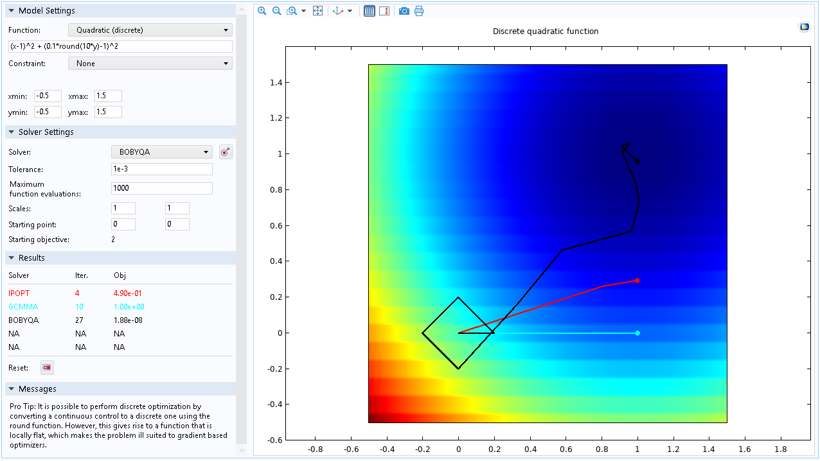
Quadratic
(discrete)
Pro Tip: It is possible to perform discrete optimization by converting a continuous control to a discrete one using the round function. However, this gives rise to a function that is locally flat, which makes the problem ill suited to gradient based optimizers.
Optimization Tutorials

Slide 9
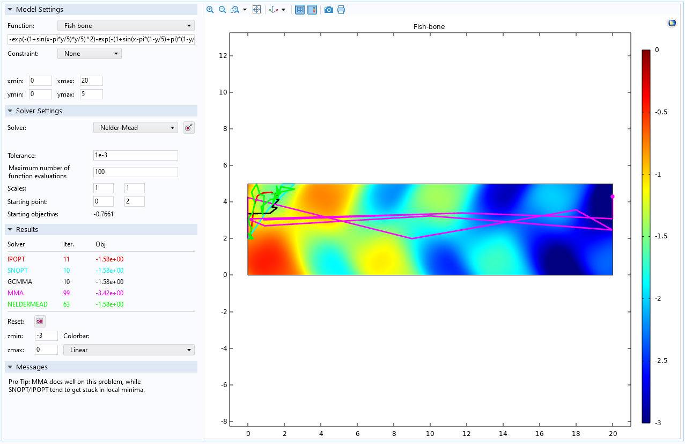
Fish bone
Pro Tip: On this problem MMA tends to be less prone to getting stuck in local minima than SNOPT/IPOPT.
Optimization Tutorials

Slide 10
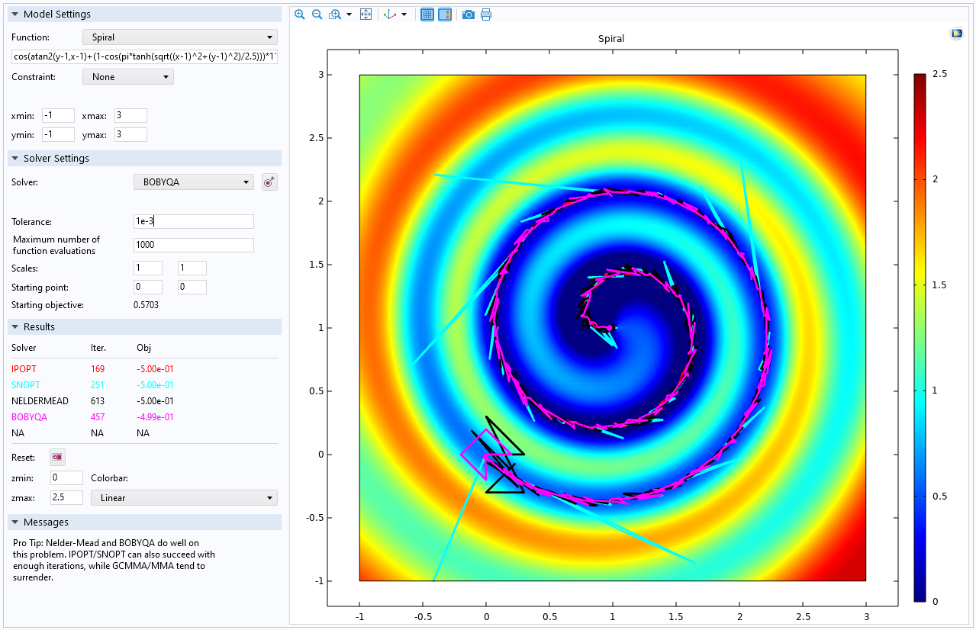
Spiral
Pro Tip: Nelder-Mead/BOBYQA do well on this problem. SNOPT/IPOPT can also succeed given enough iterations, but GCMMA/MMA tend to surrender.
Optimization Tutorials

Slide 11
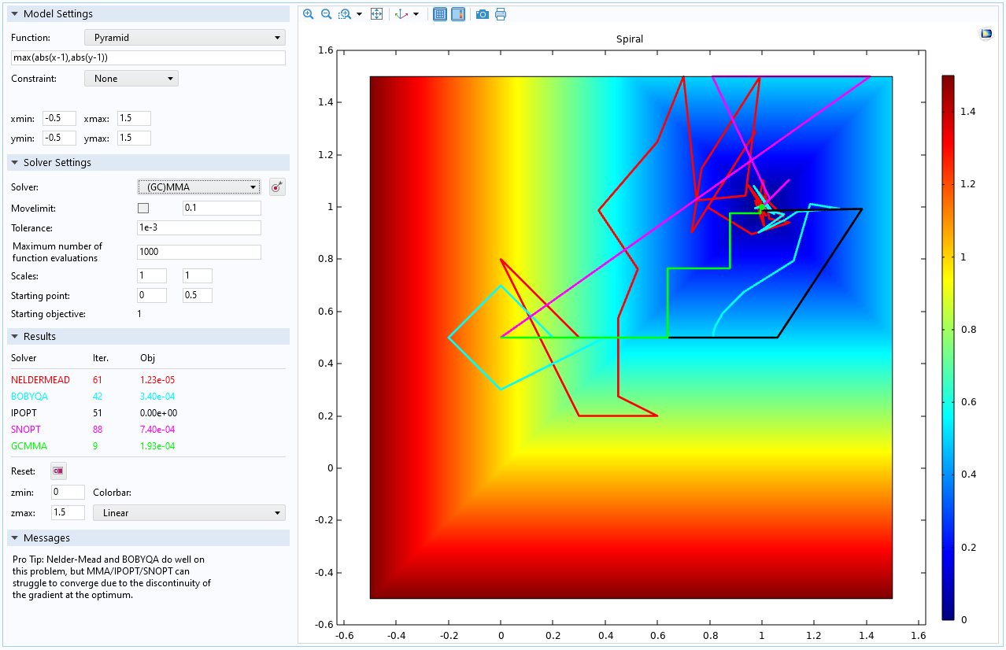
Pyramid
Pro Tip: Nelder-Mead/BOBYQA do well on this problem, but IPOPT/SNOPT/MMA can have difficulties converging due to the discontinuity of the slope at the optimum.
Optimization Tutorials

