Slide 1
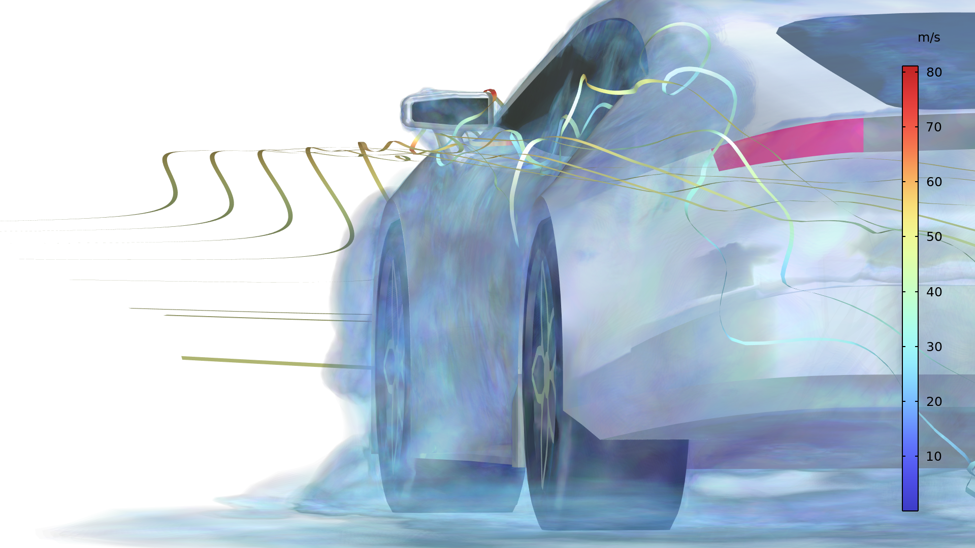
Wind Load on a Sports Car Side Door and Mirror

Slide 2
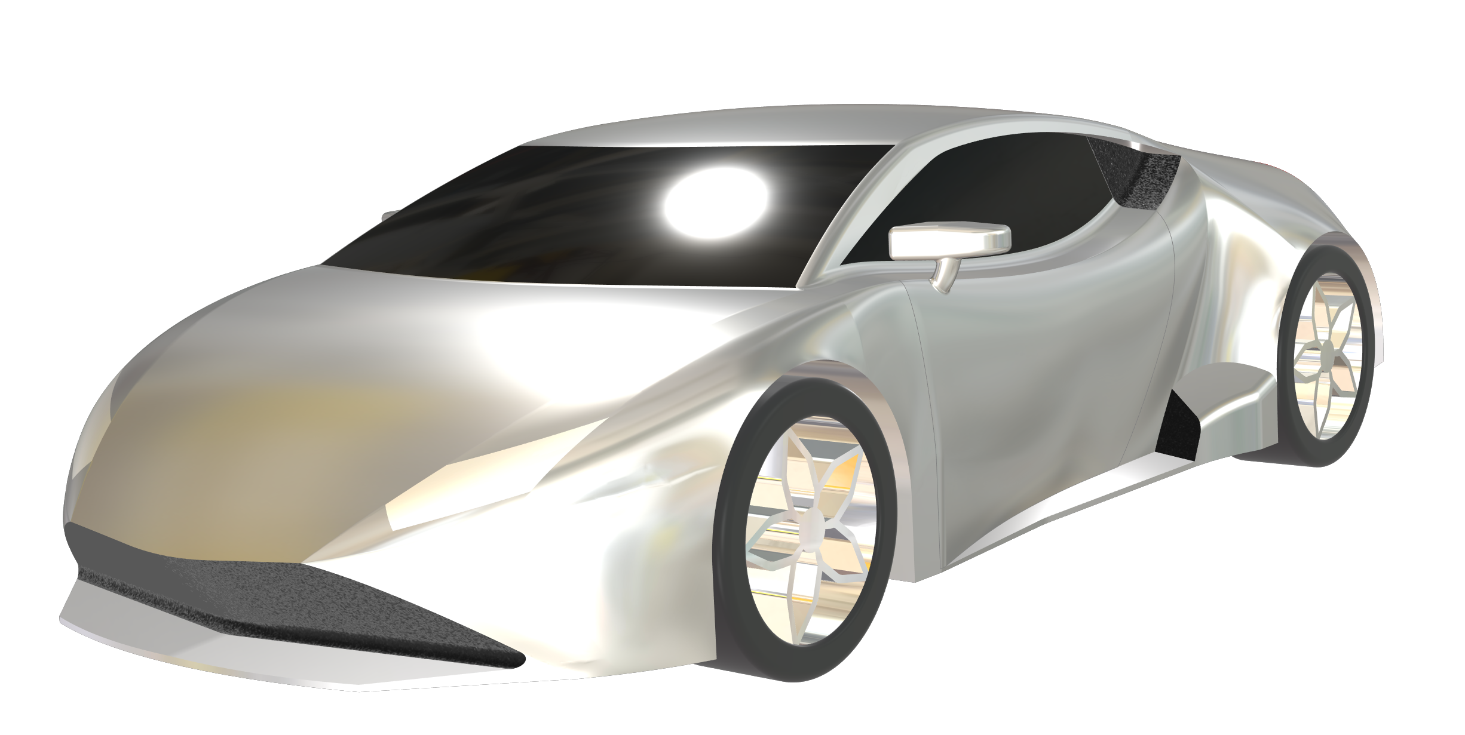
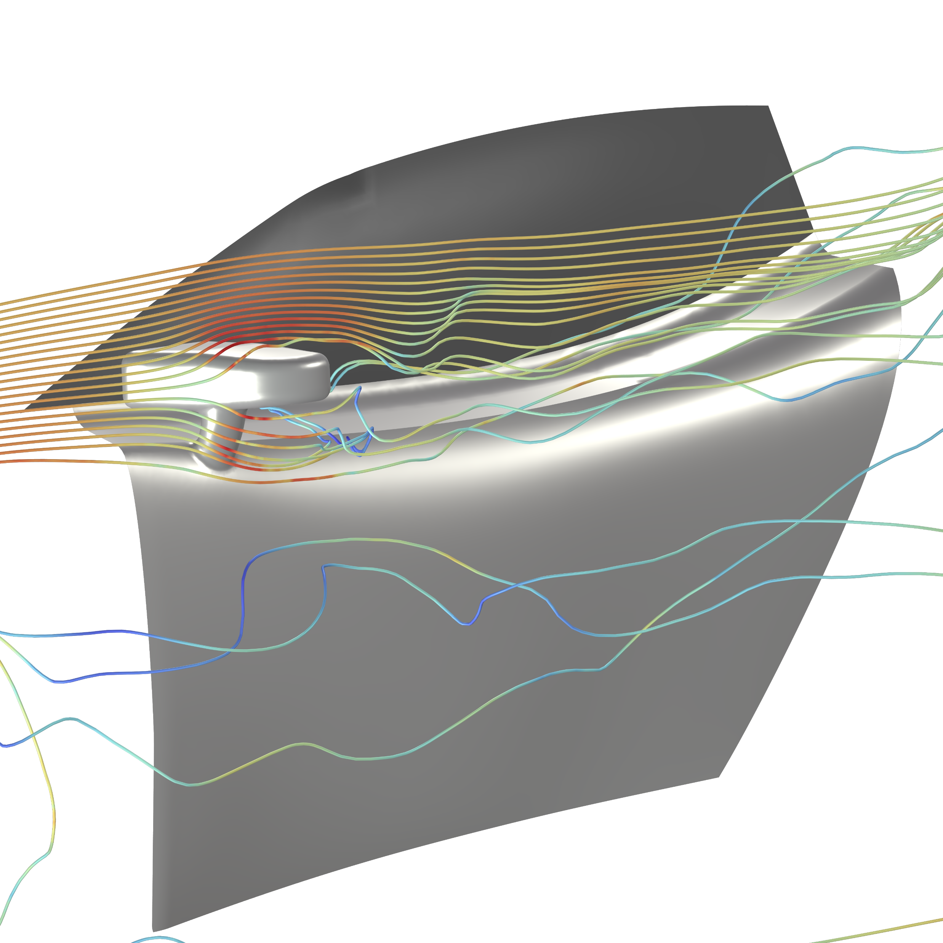
Model Definition
LES analysis for fluid flow around the car
  Computes the total forces from fluid flow on the side door and side rearview mirror
FFT to transfer the forces from the time domain to the frequency domain
Structural analysis on the side door and side rearview mirror
  Forces and constraints applied on a shell
CFD analysis on complete geometry
Structural analysis on door and mirror

Slide 3
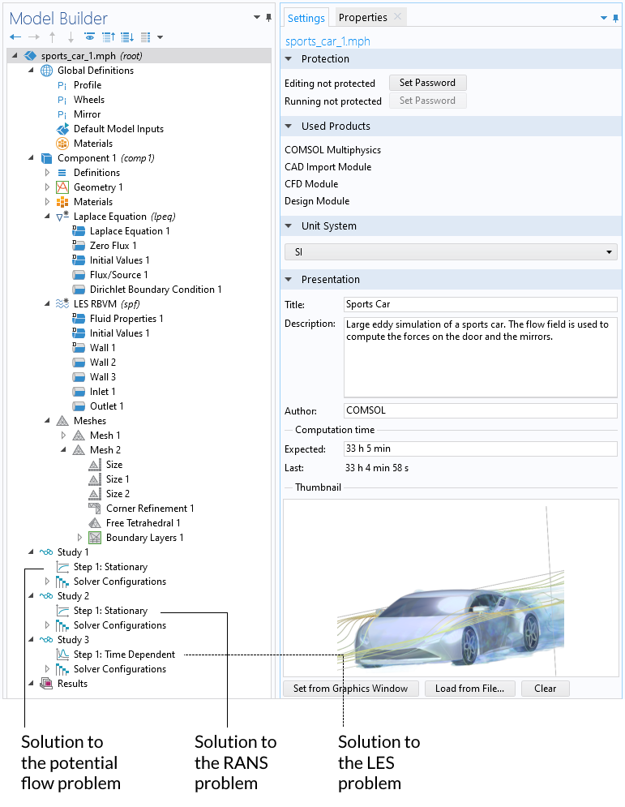
CFD Studies
Potential flow
  Computes initial condition for RANS
RANS turbulence model
  Computes initial condition for LES
LES
  Computes the forces for the structural analysis

Slide 4
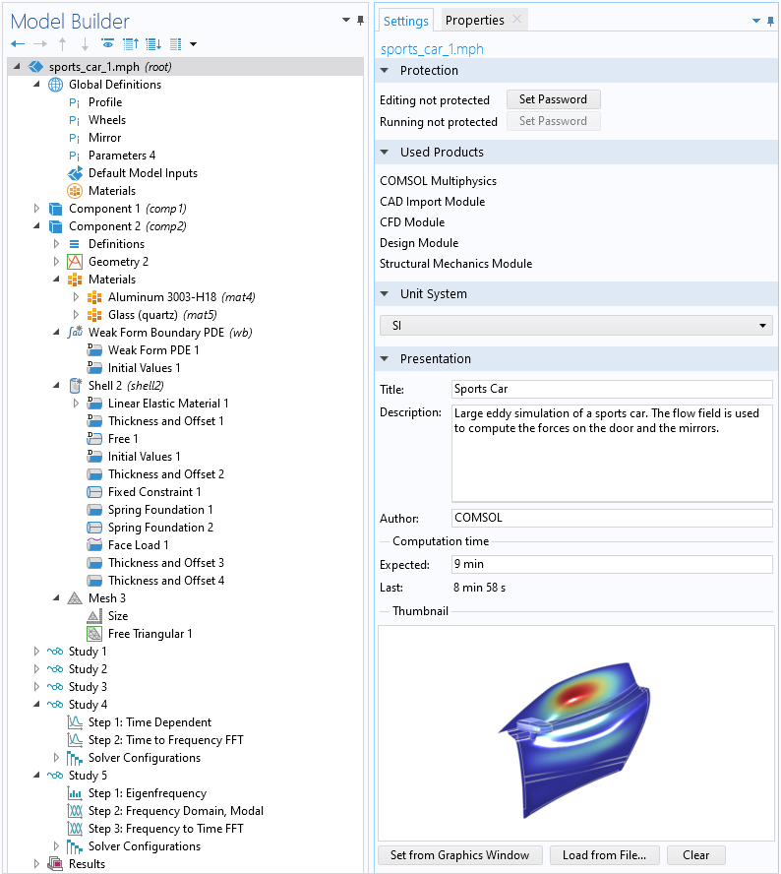
Structural Analysis
Transfer of fluid forces from time domain to frequency domain
Eigenfrequency and Frequency Domain Model studies
Frequency domain to time domain study

Slide 5
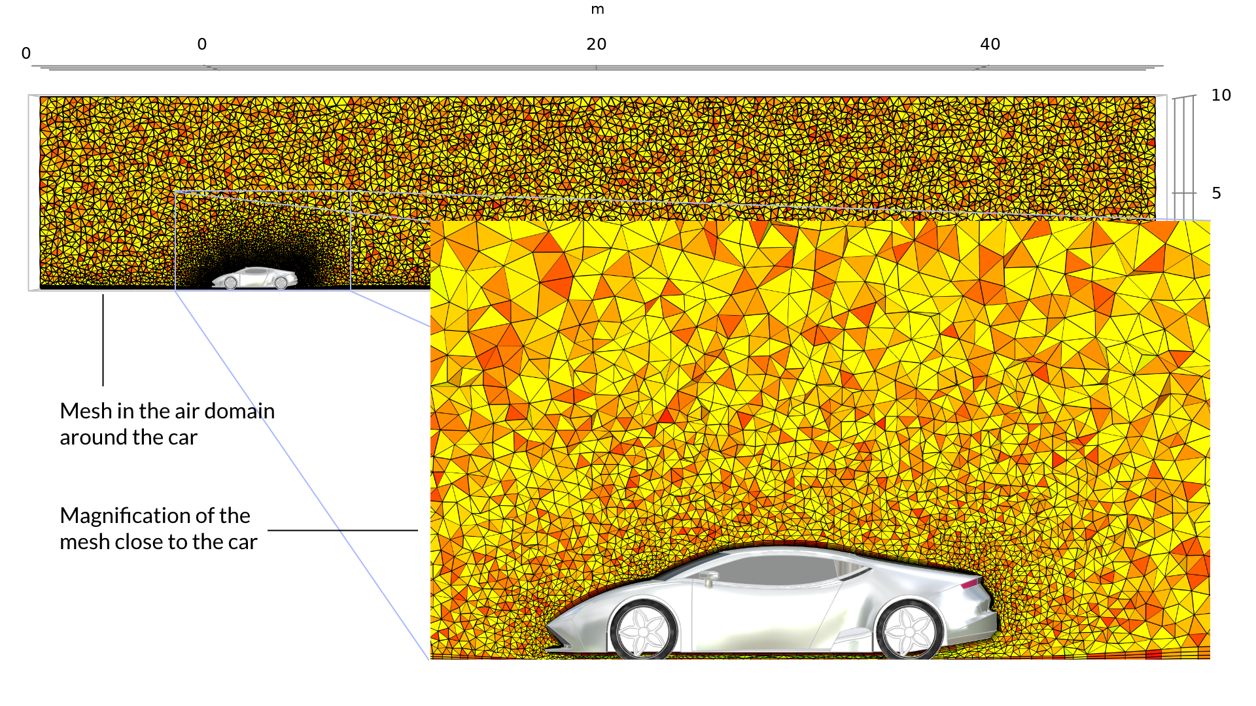
Mesh for CFD
Boundary layer mesh
Growth away from the car body
Large air domain required

Slide 6
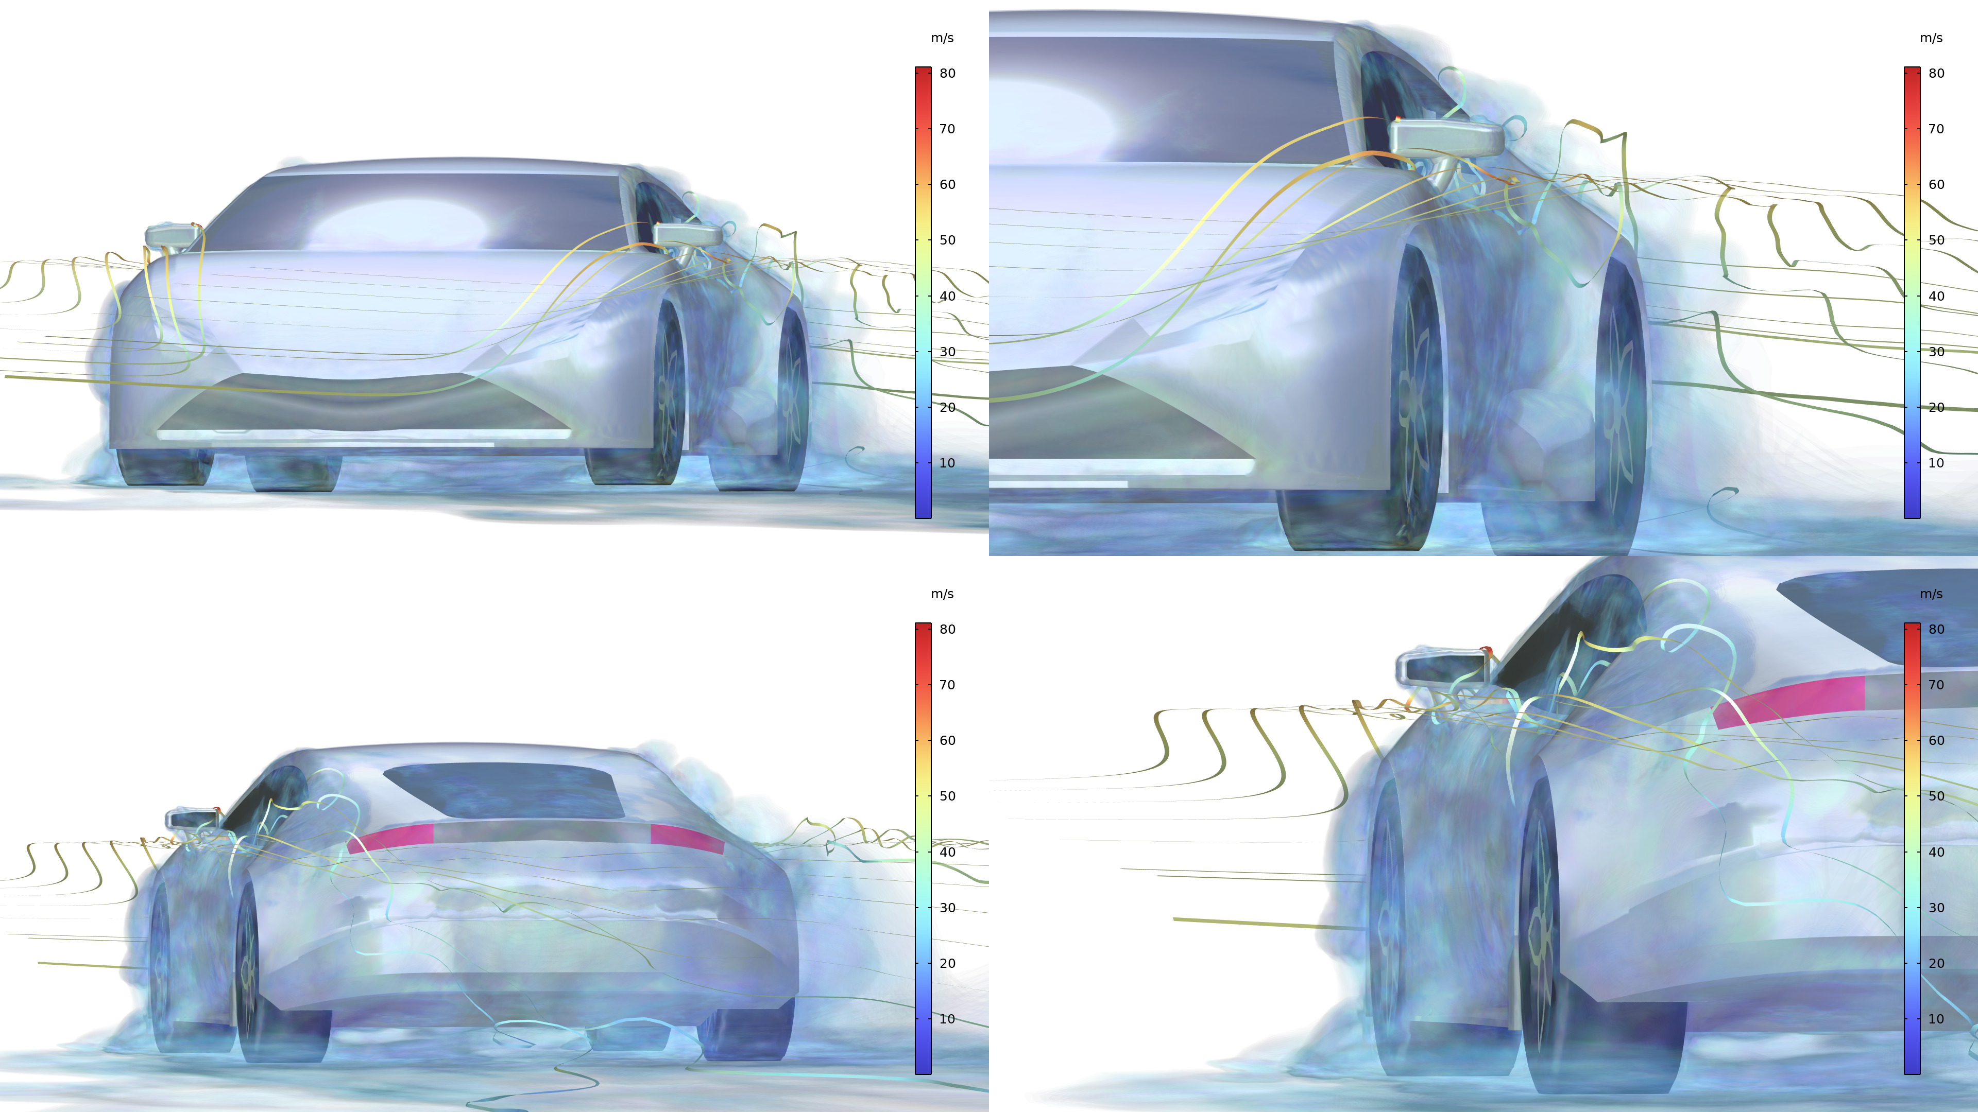
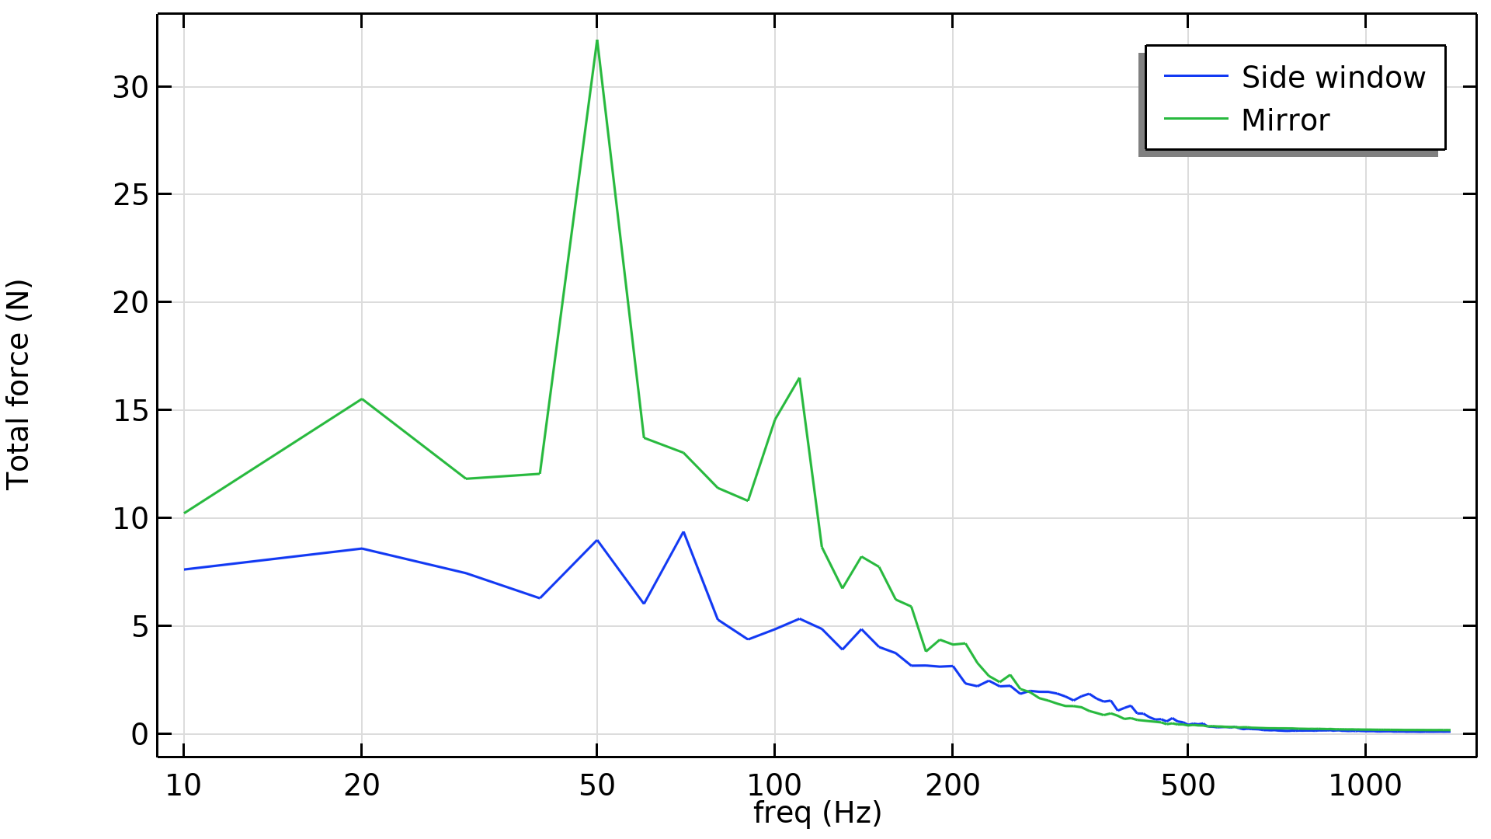
CFD Results
Drag coefficient = 0.25
Frequency of fluid forces

Slide 7
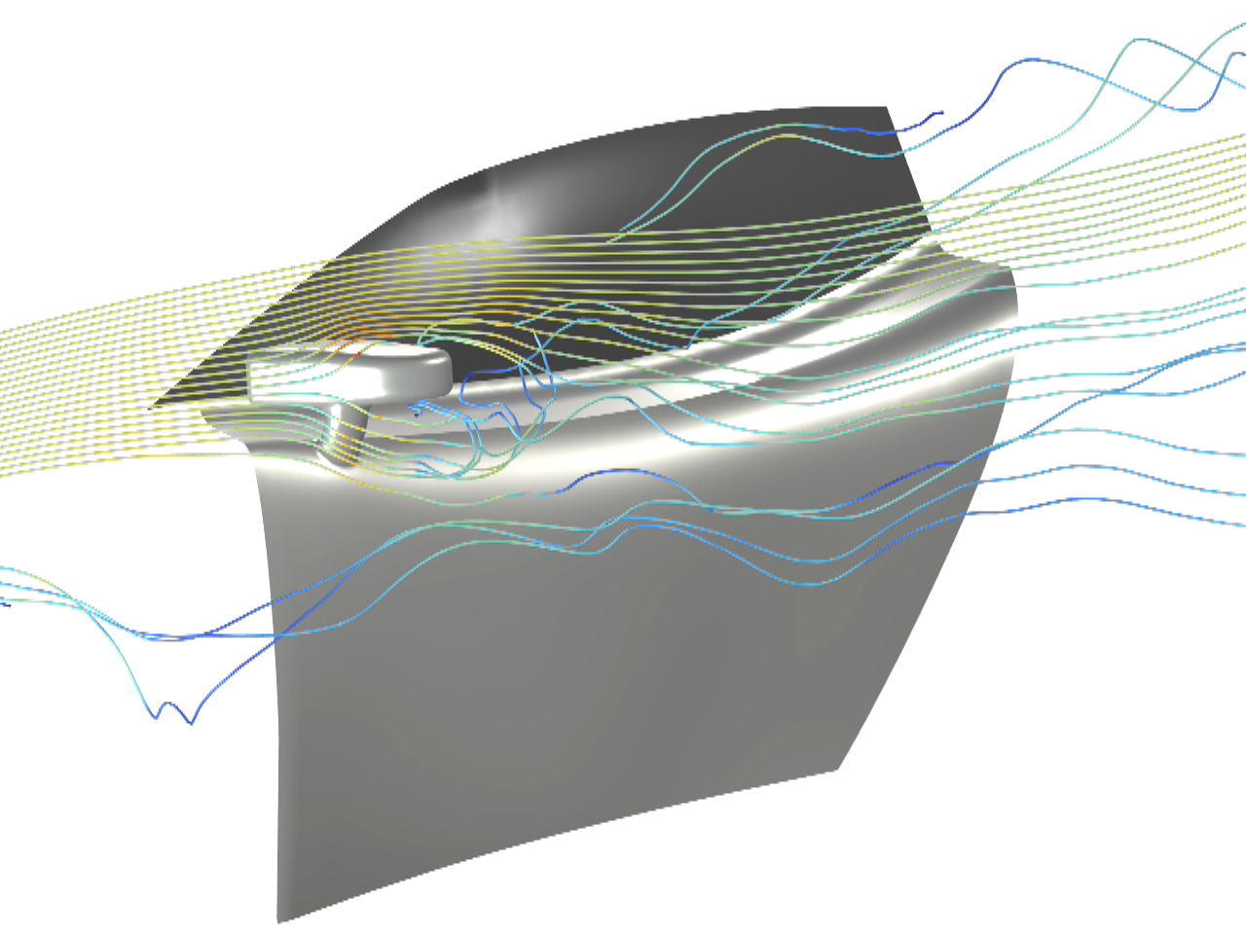
FSI
Initial study
  Displacements exaggerated by a factor 50 for visualization

Slide 8
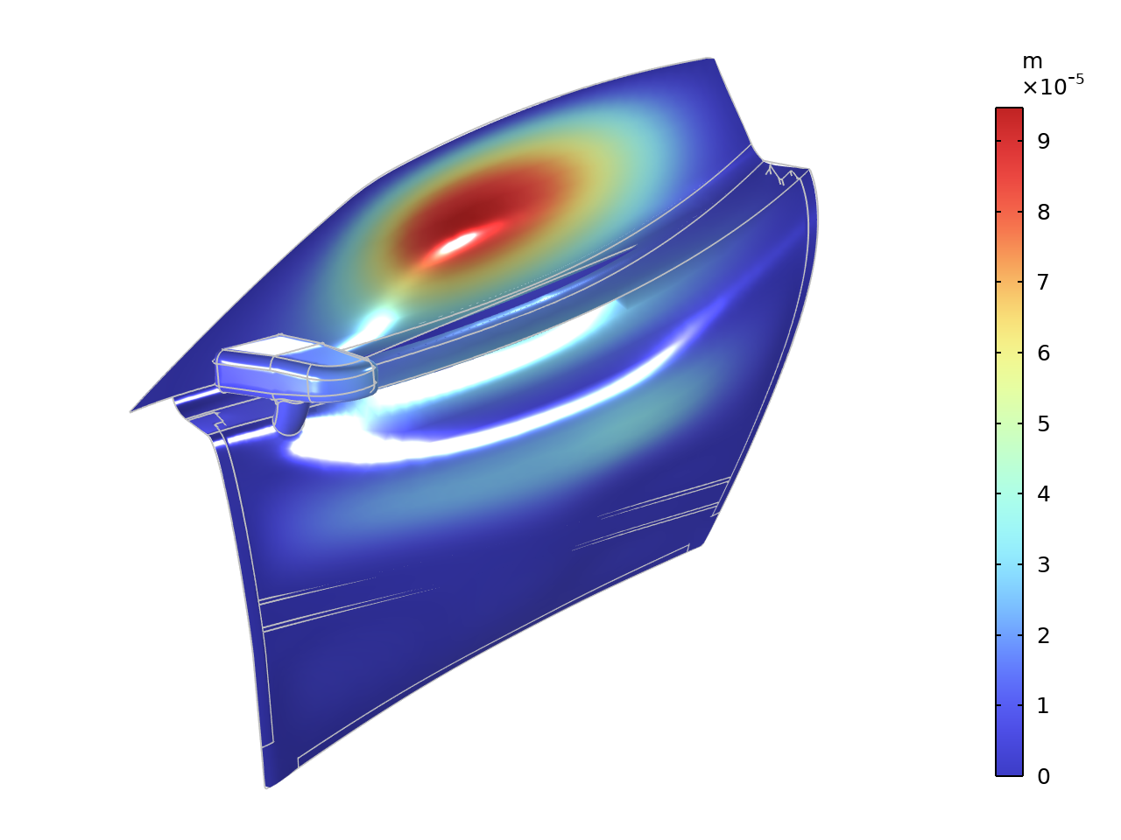
Structural Analysis
Response at 90 Hz
  Side window moves with one node
  Upper part of side door also shows a large displacement
  Difficult to damp these responses

Slide 9
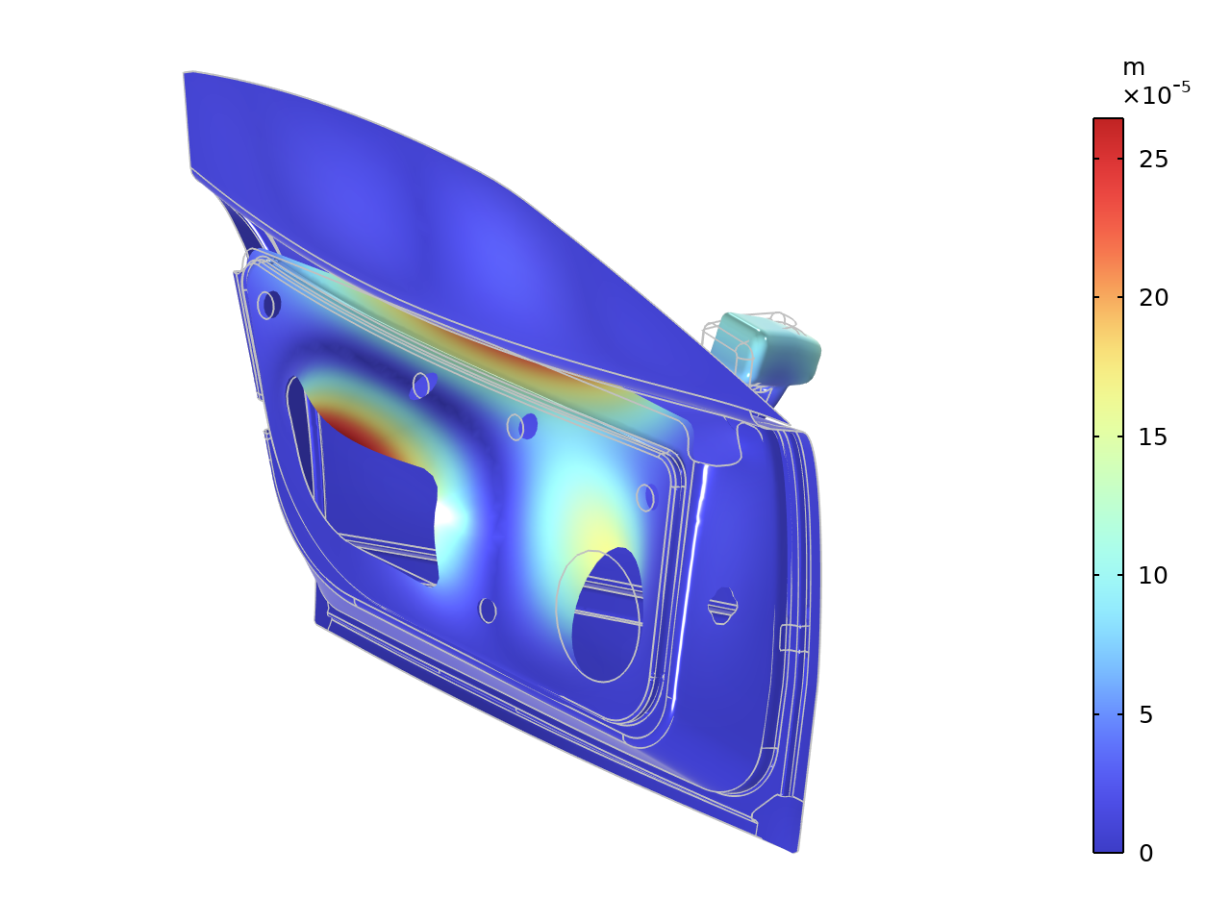
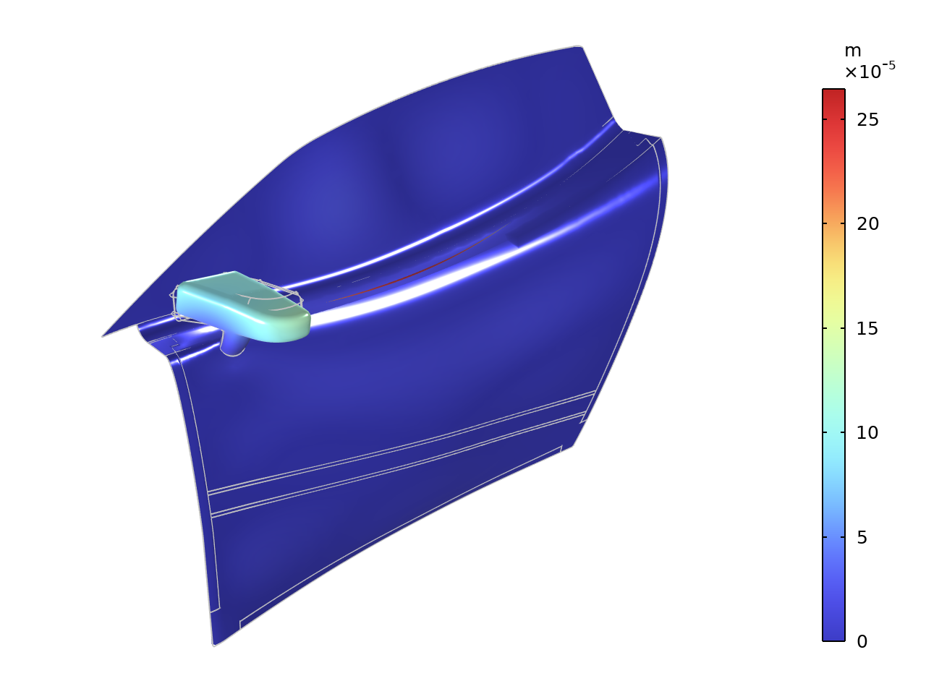
Structural Analysis
Response at 50 Hz
  Inner structure: possible to damp with trim panels
  Mirror: relatively small vibrations

Slide 10
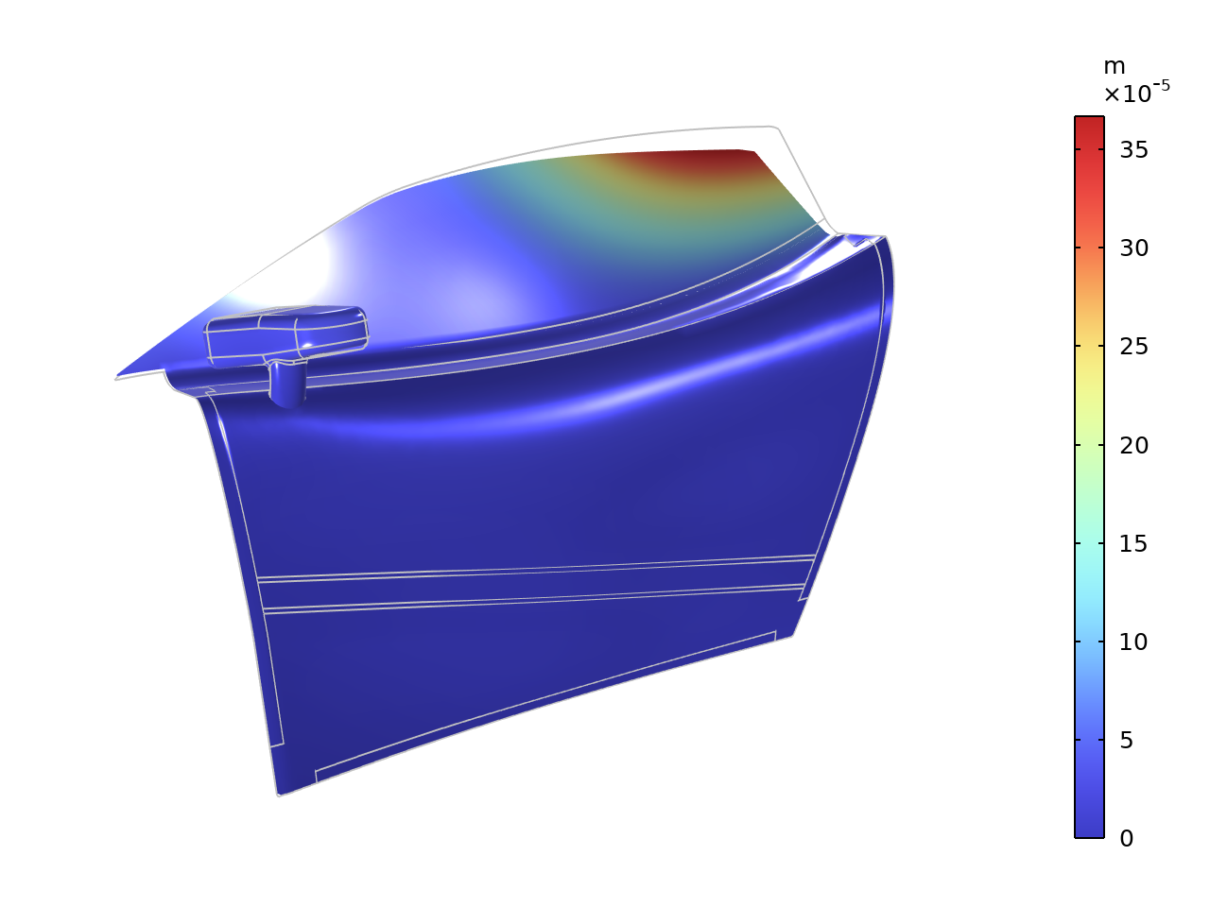
Structural Analysis
Response at 20 Hz with the window slightly rolled down
  Probably a large source of fluttering noise

Slide 11
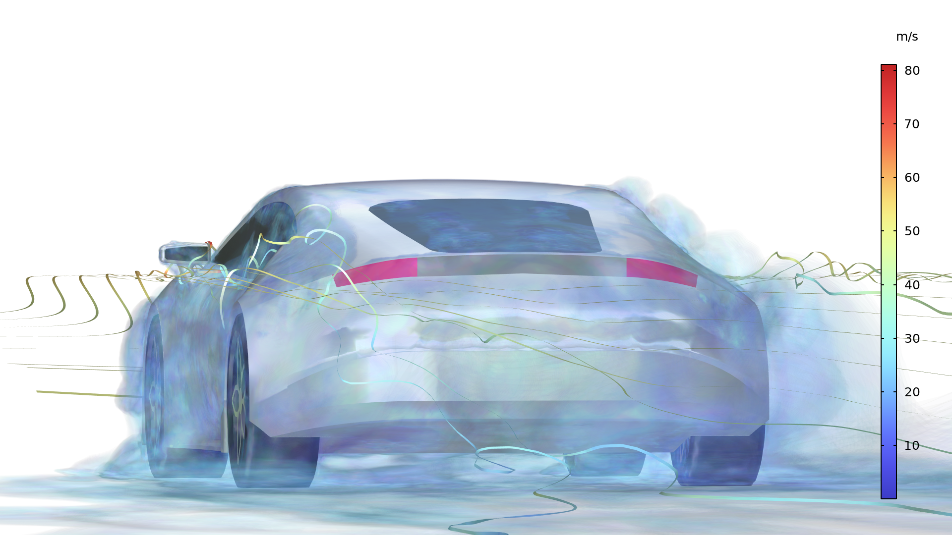
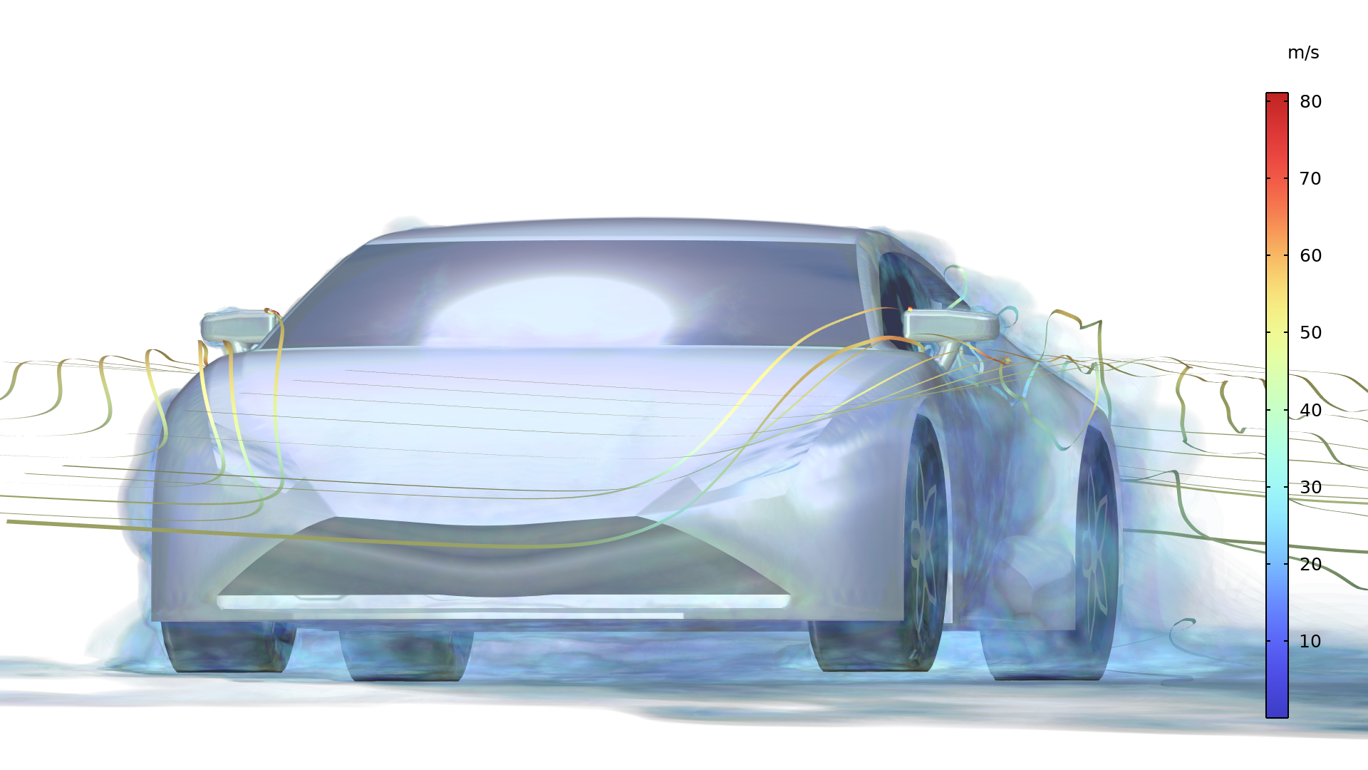
Conclusions
Simplified yet realistic analysis
Possible improvements:
  Account for gaps and misalignments between body panels in CFD analysis
  Add the rotation of the wheels
  Try to estimate the vibration from the roughness of the road

