Slide 1
Yagi–Uda Antenna for Wi-Fi Booster

Slide 2
Motivation
Due to a higher penetration capacity through solid objects, eavesdropping is highly likely to occur for the 2.4 GHz band of Wi-Fi
The Yagi–Uda antenna can direct the signal in a particular direction and avoid intruders eavesdropping on personal Wi-Fi signals
In other words, it could be treated as a “Wi-Fi booster” in the desired direction

Slide 3
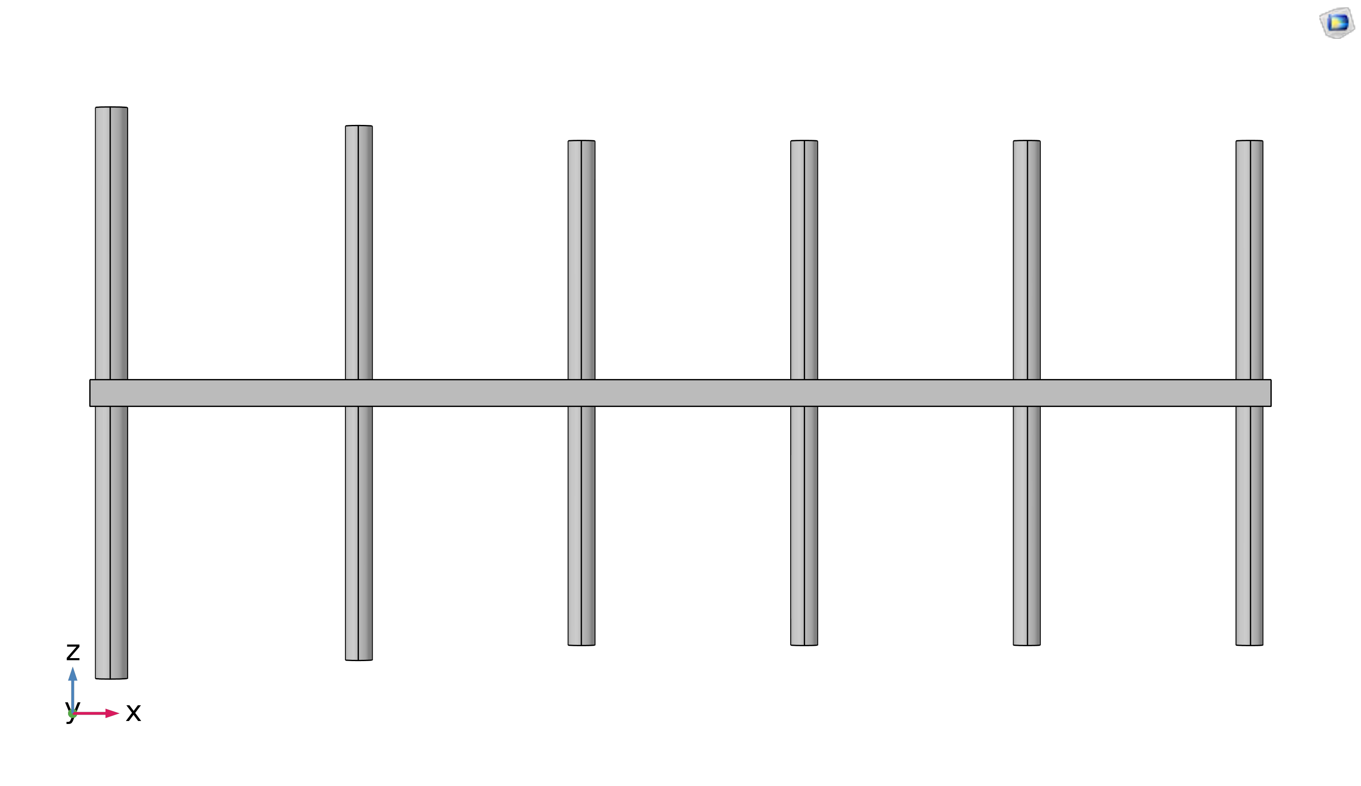
Geometry
The Yagi–Uda antenna consist of one reflector and four directors. All elements are uniformly spaced at a distance of 0.2 λ₀
The length of the reflector is 5% more than the feeder length, while the length of the director is 5% lower than the feeder length
The dimensions are optimized in a later stage for the frequency 2.45 GHz
Directors
Reflector
Feeder
Yagi–Uda antenna

Slide 4
Modeling Assumptions
The antenna is fed with the User defined type of lumped port and has a 50 Ω impedance
The Yagi–Uda structure is supported by a PTFE block
A Perfectly Matched Layer (PML) domain condition (spherical type) is used as the absorbing condition
Far-field calculation is done at the air–PML domain interface

Slide 5
Material Properties
The supporting structure for the Yagi–Uda antenna is made of PTFE with the following properties:
  Relative permittivity = 2.1
  Relative permeability = 1
  Electrical conductivity = 0 S/m
The feeder, reflector, and directors are considered as Perfect Electrical Conductors (PECs). The losses can be accounted by considering the Impedance boundary condition (IBC) for these electrically conducting materials.

Slide 6
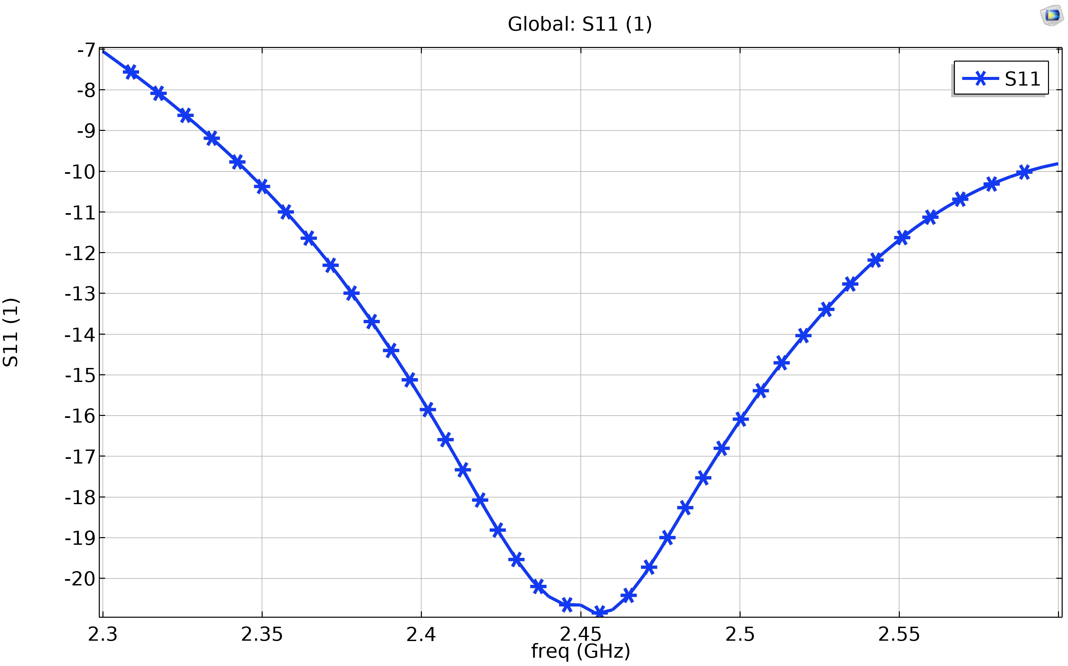
Results
S-parameter response.
S-parameter response for the Yagi–Uda antenna

Slide 7
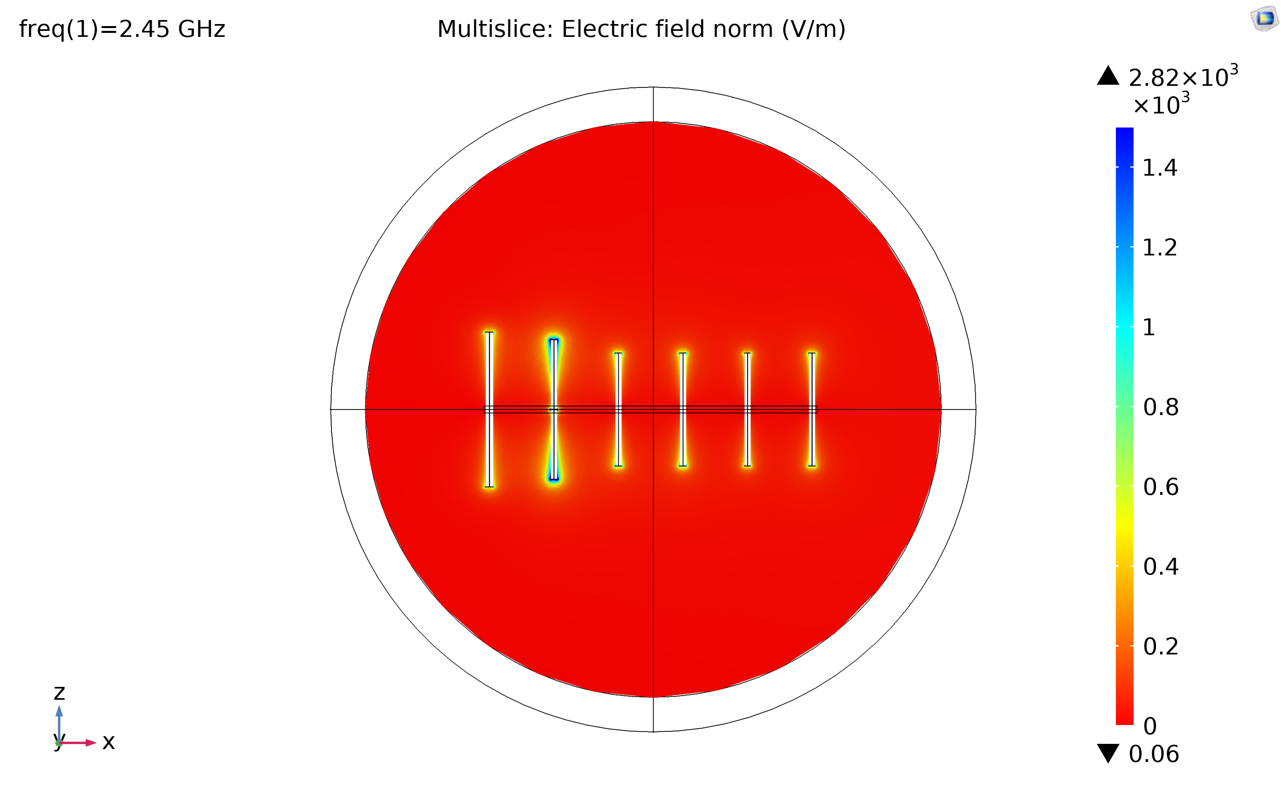
Results
The electric field norm is getting strongly coupled to directors, suggesting the wave is strongly steered by directors in the +X axis.
Electric field norm distribution in the E-plane of the antenna

Slide 8
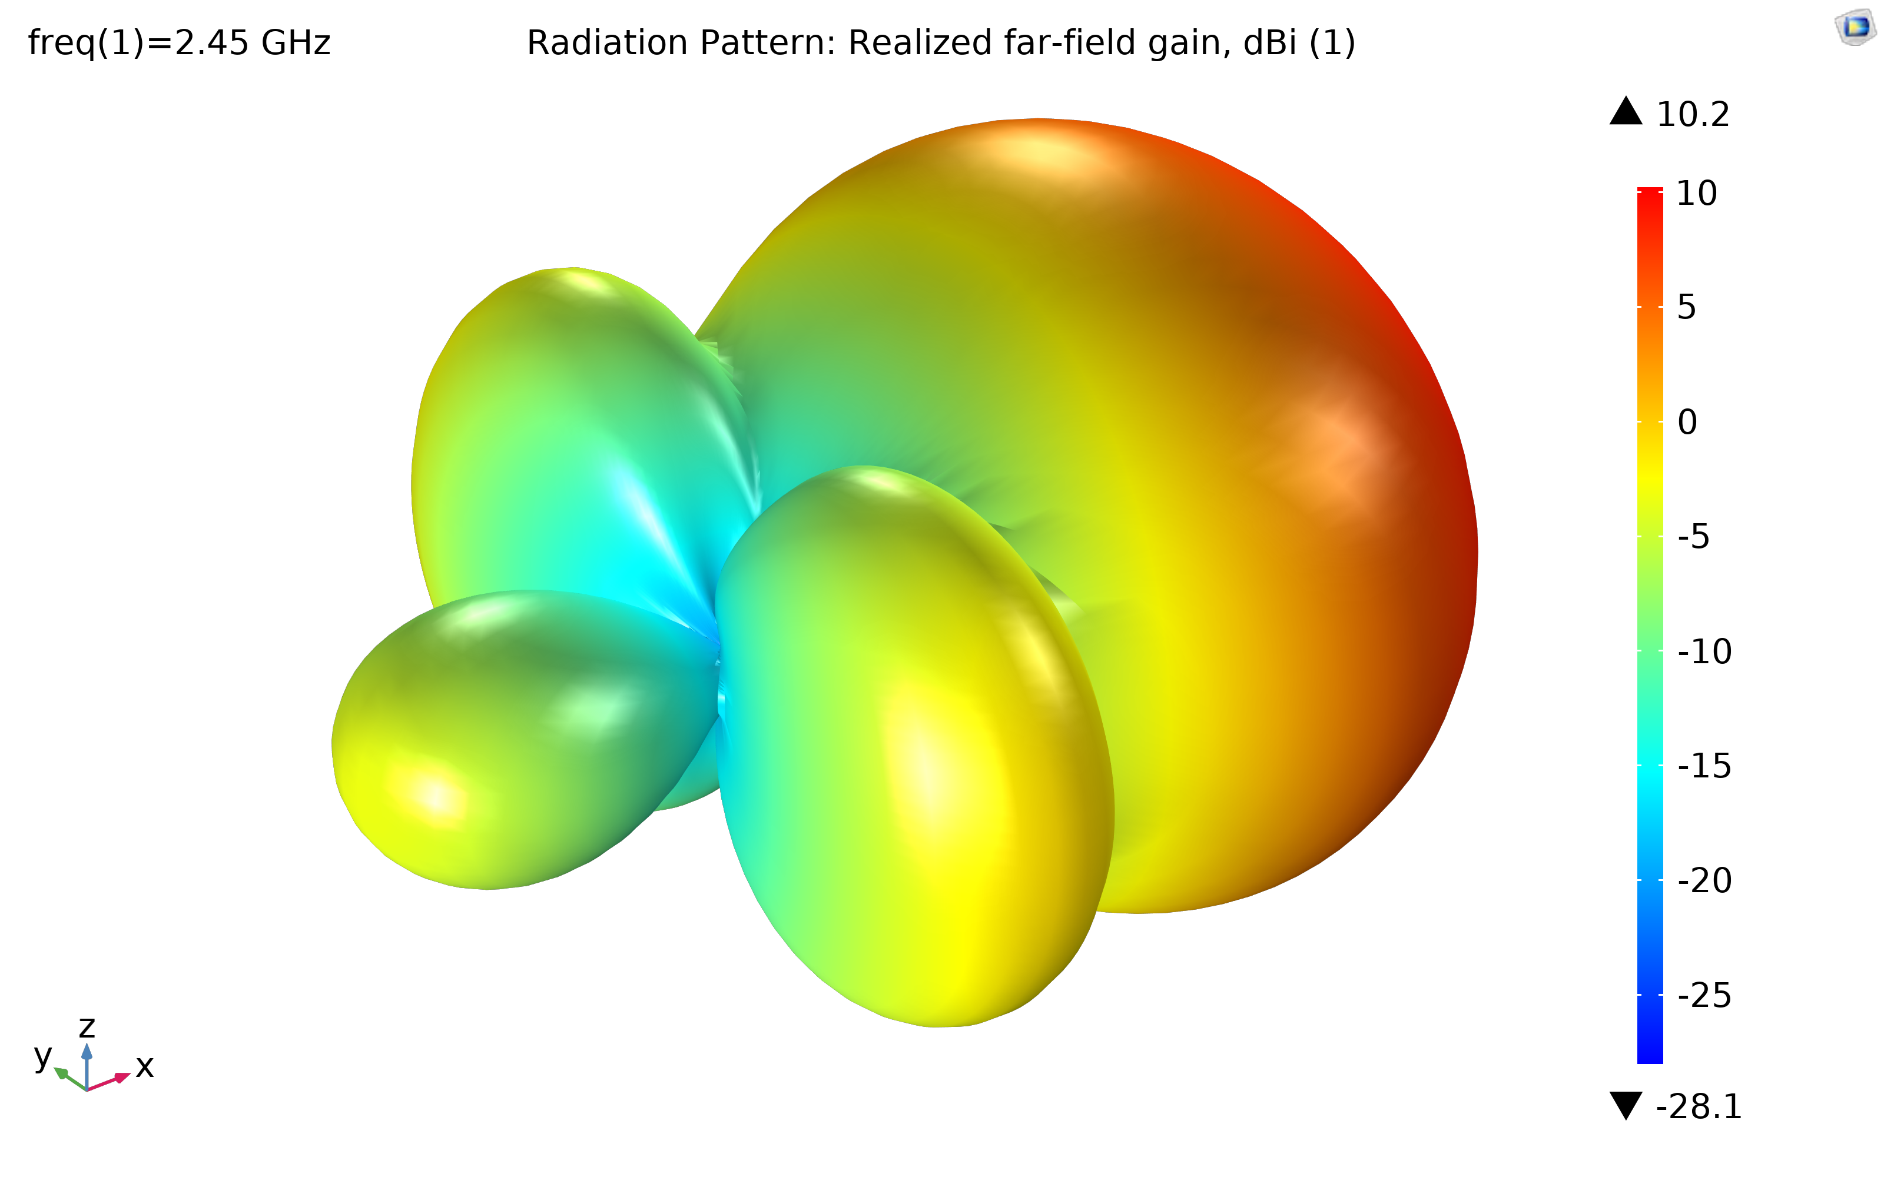
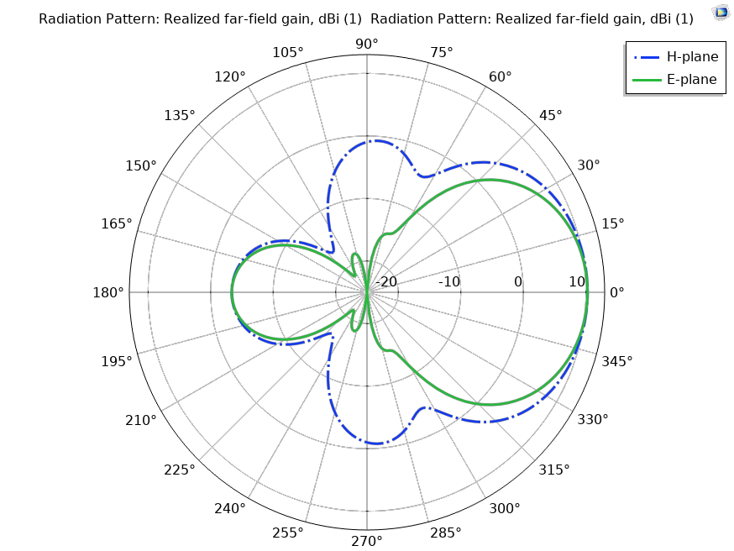
Results
a
3D radiation pattern: Far-field gain in dBi
Polar plot: E-plane pattern

Slide 9
Conclusion
The Yagi–Uda antenna with a center frequency of 2.45 GHz was modeled
With four equally spaced directors and a reflector, the Yagi–Uda antenna has achieved a maximum far field gain of 10 dBi and has a front-to-back ratio of 14 dB
The operating frequency band of the designed Yagi–Uda antenna finds its application for Wi-Fi bands, and by directing Wi-Fi signals with this antenna, eavesdropping can be reduced

