Slide 1
Pulse Reverse Plating

Slide 2
Background
Due to electrolyte ohmic and mass transfer effects, protruding parts of an electrode surface are typically favored over recessed parts during electrodeposition
As a result of the higher deposition rate, the growth of the protruding parts will accelerate over time, resulting in highly non-homogeneous deposited thicknesses and in worst cases the formation dendrites and porous deposits
By the use of accelerating and suppressing agents (levelers), the local kinetics of the electrodeposition reaction can be altered to depend less on pure ohmic and mass transfer, resulting in smoother deposits
However, the use of additional chemicals may not be suitable when 100% pure deposits are required
This tutorials exemplifies the use of reverse current pulses for achieving smooth surfaces

Slide 3
Primary and Secondary Current Distributions
In the example, mass transfer effects are neglected
When designing the pulsed current cycle, the different characteristics of Primary and Secondary Current Distributions are considered
  Primary:
    The current distribution is dominated by ohmic effects
    Current densities are high on protrusions
  Secondary:
    The current distribution is also affected by local electrode polarization
    The current distribution is more homogeneous than for the Primary case (but the current density is still higher on protrusions compared to recessed areas)

Slide 4
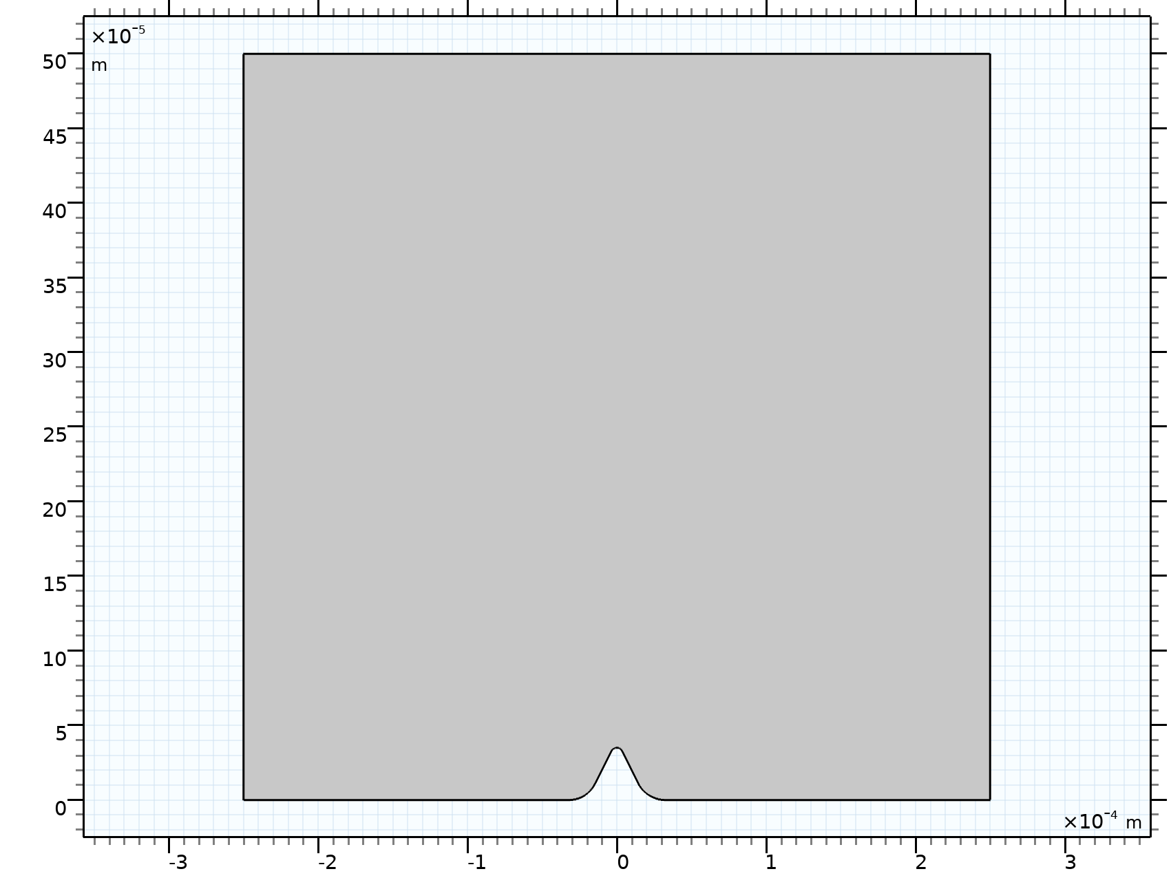
Model Definition
Bulk Electrolyte Boundary
Electrolyte
Domain
Constant electrolyte conductivity
On the Electrode Surface
  Cu²⁺ + e⁻ ⇔ Cu(s)
  Butler-Volmer kinetics
We first investigate the case of a constant (forward) current density of 5 A/dm²
Depositing Electrode Surface
With Protrusion

Slide 5
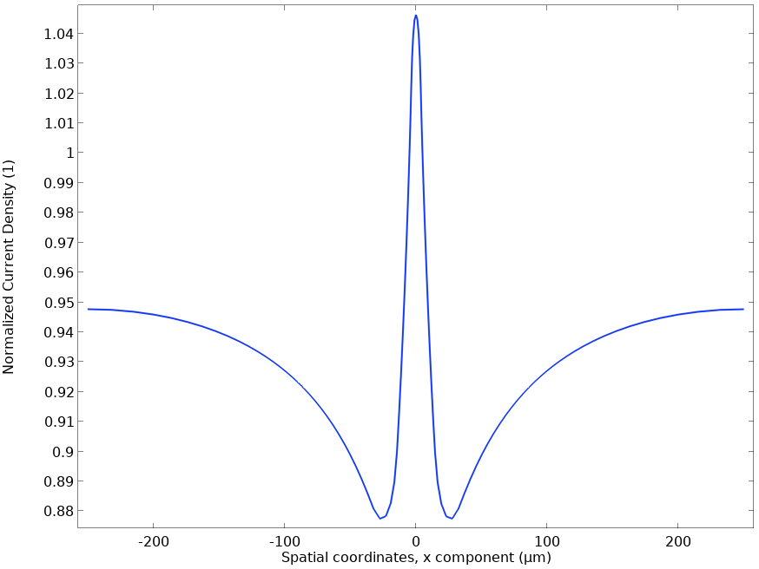
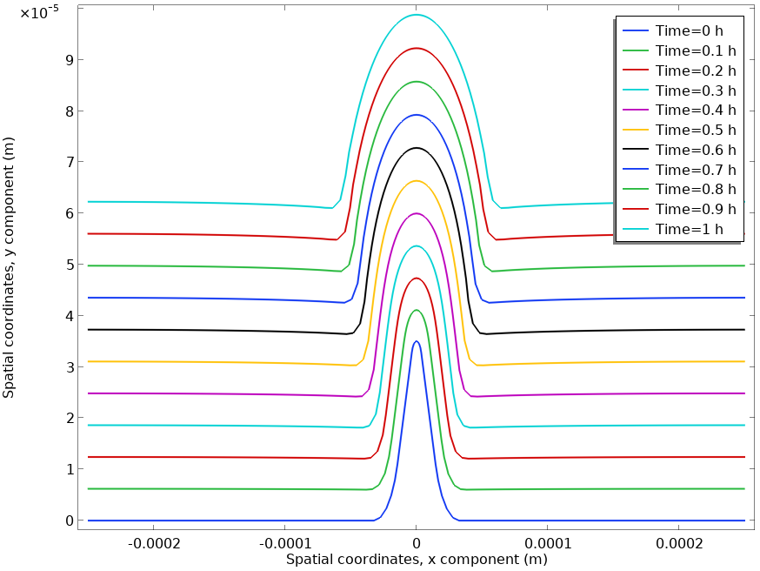
Constant Current Results, 5 A/dm²
Protrusion exhibits
accelerated growth
Initial Current Distribution
Shape Evolution
Highest current density
at peak of protrusion

Slide 6
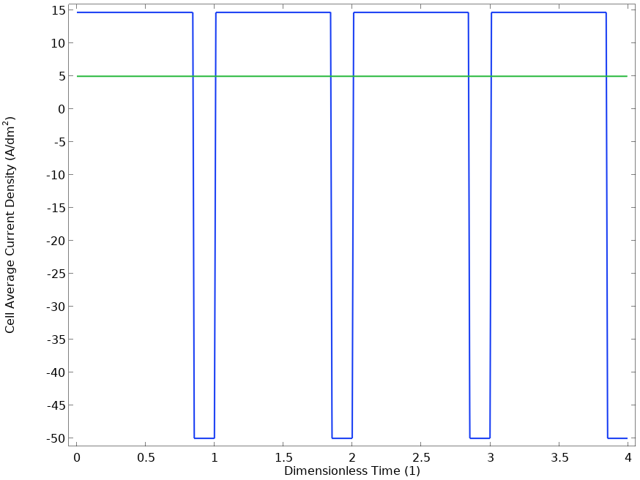
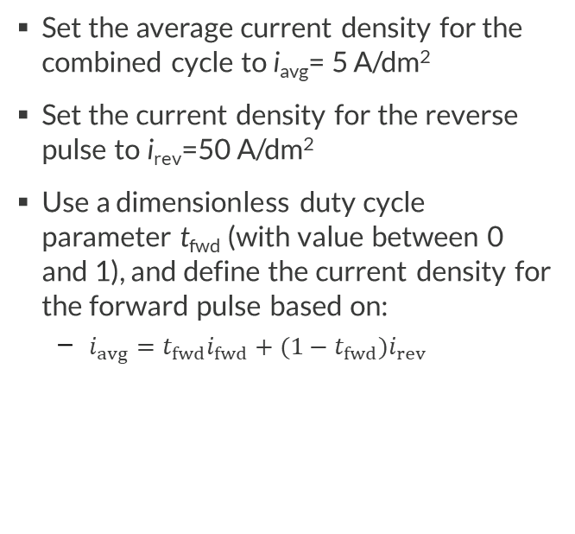
Defining the Forward-Reverse Cycle
Set the average current density for the combined cycle to i_{avg}= 5 A/dm²
Set the current density for the reverse pulse to i_{rev}=50 A/dm²
Use a dimensionless duty cycle parameter t_{fwd} (with value between 0 and 1), and define the current density for the forward pulse based on:
  $i_{avg}=t_{fwd}i_{fwd}+(1−t_{fwd})i_{rev}$
i_{fwd}
i_{avg}
t_{fwd}
i_{rev}

Slide 7
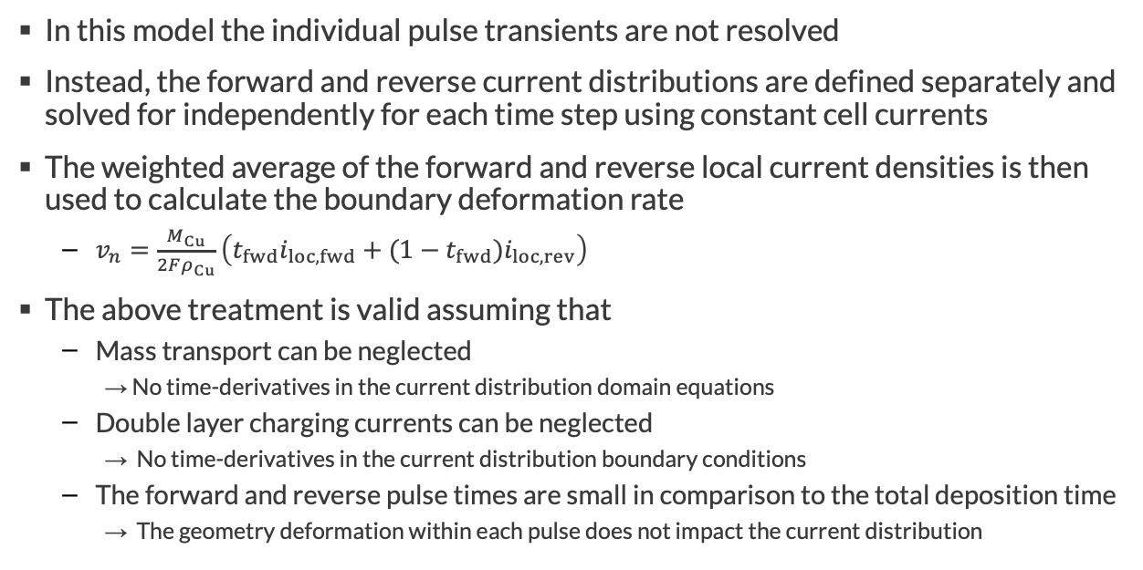
Quasi-Stationary Assumption
In this model the individual pulse transients are not resolved
Instead, the forward and reverse current distributions are defined separately and solved for independently for each time step using constant cell currents
The weighted average of the forward and reverse local current densities is then used to calculate the boundary deformation rate
  $v_{n}=\frac{M_{Cu}}{2Fρ_{Cu}}\left(t_{fwd}i_{loc, fwd}+(1−t_{fwd})i_{loc, rev}\right)$
The above treatment is valid assuming that
  Mass transport can be neglected
    → No time-derivatives in the current distribution domain equations
  Double layer charging currents can be neglected
    → No time-derivatives in the current distribution boundary conditions
  The forward and reverse pulse times are small in comparison to the total deposition time
    → The geometry deformation within each pulse does not impact the current distribution

Slide 8
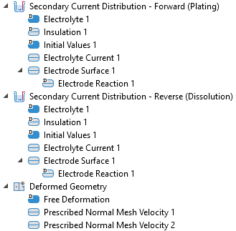
Implementation
Two Secondary Current Distribution interfaces
  Defined on the same geometry
  Assumed quasi-stationary within each forward/reverse pulse, with constant boundary conditions
  Current distributions change with time due to deformation
  Only the Electrolyte Current boundary conditions differ
Deformed Geometry
  User-defined expressions defines boundary velocity
Cell current density for forward cycle set here
Cell current density for reverse cycle set here
Boundary velocity depends on Electrode Reaction local current densities

Slide 9
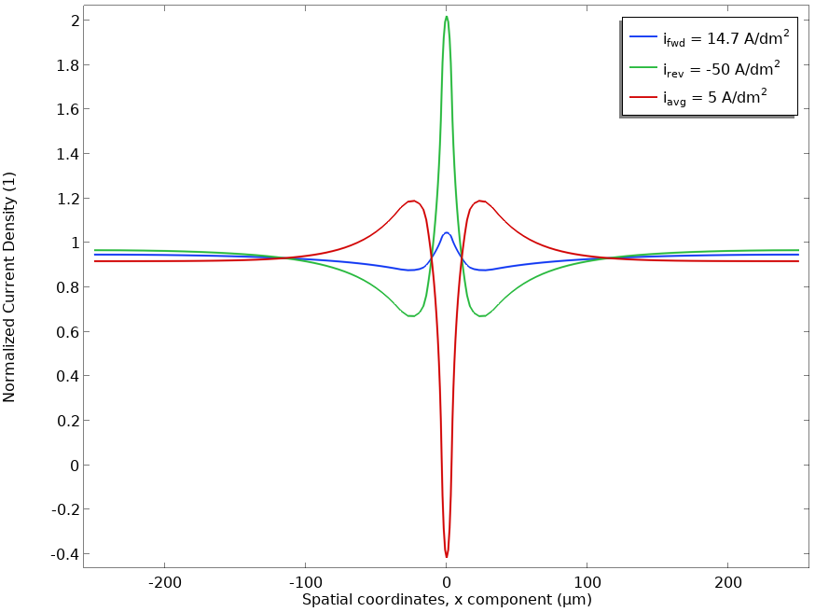
Initial Current Densities for t_{fwd}=0.85
The combined cycle results in
negative deposition current
densities at the center of
the protrusion

Slide 10
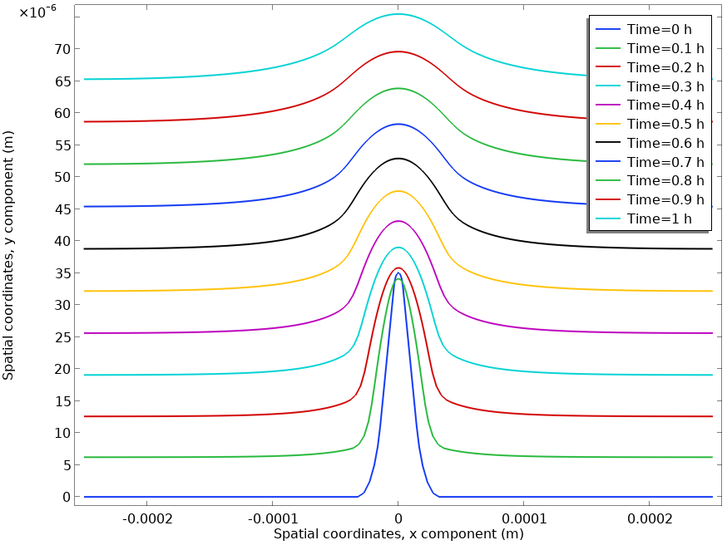
Shape Evolutions for t_{fwd}=0.85
Protrusion now shrinks

Slide 11
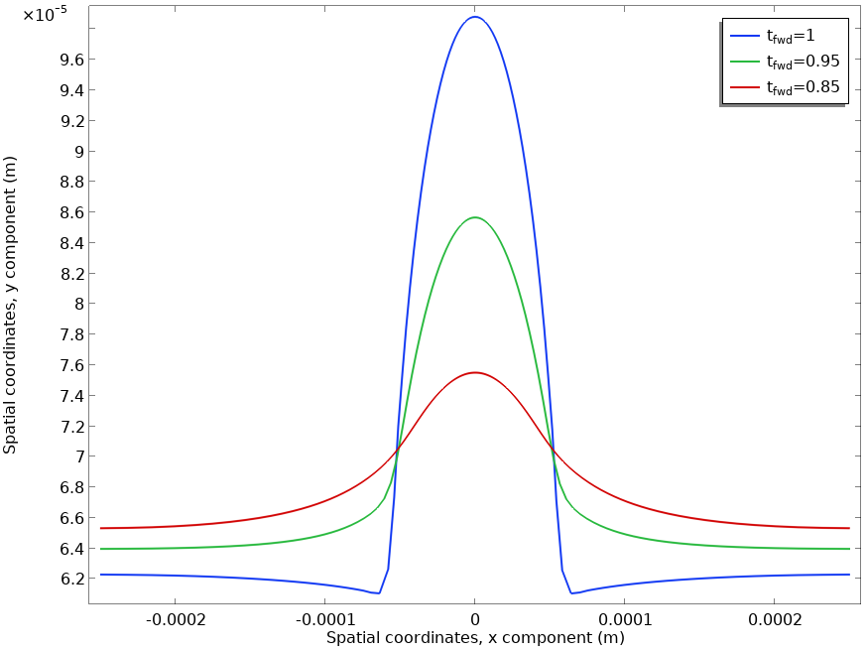
Comparing Final Shape for Different t_{fwd}

