Slide 1




Mechanical Stability And Flow Analysis of Hollow Microneedle Array For Transdermal Drug Delivery
Gowthami Anbazhagan , Sreeja B S
Department of Electronics and Communication Engineering, Anna University, Chennai, Tamilnadu, India

Slide 2
Presentation Outline
Why Microneedles?
Modelling and Simulation approach
Structural Analysis of Hollow Microneedle
Geometry Parameters under loading conditions
Fluidic analysis of Hollow Microneedle
Skin Insertion Analysis
Questions and Discussion

Slide 3
Microneedle for Transdermal Drug Delivery
Transdermal drug delivery (TDD) -minimally invasive, patient-friendly method for drug and vaccine delivery
Microneedles(MN) – Painless, safe administration
Microneedles classified as
Solid, Hollow, Coated, Dissolving, Hydrogel
Finite element analysis (FEA) has received a great deal of interest recently in the MN sector
Analysis helps to avoid expensive experimental trials and provides the pathway to create customized MN according to patient skin

Slide 4
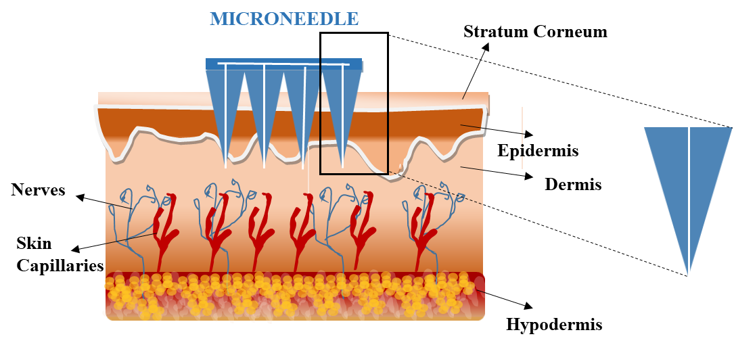
Hollow Microneedle for Transdermal Drug Delivery
Advantages
Accommodate a large dosage or volume of drug solution inside the hollow cavity
Ability to inject a controlled large amount of doses
Deliver higher molecular weight drugs into the epidermis or upper dermis layer
Fig.1 Schematic illustration of Human Skin with microneedle

Slide 5
Hollow Microneedle for Transdermal Drug Delivery
Objective of Study
Hollow-centered conical and pyramidal microneedle array with an integrated reservoir
Mechanical and Fluidic analysis of conical and pyramidal microneedle array
Discussion - effect of geometry parameters in relation to stress and flow analysis
Investigation on geometry structure for the fluid flow analysis using different viscous fluid
Skin insertion analysis of microneedle array with different skin thickness

Slide 6
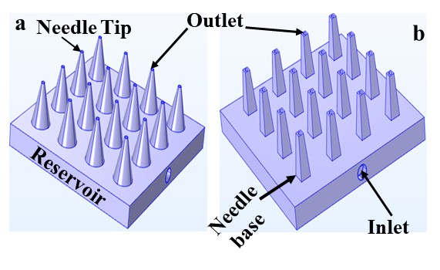
Hollow Microneedle Specification
Component | Proposed system
Height of microneedle | 400-1000 μm
Outer radius of microneedle | 150-300 μm
Inner radius of microneedle | 10-30μm
Distance between adjacent needles | 650μm
Length of the reservoir | 15mm
Height of reservoir | 4mm
Reservoir capacity | 2ml
Number of Microneedles | 16
Fig. 2 Schematic illustration of proposed three dimensional model in top view a Conical Microneedle array b Pyramidal Microneedle array with reservoir
Sixteen microneedles, placed in a 4x4 array
Reservoir at the bottom of the microneedle
Each microneedle has a hollow lumen that serves as an outlet
Input inlet is constructed on one side of the microneedle patch

Slide 7
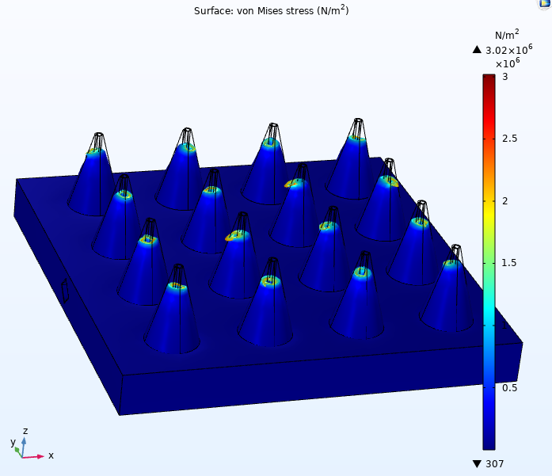
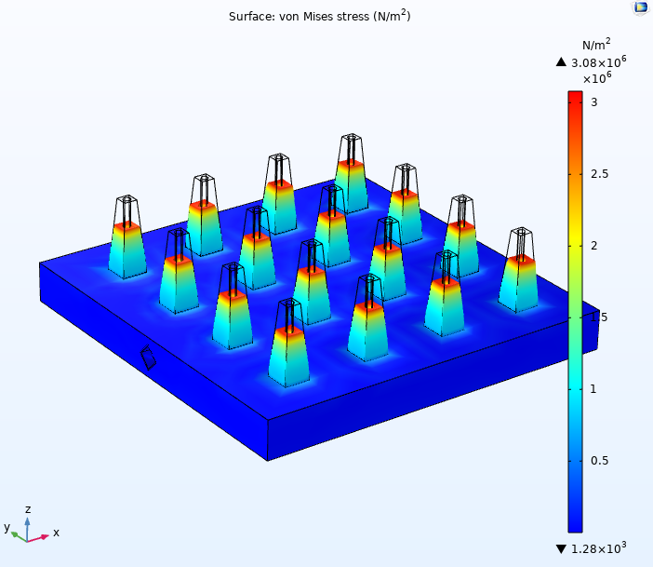
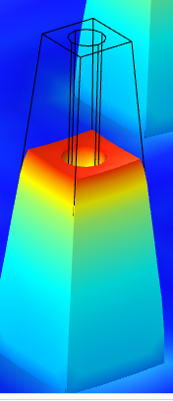
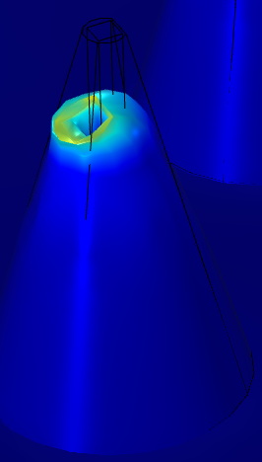
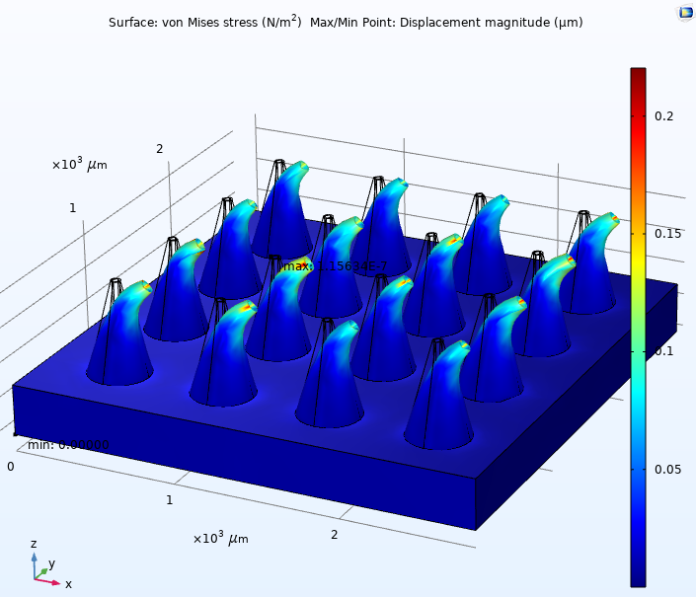
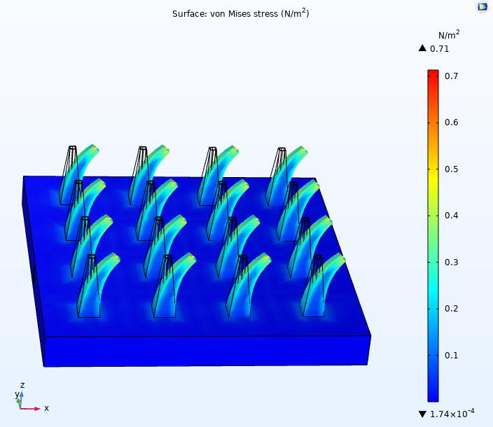
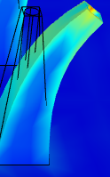
Structural Analysis of Hollow Microneedle
Physics----→Structural Mechanics ----→Solid Mechanics
Axial Loading
Pressure
at tip
Maximum stress
3.18MPa
3.18MPa
Fixed base
Fig.3 Axial stress analysis a Conical MN array b Pyramidal MN array (H=600µm, D_{base}=200µm, D_{tip}=30µm)
Bending Loading
Total force
Fixed base
Fig.4 Bending stress analysis of 4x4 Pyramidal Microneedle array (H=600µm, D_{base}=200µm, D_{tip}=30µm)

Slide 8
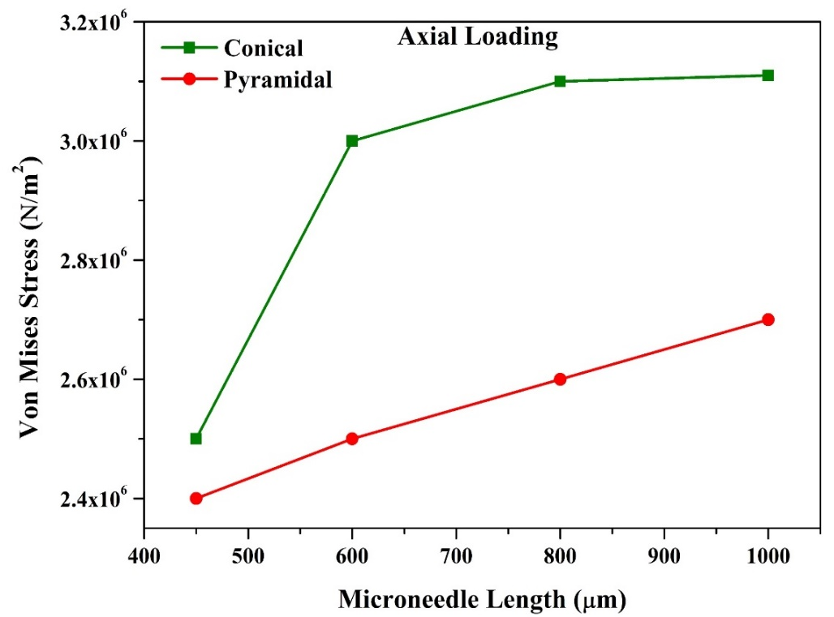
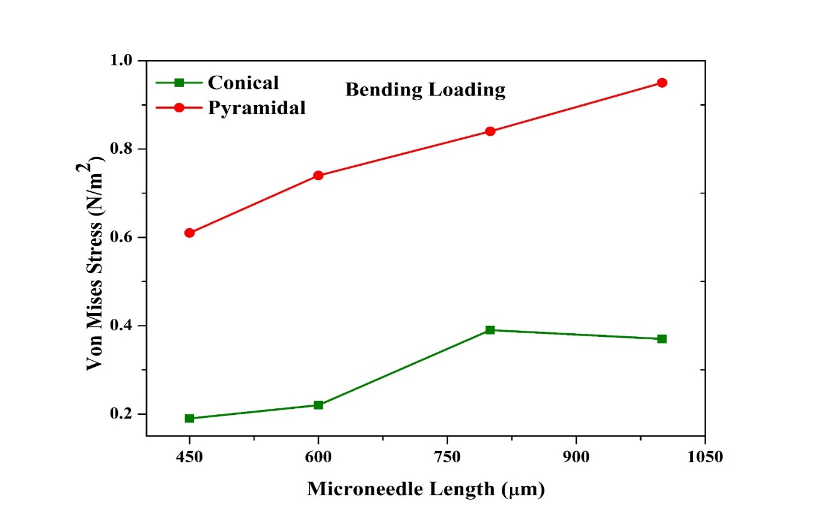

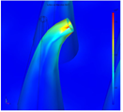
Variation of maximum stress with the length of microneedle under different loading condition
Axial Loading
Pressure
at tip
Fixed base
Bending Loading
Total force
(a)
(b)
Fixed base
Needle height directly relates with strength of the microneedle and depth of penetration
As observed, increasing the length of the needle, increased maximum stress and has increased chance of instability
circular-shaped conical microneedle will undergo more stress during axial loading and experiences less bending in the tip of the conical structure.
Conical geometry has a sharper structure and easily penetrates into the skin without any bending or failure

Slide 9
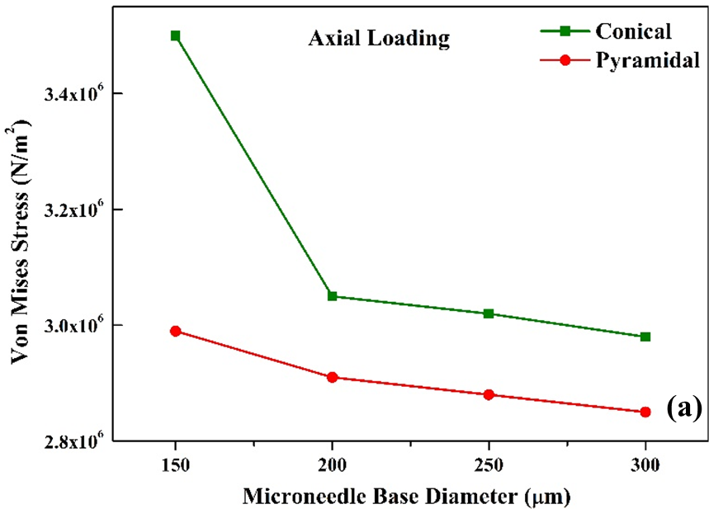
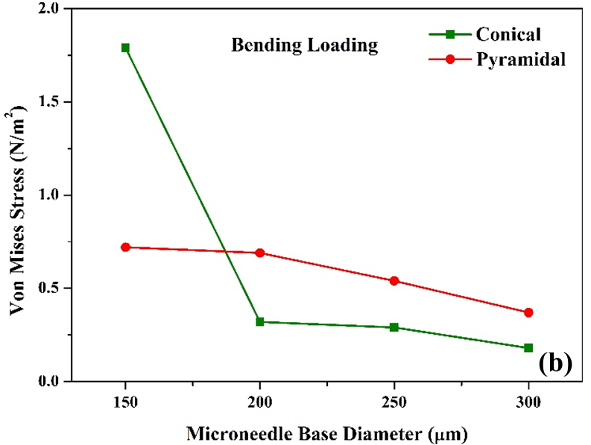
Variation of maximum stress with the base width of microneedle under different loading condition
Axial Loading
Pressure
at tip
Fixed base
Bending Loading
Total force
Inference
base diameter of the microneedle is investigated with the variation from 150 to 300 μm
Base radius increasing will decrease the stresses and deflections and enhancing the stability of the structure with increased penetration percentage
Fixed base

Slide 10
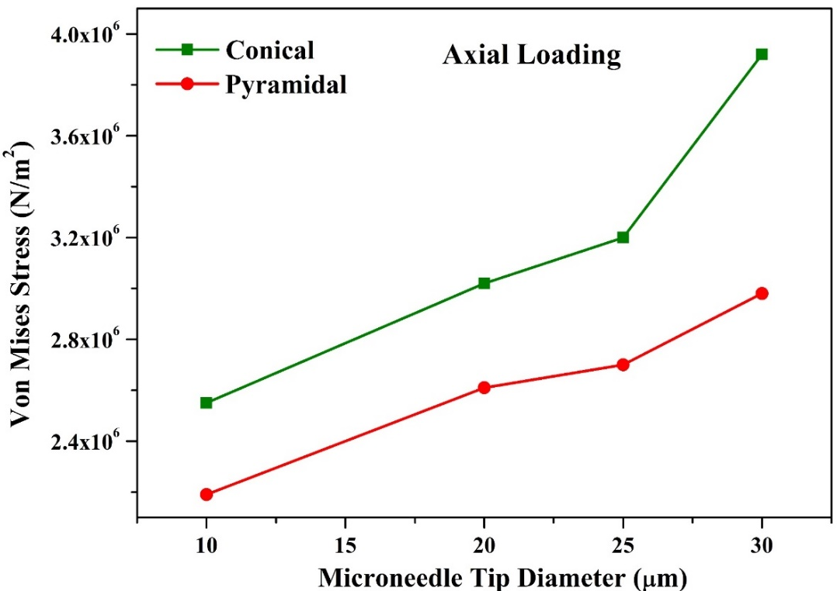
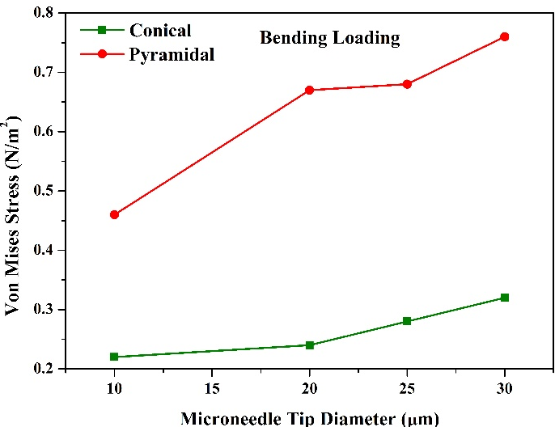
Variation of maximum stress with the tip width of microneedle under different loading condition
Axial Loading
Pressure
at tip
Fixed base
(a)
(b)
Bending Loading
Total force
Inference
Stress rises with the increase of the tip surface
Larger needle tip radius induce more pain at injection site
Maximum deflection occurs at the tip of microneedle under bending loading
conical structure with a circular tip has less bending and strong enough, so that it does not break when inserted inside the skin
Fixed base

Slide 11
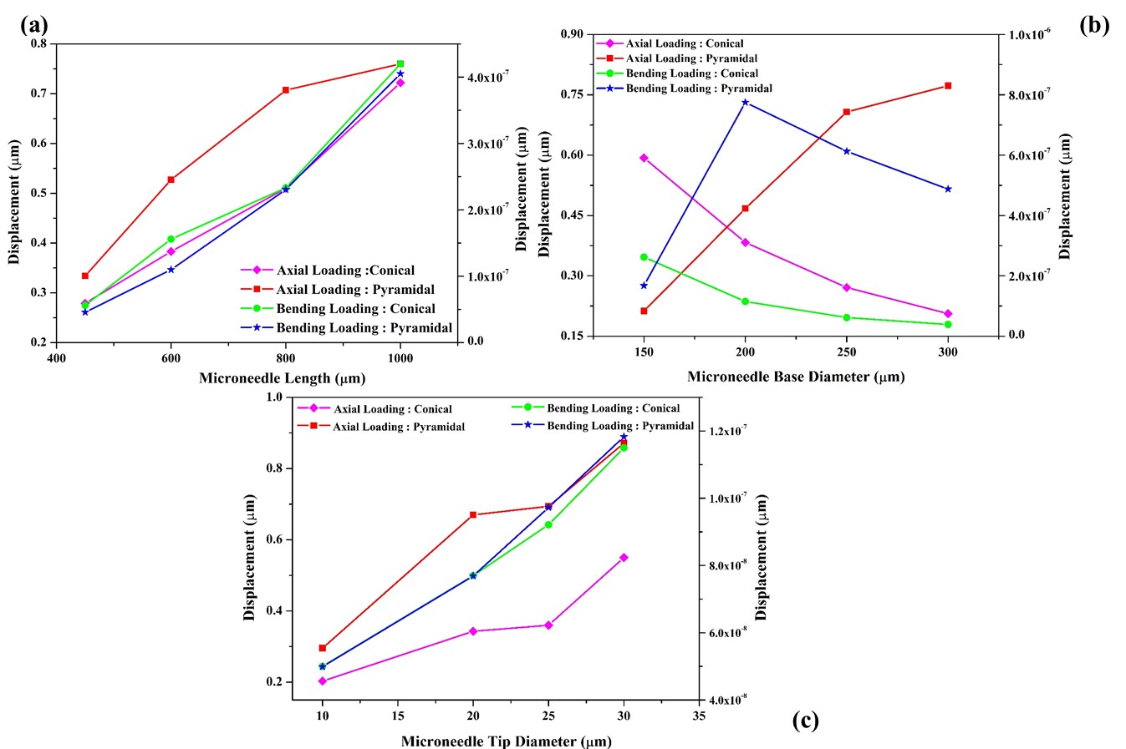
Structural Analysis of Hollow Microneedle
Fig. Variation of displacement under axial and bending loading a Length b Base Diameter c Tip diameter
Microneedle with a high displacement can cause a significant amount of pain, harm skin tissues, and accidentally break itself
Displacement gradually increases with microneedle length
Displacement increases as the base of the microneedle structure increases
Microneedle array with a tip diameter of 30 μm produces more displacement. Hence, a lesser tip surface results in smooth penetration into the human skin without breakage

Slide 12
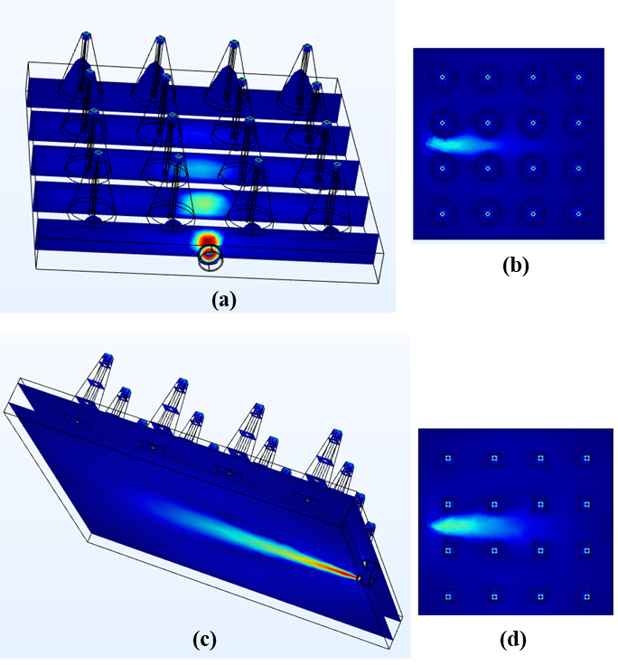
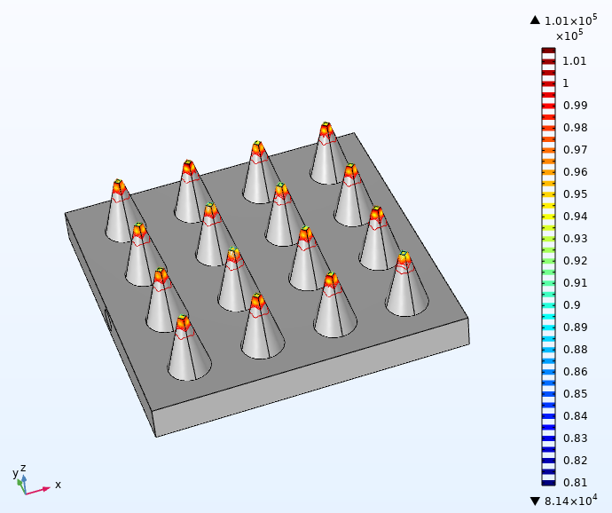
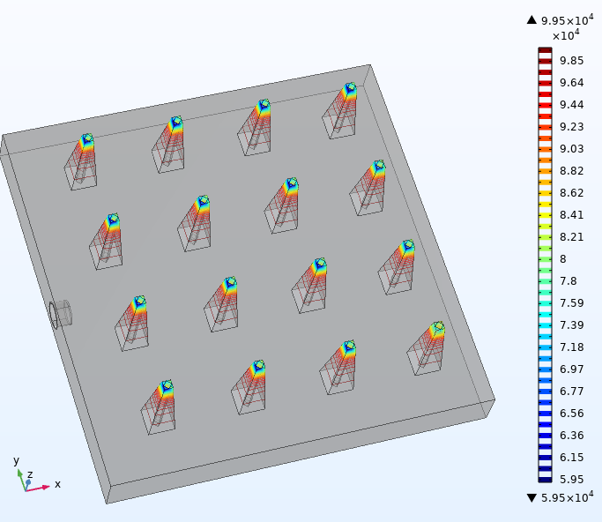
Microfluidic Analysis of Hollow Microneedle
Velocity Profile
Physics----→Fluid Flow----→Laminar Flow
Pressure Distribution
(a)
(b)
Fig.6 Pressure Distribution for 4 × 4 microneedles array with water as fluid for a Conical Microneedle array and b Pyramidal Microneedle array (H=600µm, D_{base}=200µm, D_{tip}=30µm)
Fig.5 Velocity Profile across the plane in CFD analysis. a,c 3D view of a conical and pyramidal MN array with uniform velocity distribution. b,d Top view of the velocity distribution of fluid flow in conical and pyramidal microneedle array (H=600µm, D_{base}=200µm, D_{tip}=30µm)

Slide 13
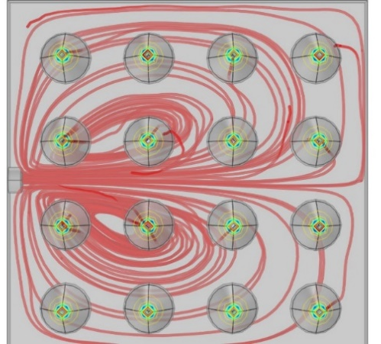
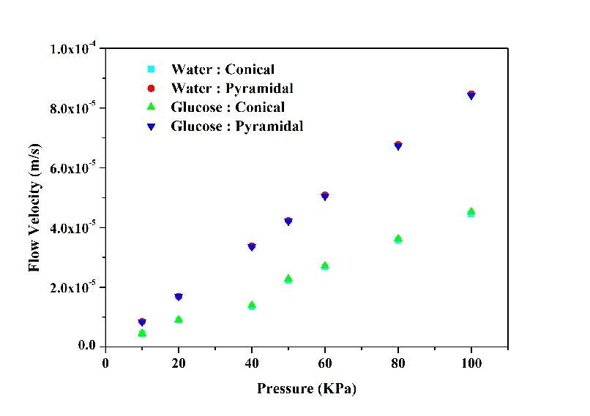
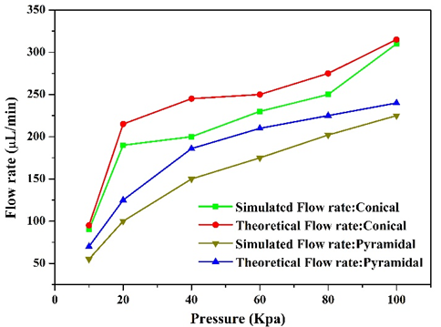
Microfluidic Analysis of Hollow Microneedle
Fig.7 Top view of streamline distribution of water fluid at a pressure of 100Kpa
Fig.8 Velocities of different fluids in relation to inlet pressures
Fig.9 Comparison of theoretical and simulation flow rate of water with variation in applied pressure
velocity increases with the increase of inlet pressure
velocity changes with fluid viscosity, water has a higher velocity than glucose
flow rate is high for a low viscous fluid, flow rate of the water is higher compared to glucose

Slide 14
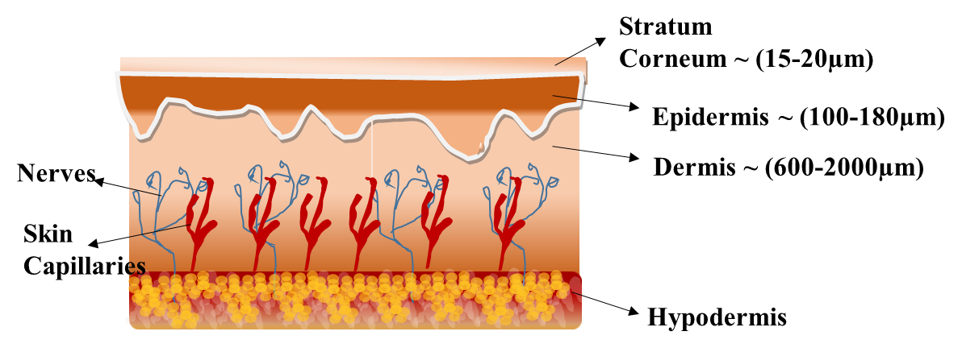
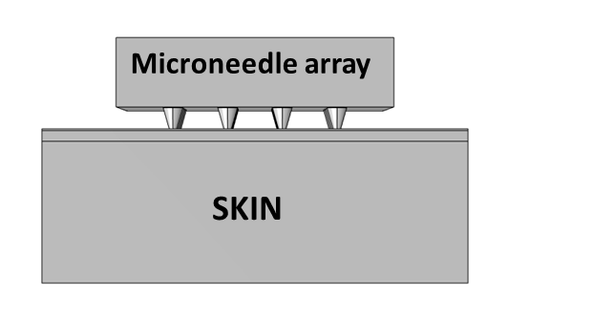
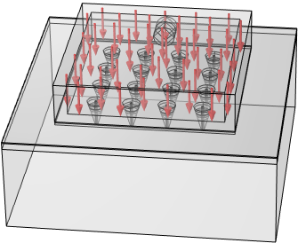
Skin Insertion analysis of Hollow Microneedle
Force
Stratum Corneum ~ 20µm
Epidermis ~150µm
Dermis ~ 2000µm
Fig.10 Schematic representation of Human skin and its layers
Fig.11 Geometrical representation of 4x4 microneedle array and skin layer
Parameters | Stratum corneum | Epidermis | Dermis
Density (Kg/m³) | 1300 | 1200 | 1200 (Z. Chen et al. 2018)
Poisson’s ratio (Boonma, Narayan, and Lee 2013) | 0.49 | 0.42 | 0.42
Young’s Modulus MPa | 0.02 | 1 | 100
Thickness (µm) | 20 | 150 | 2000
Fig.12 Top view representation of multi-layered skin model with 4x4 array of microneedle penetration

Slide 15
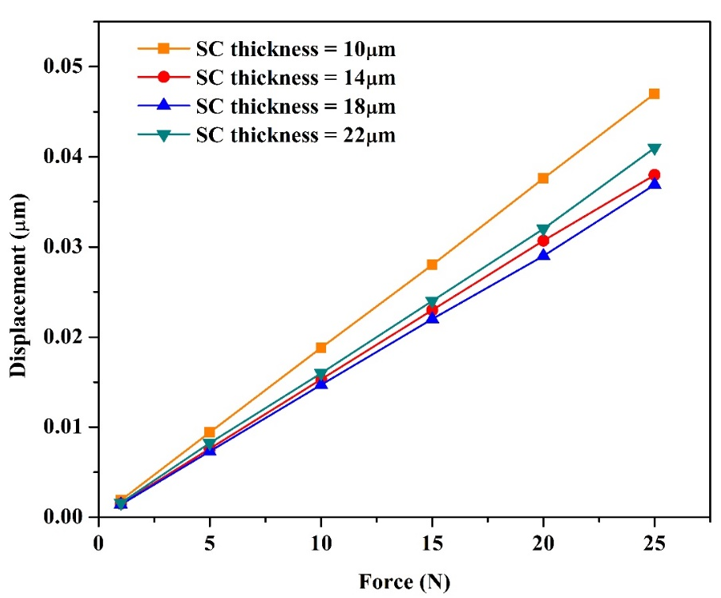
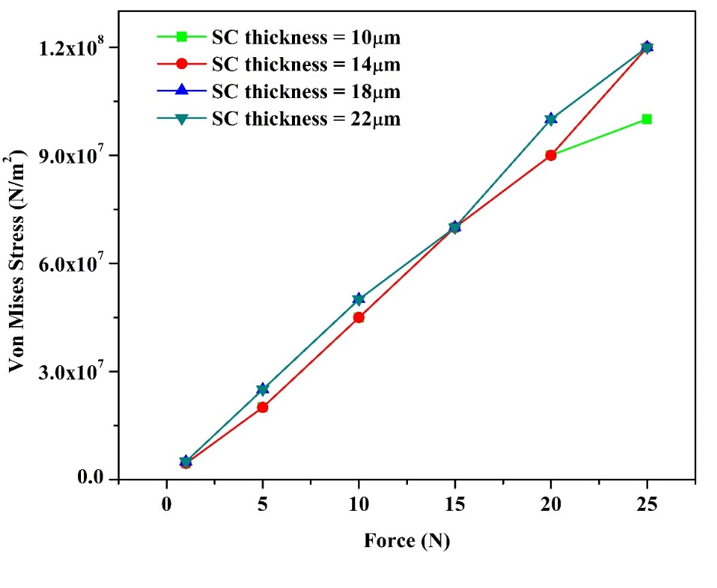
Skin Insertion Analysis of Hollow Microneedle
Fig.13 (a) Von mises stress variation for different thickness of stratum corneum
(b) Displacement changes for different thickness of stratum corneum
Von mises stress occurrence is higher for the stratum corneum layer with more thickness
Possibility of stress occurrence of the microneedle array on older people’s skin is much higher
Skin with a thicker stratum corneum layer requires more force on the microneedle array to reach the epidermis layer during penetration
Displacement increase with the minimum thickness of the layer with the deeper penetration

Slide 16
Conclusion
4x4 hollow PVA microneedle array with centered cylindrical lumen is designed and simulated for the controlled drug delivery system.
The various microneedle geometry structures (conical, pyramidal) and parameters (length, base and tip diameter) has been considered for the structural and microfluidic analysis.
Increasing the length of the needle increased maximum stress and has increased chance of instability.
The increase in base diameter will decrease the stresses and deflections and enhancing the stability of the structure with increased penetration percentage.
The microneedle with larger needle tip diameter induce more pain at injection site.

Slide 17
Conclusion
The stress generated proved that the microneedle would remain intact for the applied pressure of 3.16 MPa
It was discovered that a sharp conical tip produces less tension, which leads to painless drug distribution
Fluidic analysis shows that high viscous fluid has lower velocity profile and vice versa.
Similarly, the flowrate of water for conical microneedle were 320µL/min and for pyramidal microneedle array were 230µL/min at 100KPa inlet pressure

Slide 18
References
Anbazhagan, G., Suseela, S.B. & Sankararajan, R. Design, analysis and fabrication of solid polymer microneedle patch using CO2 laser and polymer molding. Drug Deliv. and Transl. Res. (2023).
Anbazhagan, G., Suseela, S.B. & Sankararajan, R. Effect of hollow microneedle geometry structure on mechanical stability and microfluidic flow for transdermal drug delivery applications. Microfluid Nanofluid 27, 25 (2023).
Karumuri, S.R., Mohammed, H., Guha, K., Puli, A.K., Einsanwi, A. and Kondavitee, G.S. (2021), Design, simulation and analysis of micro electro-mechanical system microneedle for micropump in drug delivery systems. IET Nanobiotechnol, 15: 484-491.
Yan, Qinying, Jiaqi Weng, Shulin Shen, Yan Wang, Min Fang, Gensuo Zheng, Qingliang Yang, and Gensheng Yang. 2021. "Finite Element Analysis for Biodegradable Dissolving Microneedle Materials on Skin Puncture and Mechanical Performance Evaluation" Polymers 13, no. 18: 3043.
Md Asadujjaman Sawon, Mst Fateha Samad, Design and optimization of a microneedle with skin insertion analysis for transdermal drug delivery applications, Journal of Drug Delivery Science and Technology, Volume 63,2021.
Chen, Shuhu, Nannan Li, and Jing Chen. 2012. “Finite Element Analysis of Microneedle Insertion into Skin.” Micro and Nano Letters 7 (12): 1206–9. https://doi.org/10.1049/mnl.2012.0585.
Boonma, Apichart, Roger J. Narayan, and Yuan Shin Lee. 2013. “Analytical Modeling and Evaluation of Microneedles Apparatus with Deformable Soft Tissues for Biomedical Applications.” Computer-Aided Design and Applications 10 (1): 139–57. https://doi.org/10.3722/cadaps.2013.139-157.

Slide 19
Thank You

