Slide 1

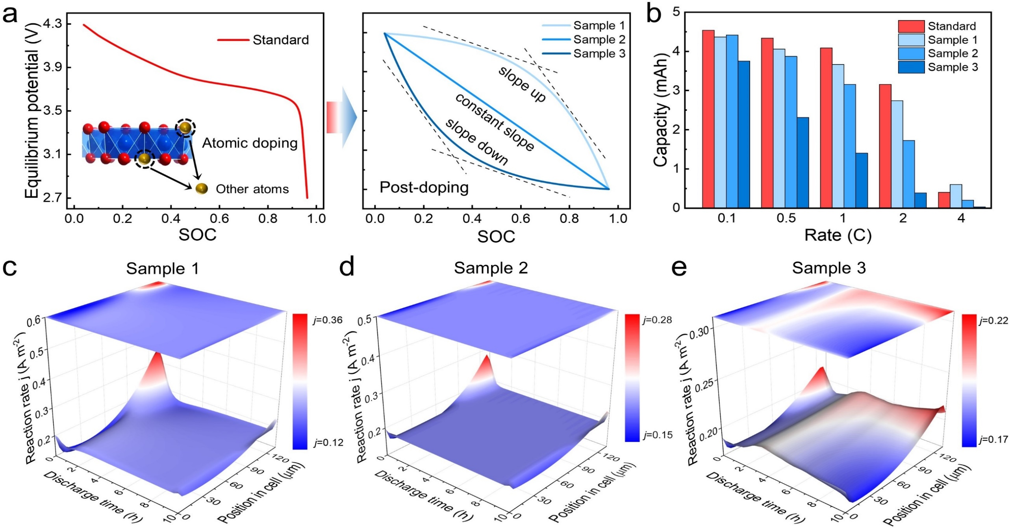
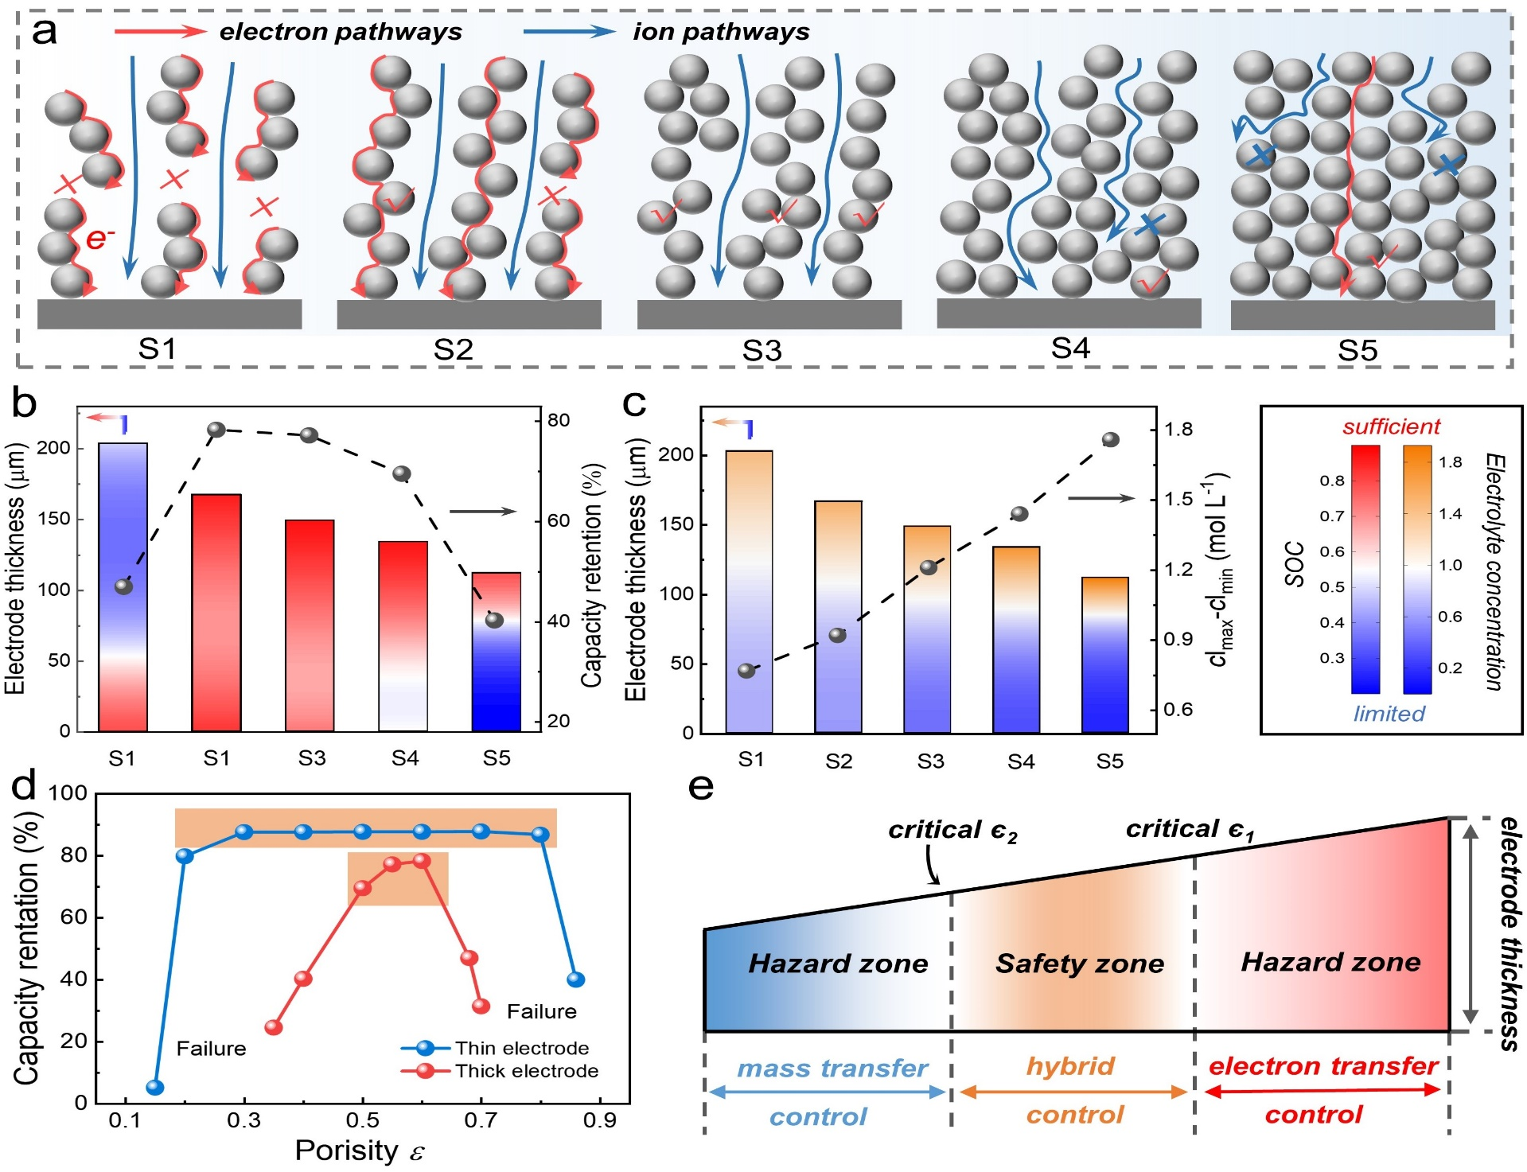
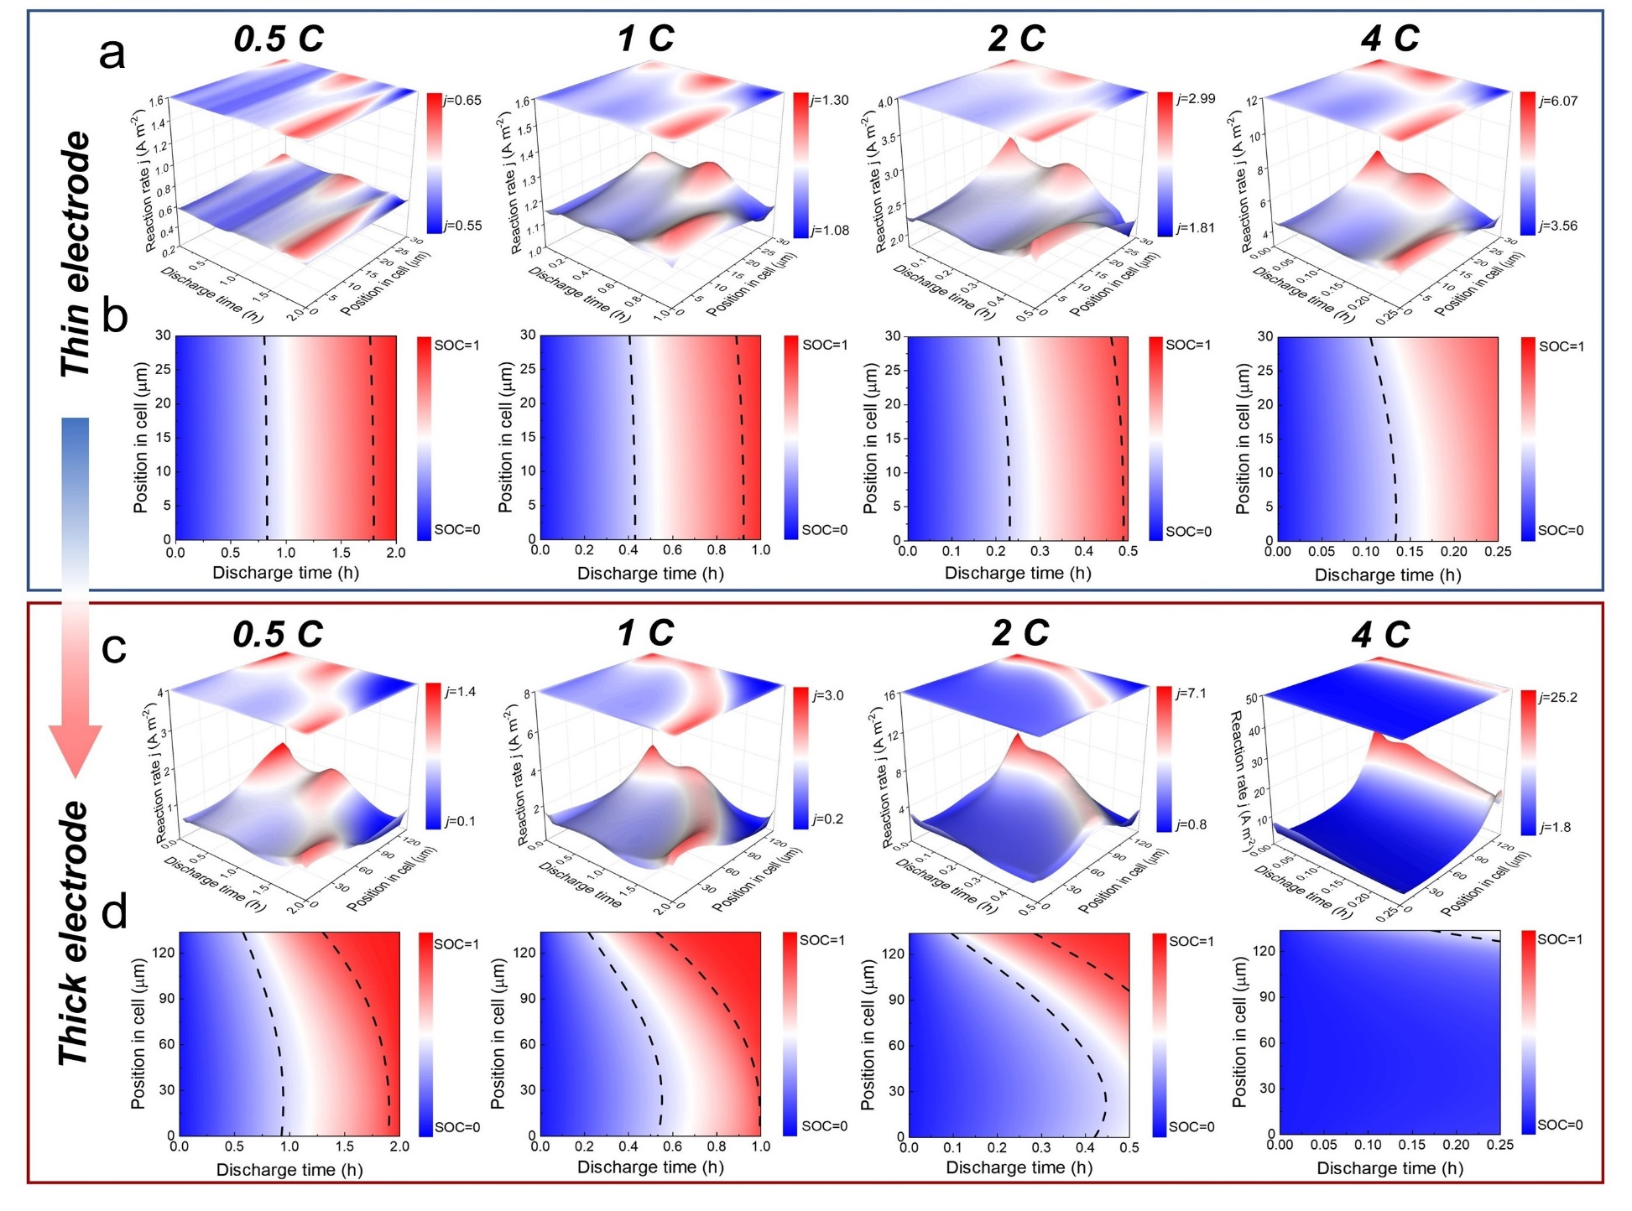
Rational Design of Thick Electrodes in Lithium-Ion Batteries by Re-understanding the Relationship Between Thermodynamics and Kinetics
Kang Fu, Xueyan Li, Kai Sun, Zhuojun Zhang, Haosong Yang, Lili Gong, Guangzhao Qin, Di Hu, and Peng Tan*
Department of Thermal Science and Energy Engineering, University of Science and Technology of China (USTC), Hefei 230026, Anhui, China
Introduction
As the demand for energy and environmental sustainability increases, there is an urgent need to explore novel battery technologies to further improve energy and power densities. Electrode structural engineering provides a universal and feasible approach to further improve energy density. Among them, increasing electrode thickness is the most direct method. However increasing the electrode thickness usually results in severe performance degradation. Traditionally, kinetic effects are considered in constructing thick electrodes, such as decreasing the tortuosity to facilitate ion transport.
Indeed, electrode processes are related to both kinetics and thermodynamics, but the influence of thermodynamics has long been neglected. Electrode materials with tilted equilibrium potentials tend to exhibit better multiplicative performance. Chen et al. also observed the phenomenon of fluctuating Li+ concentration and emphasized the influence of this thermodynamic factor on the electrode process. This inspired us to develop a new approach to prepare high-performance thick electrodes by altering the thermodynamic properties, e.g., through atomic doping interfacial engineering, and material blending [50]. These studies have shown that in addition to improving the kinetic properties, changing the thermodynamic properties is also a method worth considering to improve the performance of electrodes.
Figure 2. Effect of equilibrium potential curve law on electrode performance.
Kinetic constraints are the essential factor causing deterioration of electrode performance. The thin and thick electrodes were calendered to different degrees, and the simulation results showed that the thick electrodes were more sensitive to the control of porosity. Therefore, it is particularly important to ensure the synergistic control of electrode electrons and ions.
Kinetic and thermodynamic competing proofs of concept were performed. By introducing vertical channels in the electrodes, thermodynamics is allowed to re-dominate the electrode process and the electrode local current density distribution becomes more uniform.
Methods
To prepare the cathode, NCM622, polyvinylidene difluoride (PVDF), and conductive carbon black were weighed at a ratio of 90:5:5 and thoroughly mixed. After drying, an appropriate amount of 1-NMethyl-2-pyrrolidone (NMP) solution was added to the powder, and the mixture was stirred for 2 hours using a temperature-controlled magnetic stirrer to obtain a homogeneous slurry. The slurry was then coated onto 16μm Al foil using a doctor blade method, with the electrode loading controlled by adjusting the blade height. The coated electrode was dried in a vacuum drying oven at 80 °C for 12.
Figure 3. Simulation of thin and thick electrodes at different calendering levels.
Results
Kinetic constraints lead to inhomogeneous lithiation of the electrode, whereas the tilted phase of the equilibrium potential curve promotes homogeneous lithiation of the electrode. For thin electrodes, the electrode process is mainly dominated by thermodynamics, while thick electrodes will be dominated by kinetics at high rates.
The degree of inclination of the equilibrium potential curve determines the thermodynamic regulation. Tailoring of the equilibrium potential curve can theoretically be achieved by multiatomic multicomponent doping. The influence law of different equilibrium potential curves on the electrode performance is shown in Fig. In fact, battery performance and energy density are more of a trade-off process.
Conclusions
This work innovatively investigates the coupling effect of kinetics and thermodynamics on electrode processes and conducts a competitive analysis between them The results indicate that a sloping equilibrium potential curve facilitates the uniform utilization of electrodes, but severe kinetic constraints render the thermodynamic regulation ineffective. Thus, modifying the thermodynamic properties of the electrode to strengthen the regulatory effect is a promising approach. Kinetic constraints are the inherent factors limiting the capacity release of batteries. An in-depth analysis reveals that ensuring the hybrid control of ions and electrons can significantly alleviate kinetic reaction heterogeneity. This work provides a more comprehensive perspective and represents a significant breakthrough in guiding electrode design to achieve a higher energy density.
Figure 1. Visualization of the electrode reaction process based on
Bibliography
K. Fu, X.Y. Li, K. Sun, Z.J. Zhang, H.S. Yang, L.L. Gong, G.Z. Qin, D. Hu, T. Li, P. Tan*. Rational Design of Thick Electrodes in Lithium-Ion Batteries by Re-Understanding the Relationship Between Thermodynamics and Kinetics. Advanced Functional Materials, 2024, 2409623.
K. Fu, X.Y. Li, K. Sun, H.S. Yang, L.L. Gong, P. Tan*. Tuning the electrochemical performance of graphite electrodes in lithium-ion batteries: Thermodynamics versus kinetics. Journal of Power Sources, 2024, 606, 234568.
K. Fu, X.Y. Li, K. Sun, P. Tan*. Clarifying the limiting factor of material utilization in thick electrodes of lithium-ion batteries. Journal of Power Sources, 2024, 591, 233880.
Excerpt from the Proceedings of the COMSOL Conference 2024 Shanghai

