Slide 1


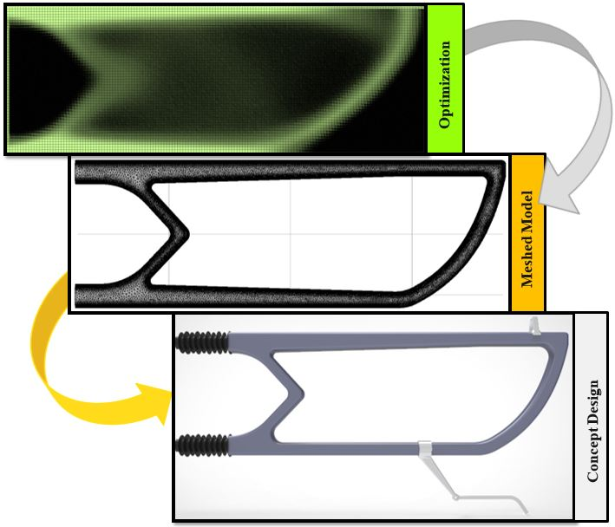
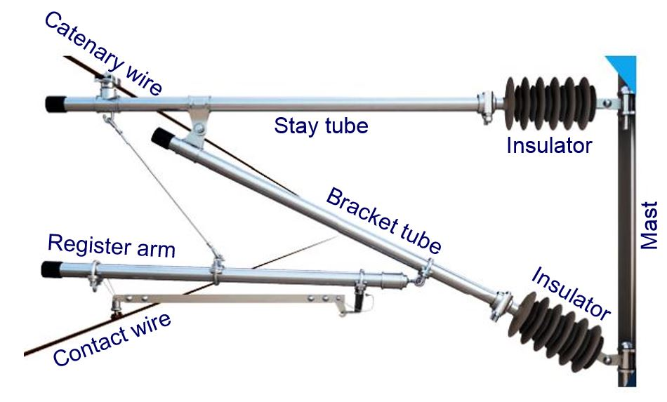
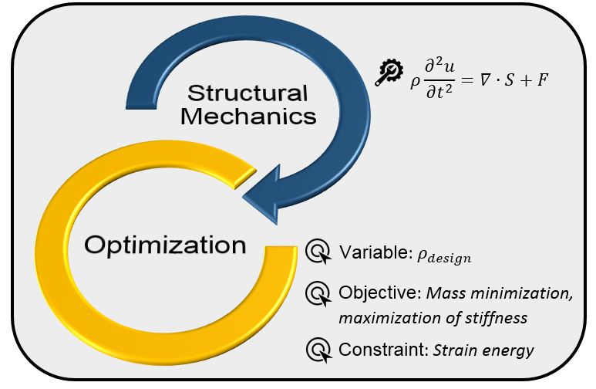
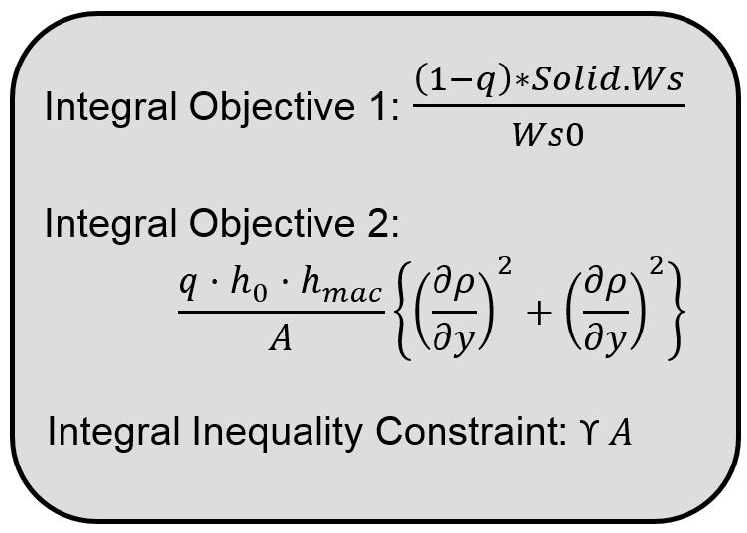
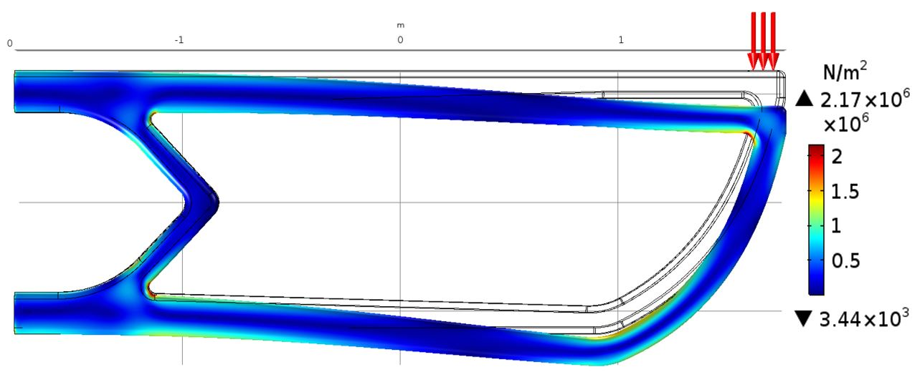
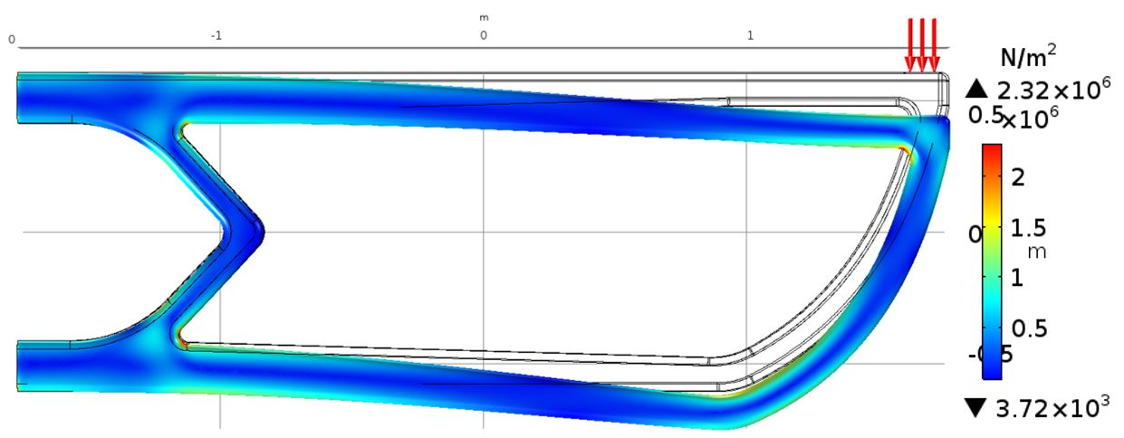
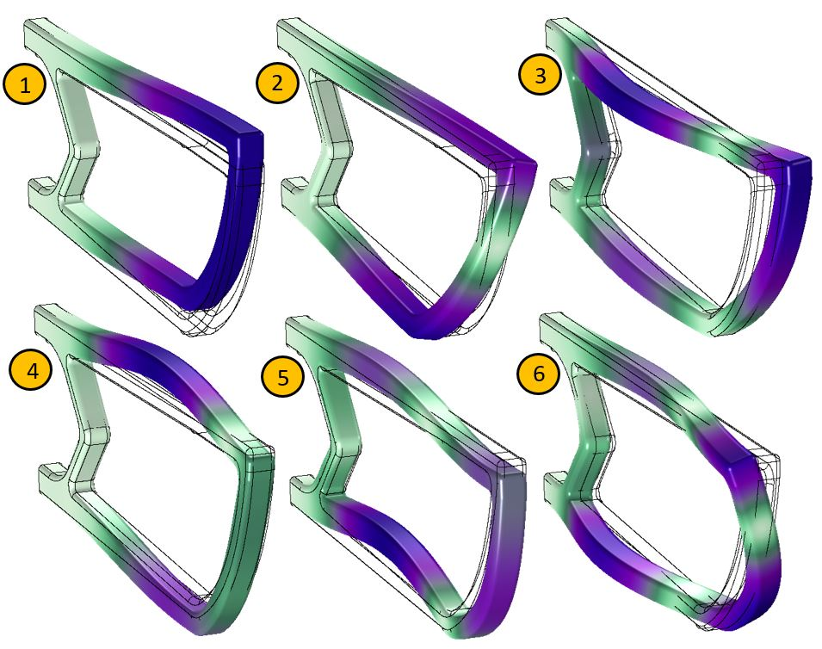
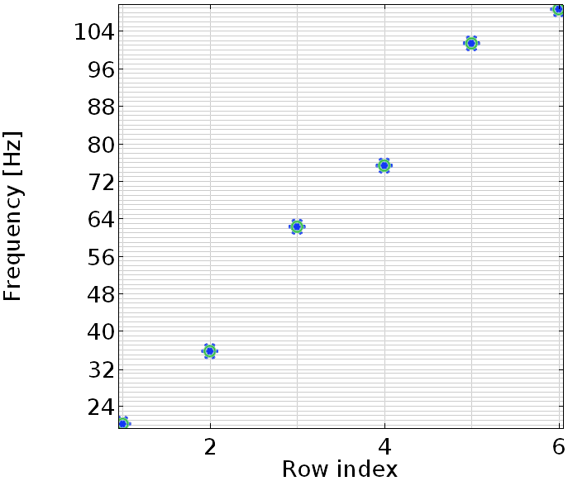
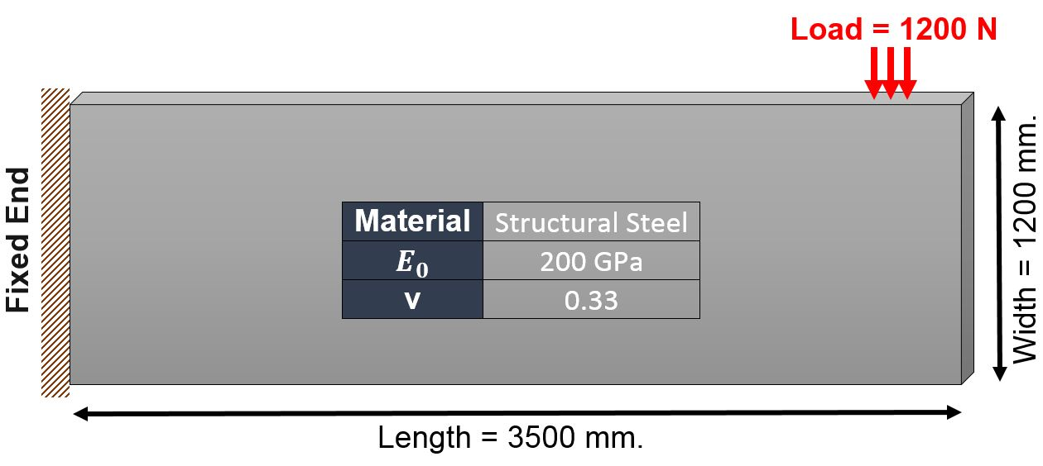

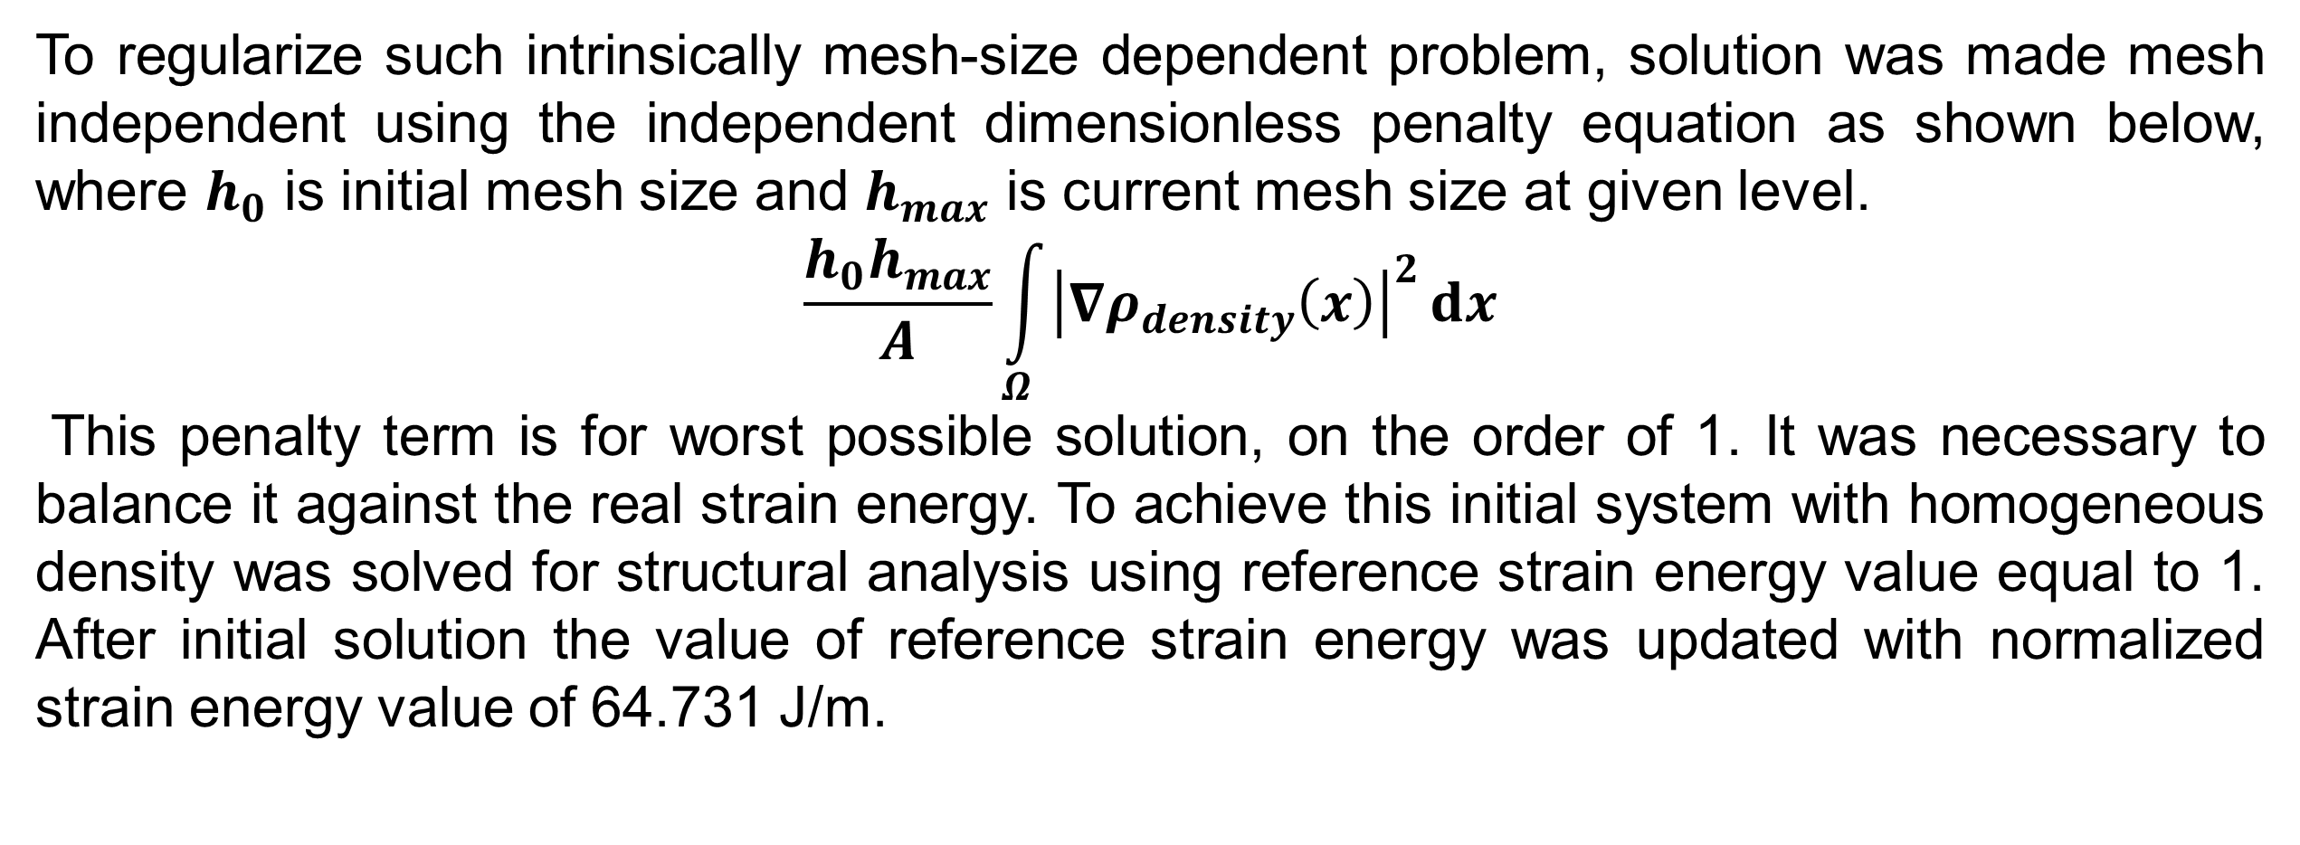
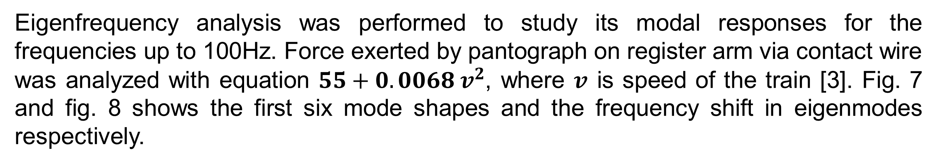
Optimization and Analysis of Modular Cantilever using Finite Element Approach
S. R. Zanje, I. Jain
Material & Processing Dept., Raychem RPG Ltd., Halol, GJ, India
Introduction: Overhead modular cantilevers are basically designed to support the assembly of overhead power transmission wires i.e. catenary (1000/1200 kgf tension), contact (1000/1200 kgf tension) and droppers to transfer the overall bending, transverse and vertical load to the mast via insulators (Fig. 1). There are few characteristics that quintessential cantilever should satisfy such as light weight and robust enough to support the current carrying assembly with trains speed 200 kmph (minimum) [1]. Now days along with above mentioned properties railway sector is also focusing on aesthetic, ease in maintenance, ease in transportation, ease in handling and other related issues. In this work, simulation model was established to study structural topology optimization to device the novel design of overhead modular cantilever to eliminate ancillary components by efficient use of material which ultimately saves both cost and material.
Results: Plot in fig. 4 shows the stiffness distribution for optimized solution. The resulted design was for the selected parameters such as material used and loading conditions. White area represents material where as the black areas represents void. Useful optimized design should be essentially in checkboard from unless composite material used for manufacturing. The study was performed with the regularization weight of q = 0.1 to get sharp result without altering the topology.
Figure 1. PPA International modular cantilever with key components.
Computational Methods: Model describes optimal distribution of slab with dimension of 3.5 meters by 1.2 meters with the thickness of 0.18 meters acting as a cantilever beam with the load of 1.2kN applied at its one end. Clearly initial model was overdesigned as stresses are unevenly distributed and hence not making effective use of the material. For optimization minimization of total strain energy set as an objective function along with the minimization of total mass criteria. The detailed flow of simulation is shown in fig. 2 in which solid mechanics represents structural properties of model while optimization interface forcing constraints, variables and objective.
The SIMP (Solid Isotropic Material with Penalization) method used to accomplish the significantly binary topology checkboard pattern with stress tensor mentioned below, with artificial density $ρ_{density}$ and Young’s modulus $E_{0}$ [2].
$E\left(x\right)=ρ_{density}{\left(x\right)}^{p}E_{0}$, $x∈Ω$
Penalty factor $p$ which makes intermediate density provides less stiffness compared to what they cost in weight with value greater than or equal to one. Basically attempt was to minimize the amount of material without violating the strain energy constrain. MMA optimization solver was used due to its capability to generate quick and reliable optimized topology with limited number of iterations for model with successively finer meshes.
Figure 4. Optimized shape used to create new cantilever design- Optimized model using SIMP model (Top), meshed 3D CAD model of devised concept (middle), generated modular concept using previous knowledge and specifications (bottom)
With optimization there was 72.3% reduction in mass of the system compared to the initial geometry (Fig.3) used under study without violating the specifications. 3D model created using optimized study later subjected to structural analysis and eigenfrequency analysis.
Figure 5. Equivalent stress: von misses stress
Figure 6. Equivalent stress: Tresca stress
In fig. 5 and fig.6, the equivalent stresses of the types ‘von misses’ and ‘’Tresca’ are shown, respectively. The type of material used for the structure is structural steel has yield strength, Ϭ = 250MPa (minimum), which is much higher compare to the observed maximum induced equivalent stress (2.32MPa). This leads to the space where we can further modify the design.
Figure 2. Physics interface and conditions with simulation work-flow
Eigenfrequency analysis was performed to study its modal responses for the frequencies up to 100Hz. Force exerted by pantograph on register arm via contact wire was analyzed with equation $55+0.0068 v^{2}$, where $v$ is speed of the train [3]. Fig. 7 and fig. 8 shows the first six mode shapes and the frequency shift in eigenmodes respectively.
Figure 7. Six first eigenmode shapes
Figure 8. Six first eigenfrequencies
Figure 3. Initial geometry under optimization study
Conclusions: A simulation model was established to optimize the conventional overhead modular cantilever using topology optimization technique. Started with general block subjected to the practical loading conditions, conventional model was modified to enhance overall functionality with less components. Topology optimized model was used to create new design concept and later subjected to the structural analysis (strength and modes) to verify optimized results.
To regularize such intrinsically mesh-size dependent problem, solution was made mesh independent using the independent dimensionless penalty equation as shown below, where $h_{0}$ is initial mesh size and $h_{max}$ is current mesh size at given level.
$$\frac{h_{0}h_{max}}{A}\int_{Ω}{{\left|∇ρ_{density}\left(x\right)\right|}^{2}ⅆx}$$
This penalty term is for worst possible solution, on the order of 1. It was necessary to balance it against the real strain energy. To achieve this initial system with homogeneous density was solved for structural analysis using reference strain energy value equal to 1. After initial solution the value of reference strain energy was updated with normalized strain energy value of 64.731 J/m.
References:
“Performance specification for modular cantilever system (MCS) for 25 KV AC traction”, specification number: TI/SPC/OHE/MCS/0150(04/2015).
M.P. Bendsᴓe, “Optimization shape design as a material distribution problem”, Structural Optimization, vol. 1, pp. 193-202, 1989.
Cho Y. ”Numerical simulation of the dynamic responses of railway overhead contact lines to a moving pantograph, considering a nonlinear dropper.” J Sound Vib. 2008;315:433-454.

