Slide 1
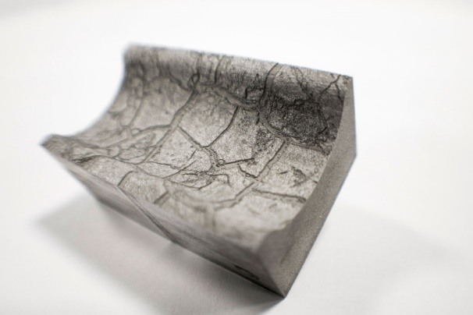
Femto-second laser texturing prediction using COMSOL Multiphysics ®
Elise Chevallier¹, Vincent Bruyère^{1,}*, G.Bernard² and Patrick Namy¹
¹SIMTEC, Grenoble, France
²GFMS, Meyrin, Switzerland
vincent.bruyere@simtecsolution.fr
25th September 2019

Slide 2
Content
Working with SIMTEC
Modelling for innovative application
How to model laser surface texturing?
Conclusions and future work

Slide 3
Content
Working with SIMTEC
Modelling for innovative application
How to model laser surface texturing?
Conclusions and future work

Slide 4

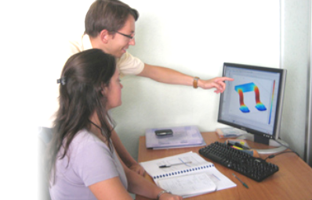
Working with SIMTEC
Industry Challenges
R&D sections: experts in their field
→ Expertise in numerical modelling?
Lack of time
FE modelling performed by a small group of people
SIMTEC’s Solutions
Numerical modelling project
  → SIMTEC’s member as your colleague
    Help improve your modelling knowledge!
    Cost-effective outsourcing

Slide 5





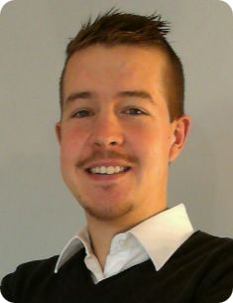




Our team & Our clients
Numerical Modelling Consultants
6 Members all EngD + PhD
  Extensive research background
  Complex problems
  Various fields of expertise
Successful Track Record:
  Big international compagnies
  Government laboratories
Involved in Research Consortia
  EU funded projects (REEcover / SHARK)
  PhD projects supervision.
Patrick Namy
Elise Chevallier
Vincent Bruyère
Jean-Marc Dedulle
Jean-David Wheeler
Maalek Mohamed-Said

Slide 6




















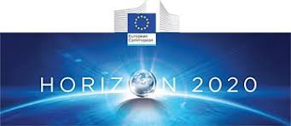
SIMTEC: 15 years of building expertise…
IV. Remote computation
I. Numerical modelling development
II. Tailored training sessions on numerical modelling
  FEM method training session
  Become an expert with solvers
  Two-phase flow modelling
III. Provide support in numerical modelling
  Discover more about our successful modelling work with clients!
  www.simtecsolution.fr

Slide 7


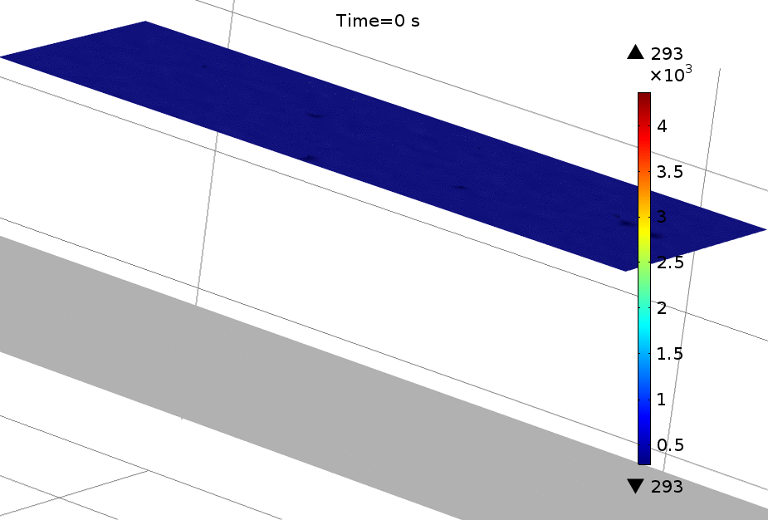
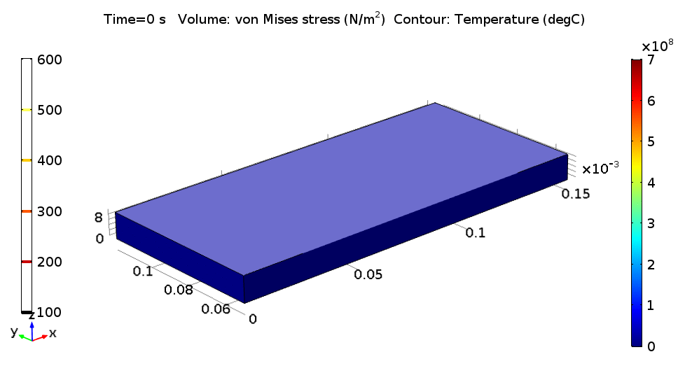
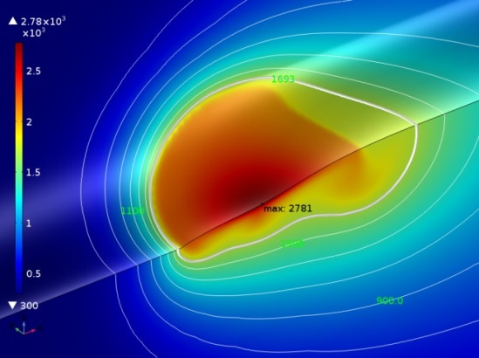
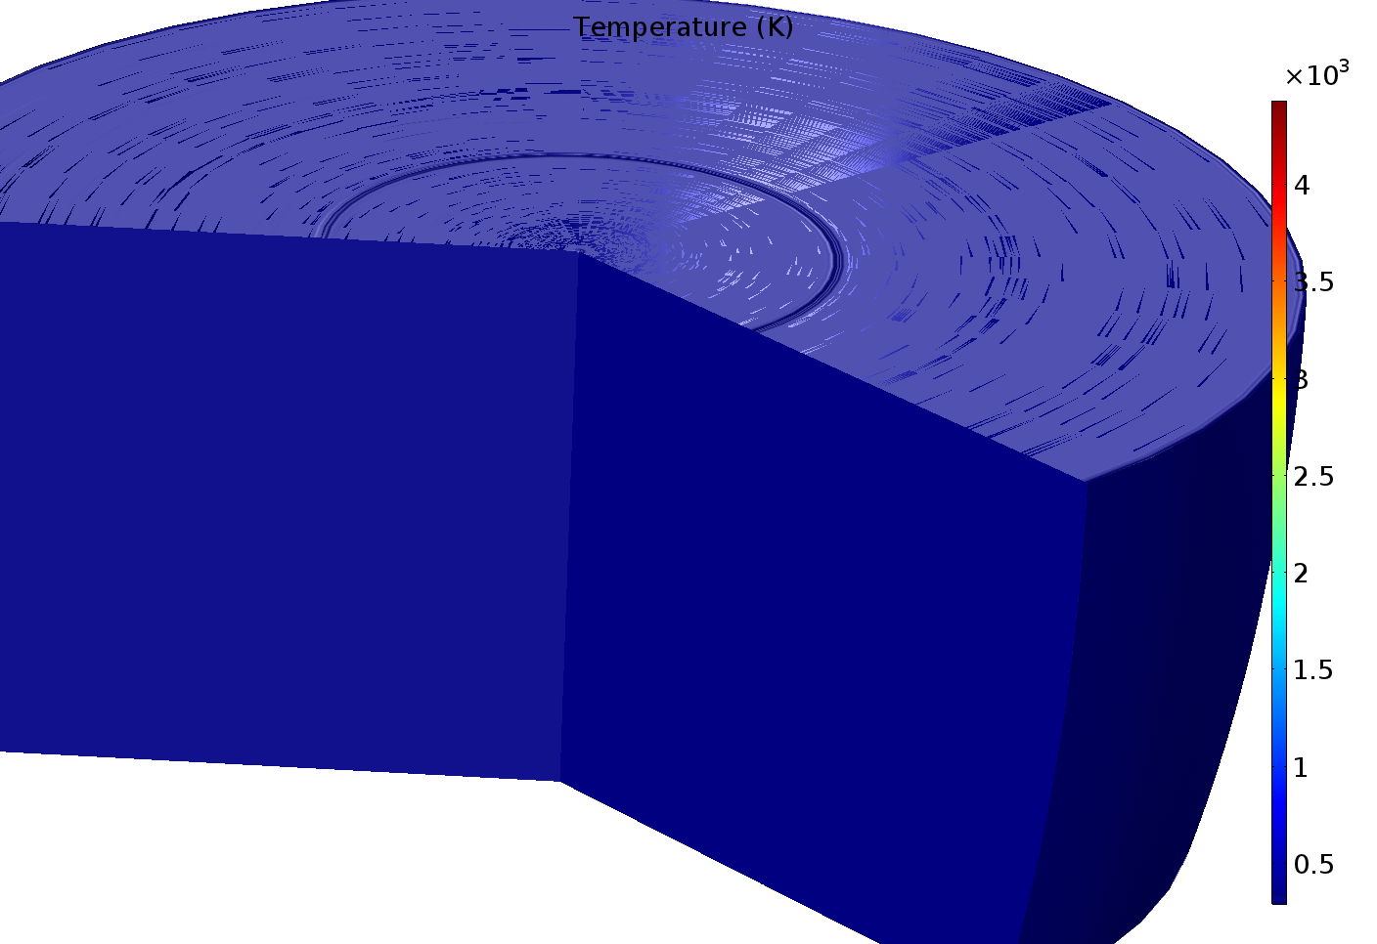
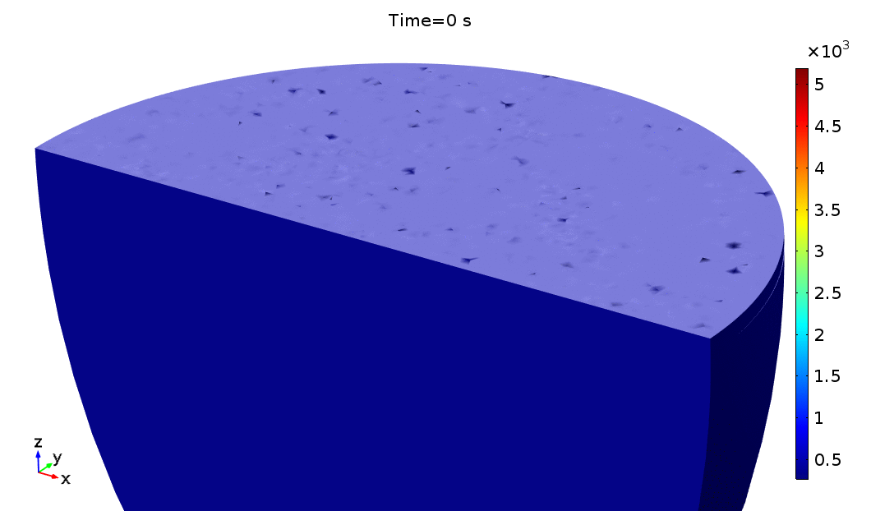
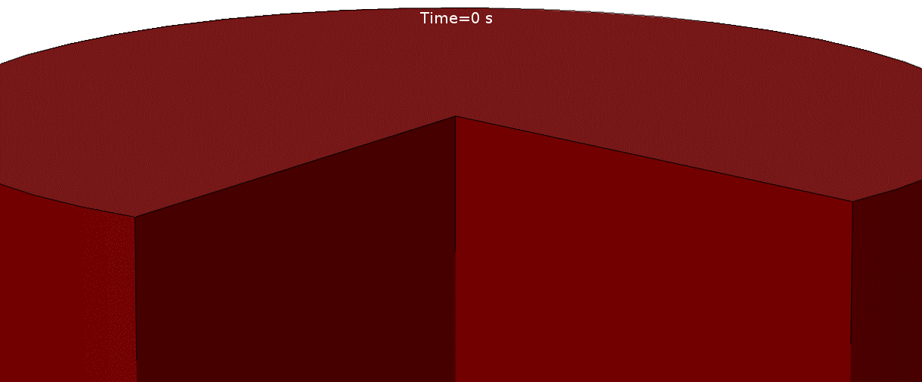
Laser/Assembly Process Modelling
Continuous Laser Welding
Additive Manufacturing
Arc Welding
Laser Drilling
Heterogeneous Laser Welding
Laser Surface Texturing

Slide 8
Content
Working with SIMTEC
Modelling for innovative application
How to model laser surface texturing?
Conclusions and future work

Slide 9
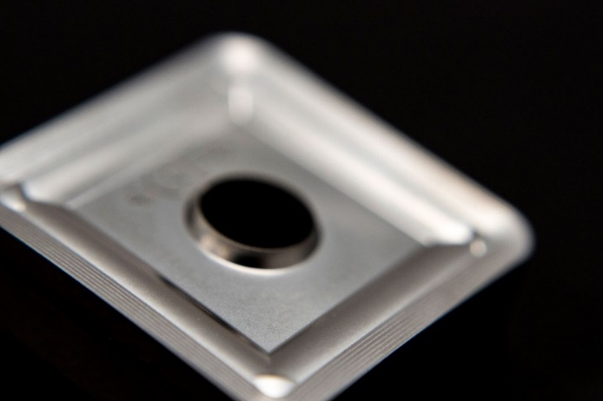
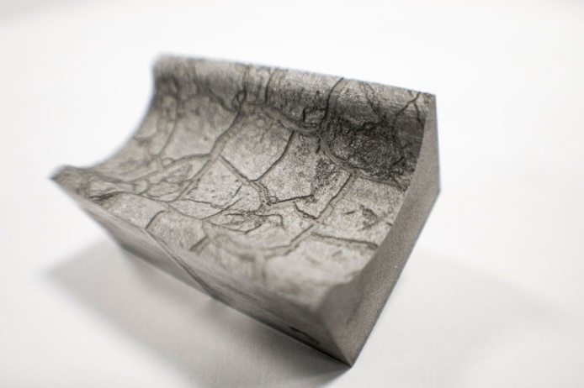
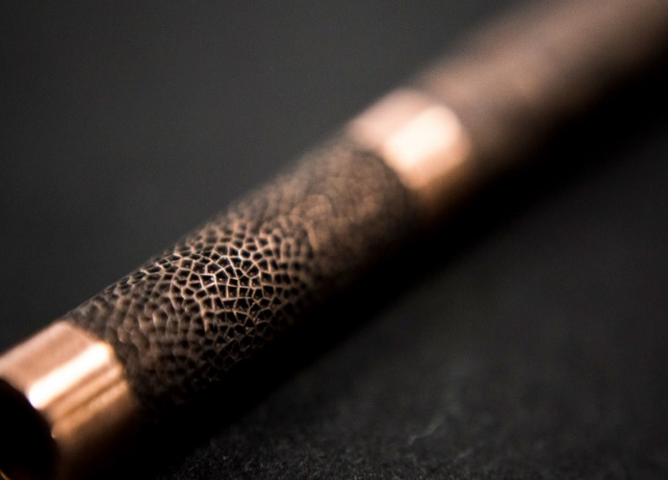
Context
Surface functionality
  Friction coefficient
  Anti-bacterial properties
  Anti-icing properties
Texturing processes
  Surface coating
  Laser surface texturing
SHARK project
  Bring laser surface texturing to industry
  Advise on the laser parameters selection

Slide 10

Context
User
  Specimen, shape, material
  Desired surface function
  Machine: - « laser parameters? »
  (frequency, pulse duration, average power …)
Surface function → Topography
Topography → Laser parameters
Direct problem
→ Topography prediction from a set of laser parameters

Slide 11
Content
Working with SIMTEC
Modelling for innovative application
How to model laser surface texturing?
Conclusions and future work

Slide 12
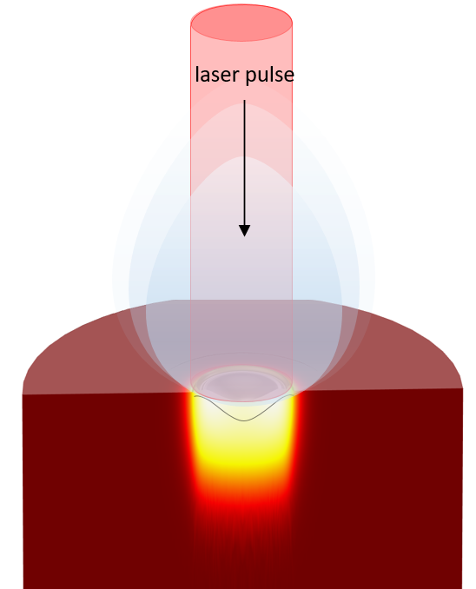
Modelling laser texturing
Physical phenomena and assumptions
  Topography prediction for different laser operating conditions
  Multiphysics and multiscale problem
M. Dal and R. Fabbro, Optics&LaserTechnology, no. 78, pp. 2-14, 2016.
A. Otto and M. Schmidt, Physics Procedia 5, pp. 35-46, 2010.
Vapour dynamics
pressure waves
Bernoulli effect
Absorption
Fresnel absorption
multiple reflections
vapour and plasma absorption
temperature dependent optical properties
Melt dynamics
melt expulsion, spilling formation
Marangoni convection
temperature dependent material properties
Heat tranfers
convective and conductive heat flux
melting and evaporation enthalpy
Phase transitions
melting and solidification
evaporation and condensation
vapour pressure on the interface
mass flux between phases

Slide 13
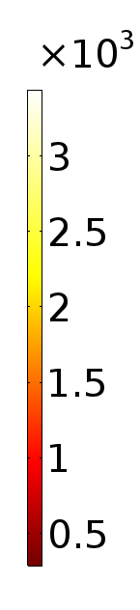
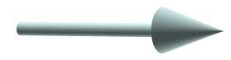
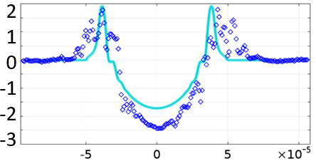
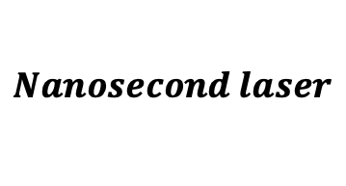
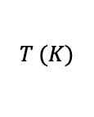
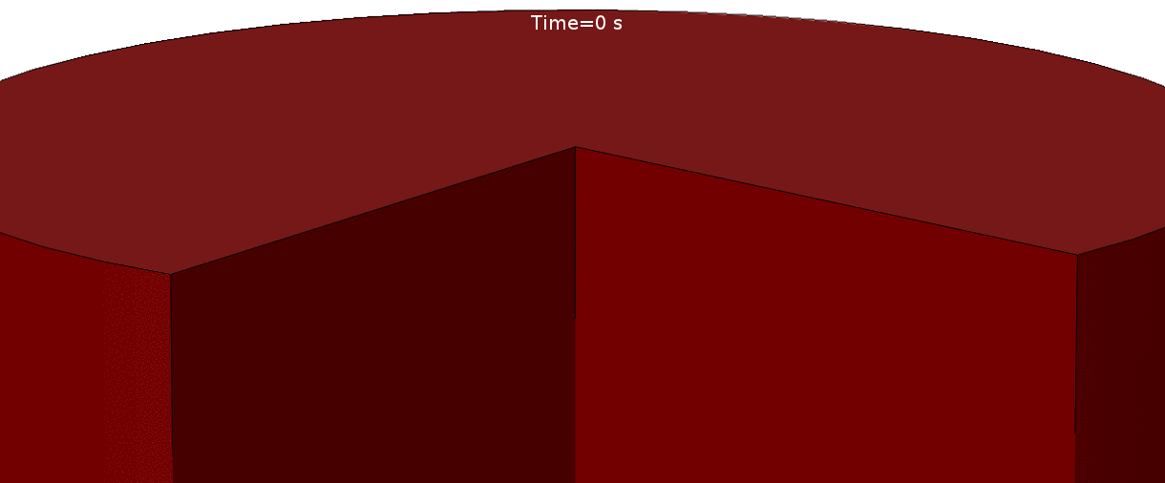

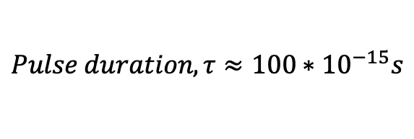
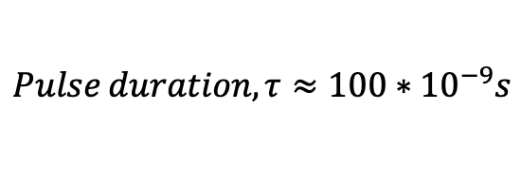
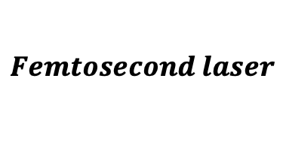
Modelling laser texturing
Different laser regimes
$$Nanosecond laser$$
$$Femtosecond laser$$
$$Pulse duration, {τ≈100∗10}^{−9}s$$
$$Pulse duration, {τ≈100∗10}^{−15}s$$
  One impact → 2D-axisymmetric geometry
  Fluid dynamics is taken into account
$$T (K)$$
  Literature review
  Development of a thermal model with ablation
Vaporised matter flux
Vaporised matter flux
Deformation x 20
  Comparison with experimental results
  Validation for one material
Distance away from crater centre $(m)$

Slide 14
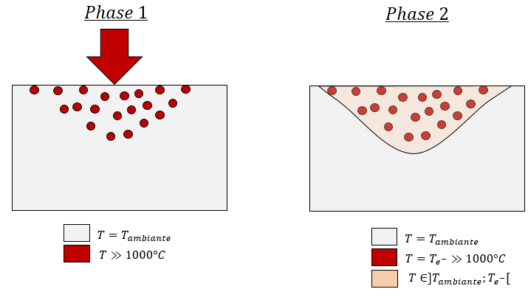
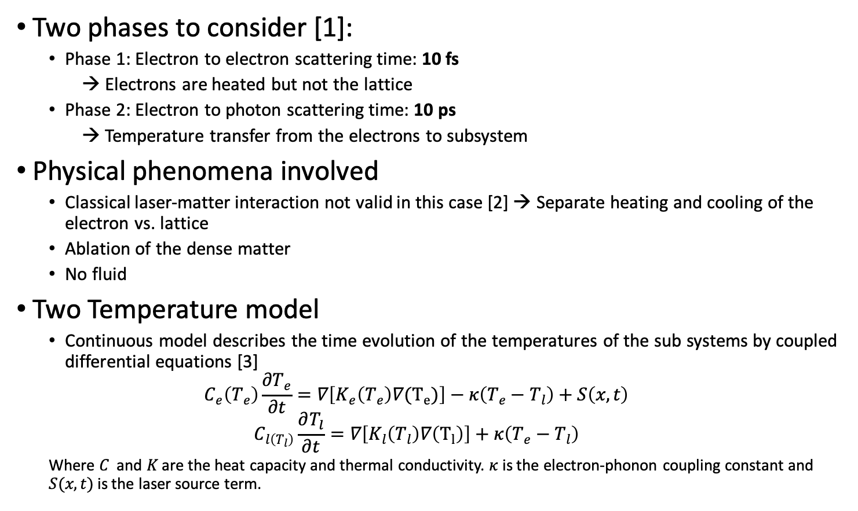
Modelling fs-laser texturing
Two phases to consider [1]:
  Phase 1: Electron to electron scattering time: 10 fs
  → Electrons are heated but not the lattice
  Phase 2: Electron to photon scattering time: 10 ps
  → Temperature transfer from the electrons to subsystem
Physical phenomena involved
  Classical laser-matter interaction not valid in this case [2] → Separate heating and cooling of the electron vs. lattice
  Ablation of the dense matter
  No fluid
Two Temperature model
  Continuous model describes the time evolution of the temperatures of the sub systems by coupled differential equations [3]
  $$C_{e}\left(T_{e}\right)\frac{∂T_{e}}{∂t}=∇\left[K_{e}\left(T_{e}\right)∇(T_{e})\right]−κ\left(T_{e}−T_{l}\right)+S\left(x,t\right)$$
  $$C_{l\left(T_{l}\right)}\frac{∂T_{l}}{∂t}=∇\left[K_{l}\left(T_{l}\right)∇\left(T_{l}\right)\right]+κ\left(T_{e}−T_{l}\right)$$
  Where $C$ and $K$ are the heat capacity and thermal conductivity. $κ$ is the electron-phonon coupling constant and $S(x,t)$ is the laser source term.

Slide 15
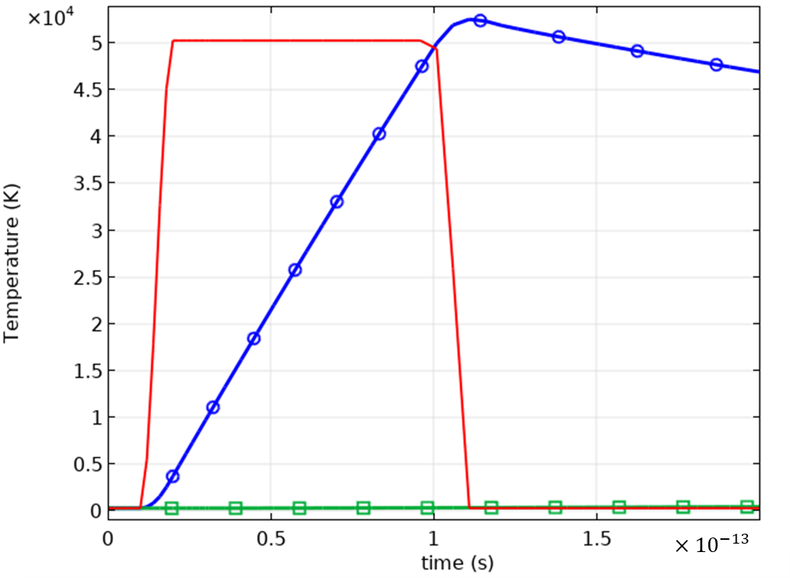
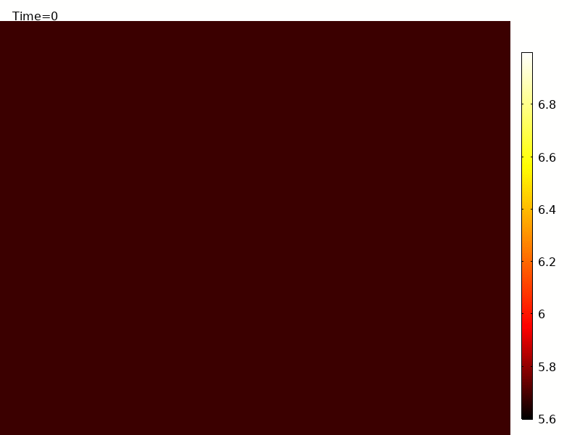
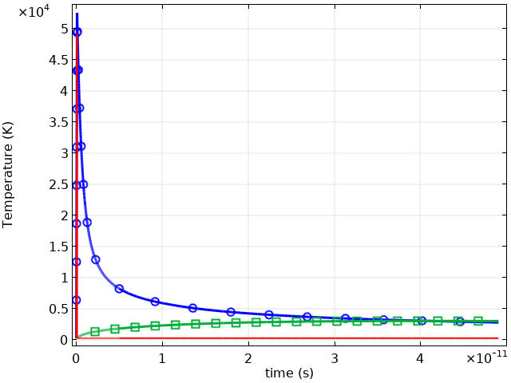


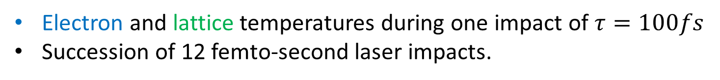
Modelling fs-laser texturing
Electron and lattice temperatures during one impact of $τ=100fs$
Succession of 12 femto-second laser impacts.
$$T/T^{∗}$$
$τ=100fs$

Slide 16
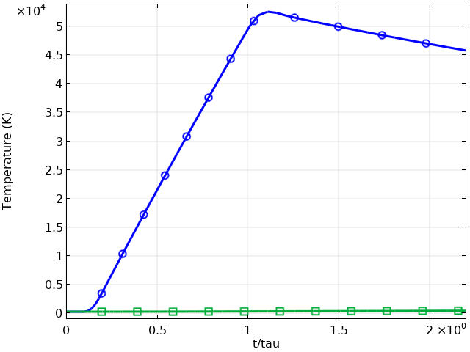
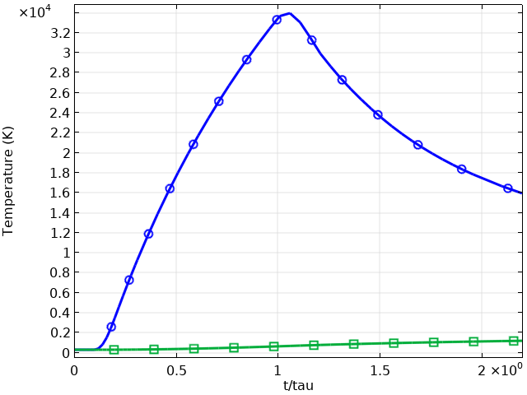
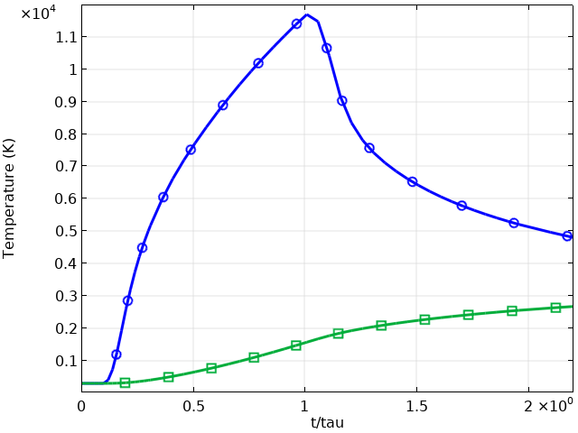
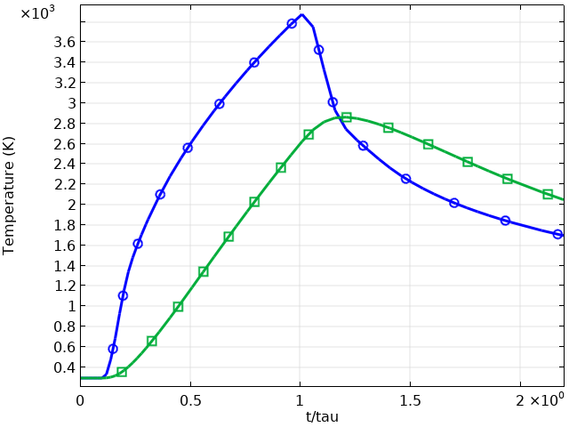
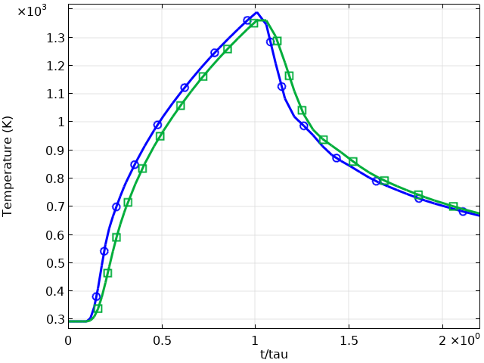
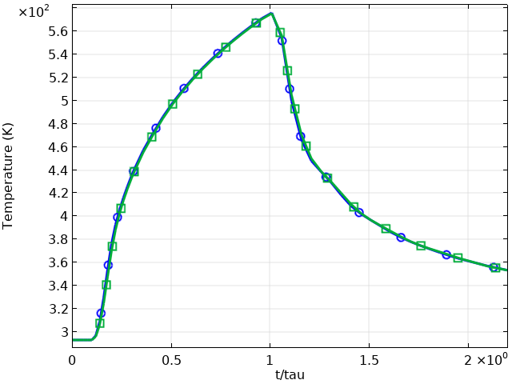

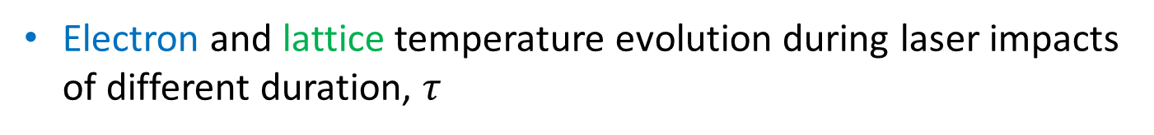





Modelling fs-laser texturing
Electron and lattice temperature evolution during laser impacts of different duration, $τ$
$τ=100fs$
$τ=1ps$
$τ=10ps$
$τ=100ps$
$τ=1ns$
$τ=10ns$

Slide 17


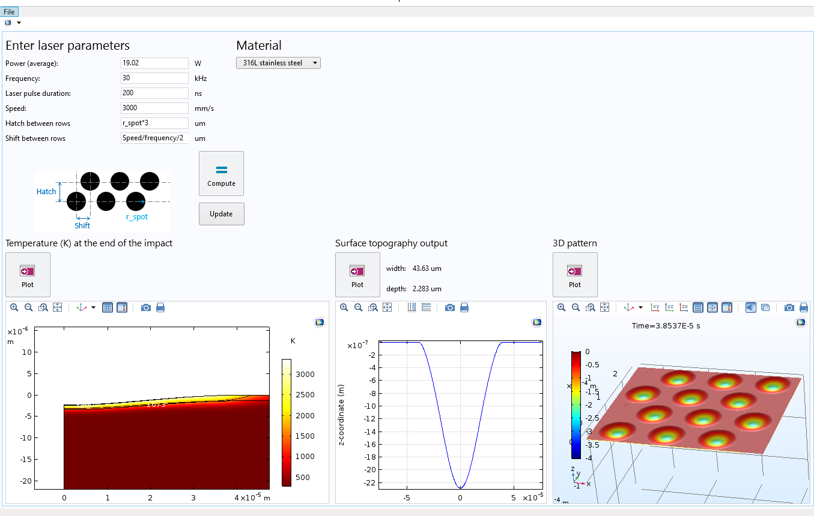
Application built from the model
Inputs
  Laser parameters
  Laser path
  Material (database)
Outcome
  Temperature field
  2D profile of a single impact
  (width, depth)
  Plot 3D pattern
Application ran on SIMTEC’s servers
15

Slide 18
Content
Working with SIMTEC
Modelling for innovative application
How to model laser surface texturing?
Conclusions and future work

Slide 19
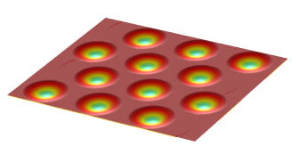
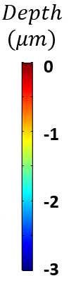
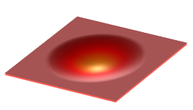
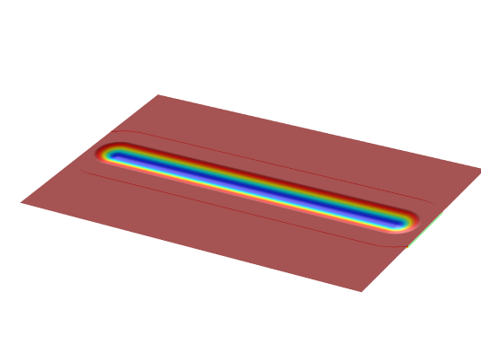
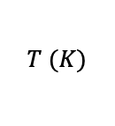
Summary and Future Work
$$T (K)$$
Numerical modelling approach of laser material interaction
Application for more than one impact, and effect of the initial surface
Future Work
Comparison of prediction against experimental measurements for femto-second laser impact
Application to grooves and more complex textures
17

Slide 20



Thank you !
References:
[1] A. Ji and Y. Zhang, Multiscale modeling of femtosecond laser irradiation on copper film with electron thermal conductivity from ab initio calculation.
[2] A. Tatra, R. Gomez Vasquez, C. Stiglbrunner and A. Otto, Numerical simulation of laser ablation with short and ultrashort pulses for metals and semiconductors, Physics Procedia (2016)
[3] K.-H. Leitz, B. Redlingshöfer, Y. Reg, A. Otto and M. Schmidt, Metal Ablation with Short and Ultrashort Laser Pulses, Physics Procedia (2011)

Slide 21
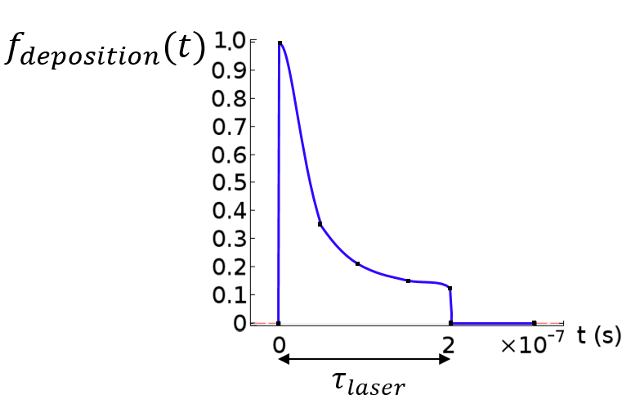
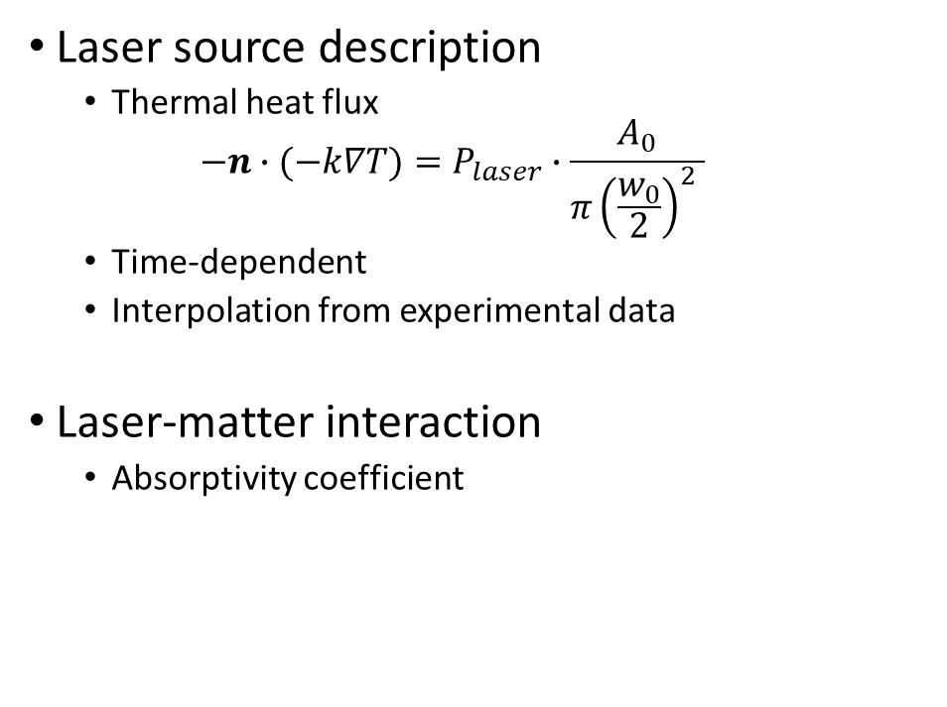
Electromagnetic problem
Laser source description
  Thermal heat flux
  $$−n∙(−k∇T)=P_{laser}∙\frac{A_{0}}{π{\left(\frac{w_{0}}{2}\right)}^{2} }$$
  Time-dependent
  Interpolation from experimental data
Laser-matter interaction
  Absorptivity coefficient

Slide 22
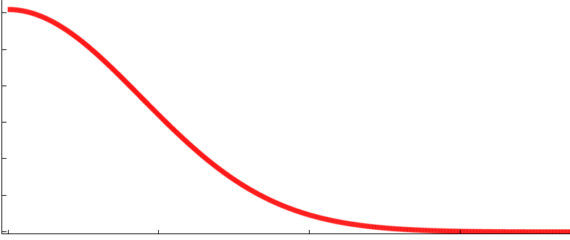
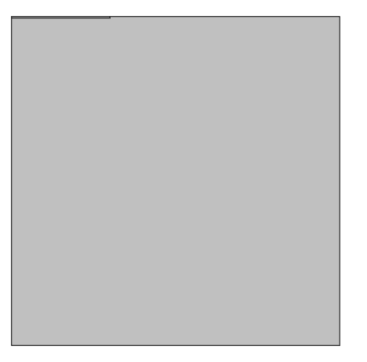
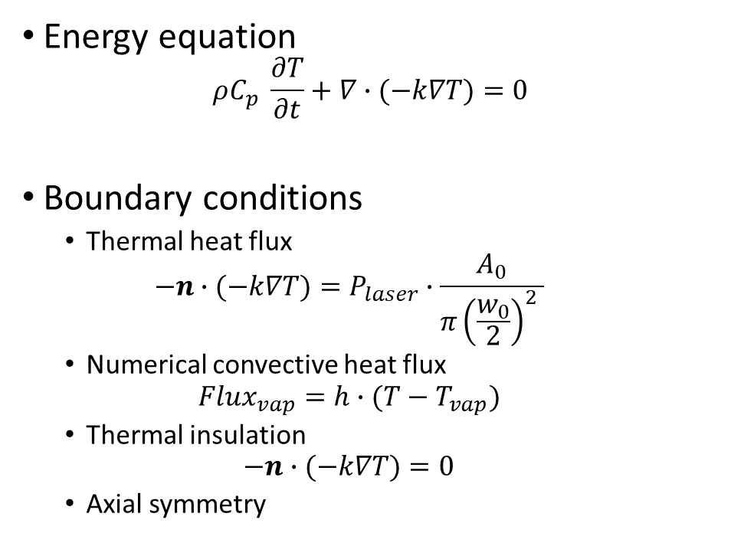
Thermal Modelling
Energy equation
$$ρC_{p} \frac{∂T}{∂t}+∇∙(−k∇T)=0$$
Boundary conditions
  Thermal heat flux
  $$−n∙(−k∇T)=P_{laser}∙\frac{A_{0}}{π{\left(\frac{w_{0}}{2}\right)}^{2} }$$
  Numerical convective heat flux
  $$Flux_{vap}=h∙(T−T_{vap})$$
  Thermal insulation
  $$−n∙(−k∇T)=0$$
  Axial symmetry
Gaussian heat flux (${10}^{12}W/m^{2}$)
1.2
0.8
0.4
0

Slide 23
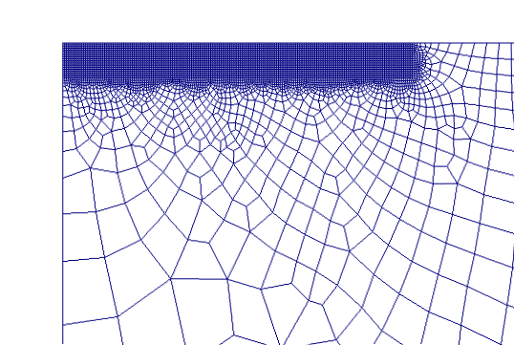

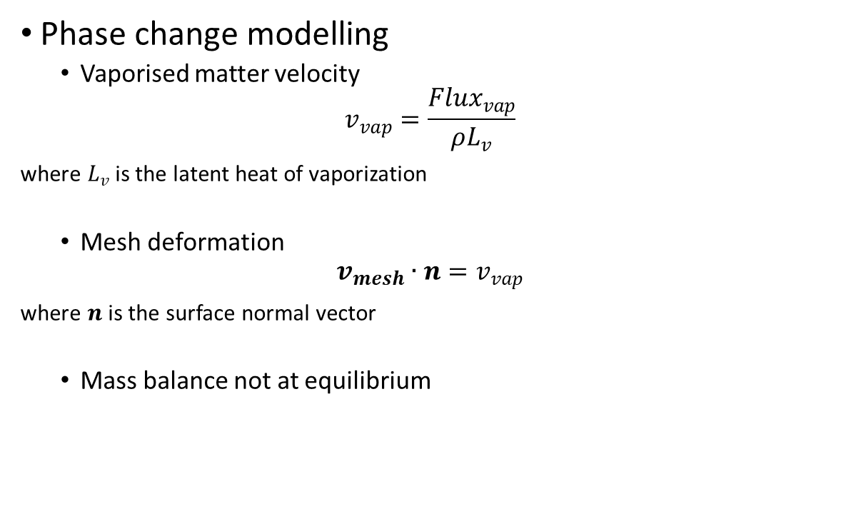
Thermal Modelling
Phase change modelling
  Vaporised matter velocity
$$v_{vap}=\frac{Flux_{vap}}{ρL_{v}}$$
where $L_{v}$ is the latent heat of vaporization
  Mesh deformation
$$v_{mesh}∙n=v_{vap}$$
where $n$ is the surface normal vector
  Mass balance not at equilibrium

Slide 24
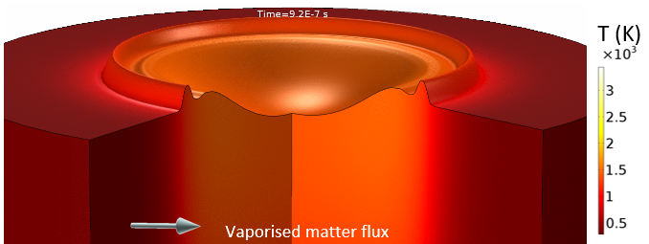

Laser material interaction modelling
Fluid modelling
  Navier-Stokes equations
$$\left\{\begin{aligned}∇∙ρu=0 \\ ρ(\frac{∂u}{∂t}+\left(u∙∇\right)u)=∇∙\left[−p\overset{̿}{I}+η\left(∇u+∇u^{T}\right)−\frac{2}{3}η\left(∇∙u\right)\overset{̿}{I}\right]+ρg\end{aligned}\right.$$
  Recoil pressure
  Surface tension and Marangoni effects
T (K)
Vaporised matter flux
Deformation x 20

