Slide 1
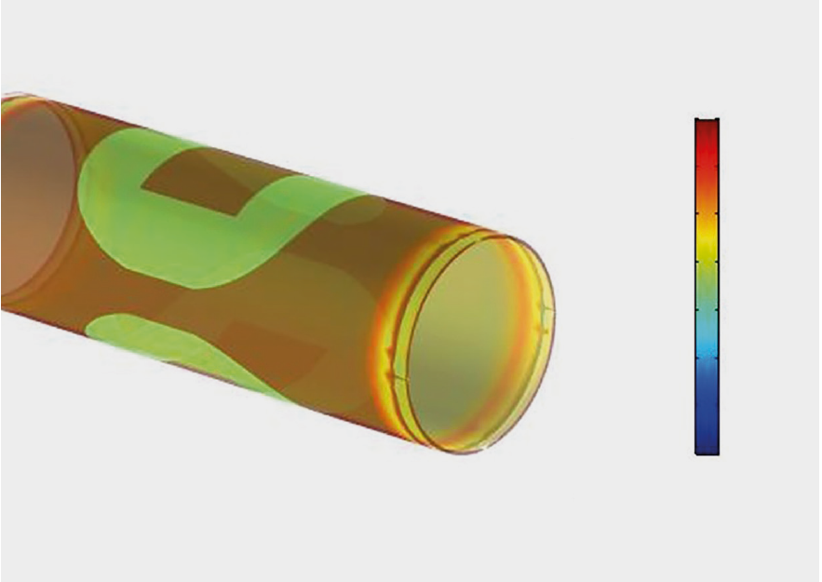
ABB
Predicting Flowmeter Performance with a
Digital Twin
ABB seeks to improve flowmeter designs to meet high performance standards and cost optimization demands
Multiphysics model of an electromagnetic flowmeter used to study:
  Electromagnetism
  Fluid dynamics
  Thermal propagation
  Structural dynamics
Digital twin based on multiphysics model enables ABB to predict flowmeter performance and improve the design of flowmeters
95% agreement between model results and field tests for calculated sensitivities
“ABB’s Electromagnetic Flowmeter Digital Twin Drives Performance”
COMSOL News 2019, Subhashish Dasgupta and Vinay Kariwala, ABB, India
Hydraulic stress field in an electromagnetic flowmeter

